Slide 1
Online Data Fusion
Xuan Liu, Xin Luna Dong, Beng Chin Ooi, Divesh Srivastava
School of Computing National University of Singapore | AT&T Shannon Research Labs

Slide 2
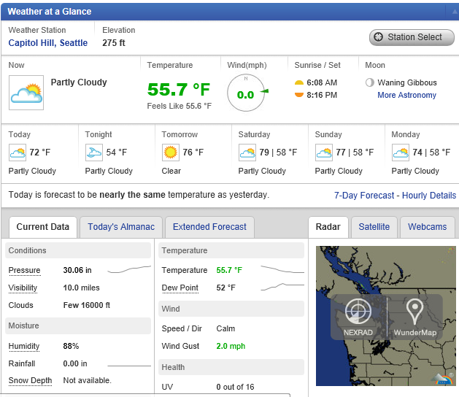
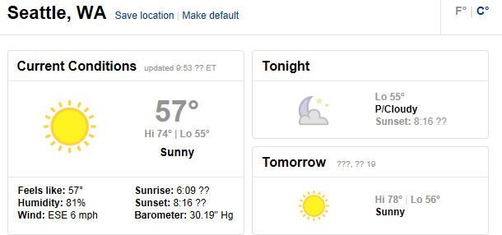
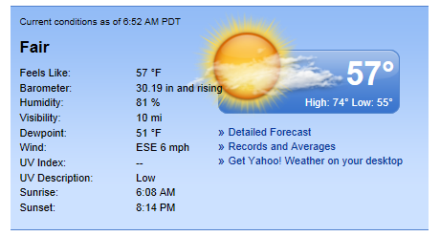
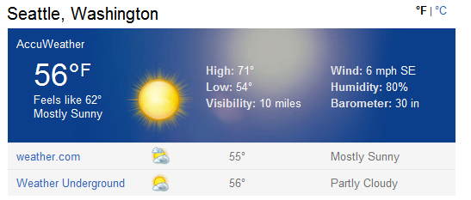
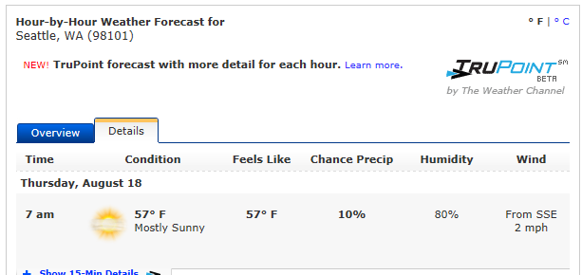
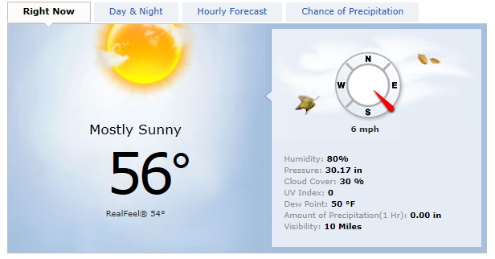
Conflicting Data on the Web
What’s the temperature and humidity of Seattle?

Slide 3
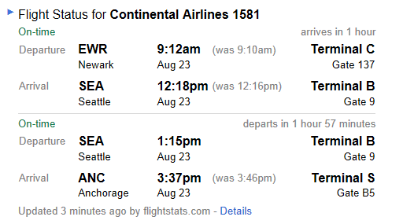
Solution 1: Choose from One Source
What’s the status of flight CO 1581?
Result of Google

Slide 4
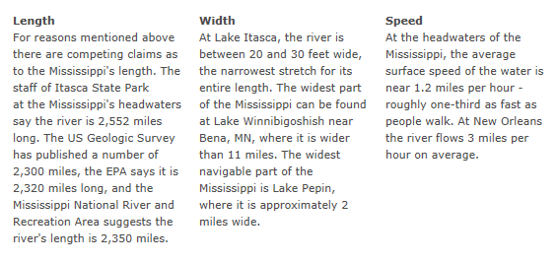
Solution 2: List All Values
What’s the length of Mississippi River?
Results on the National Park Service website

Slide 5
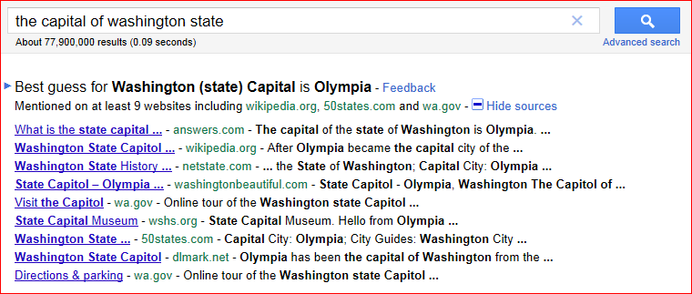
Solution 3: Best Guess on the True Value
What’s the capital of Washington state?
Google

Slide 6
Copying Between Sources
finance.boston.com
finance.bostonmerchant.com
financial.businessinsider.com
markets.chron.com
finance.abc7.com

Slide 7
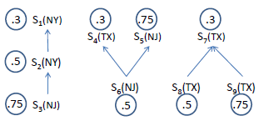
Data Fusion
Resolving conflicts
Where is AT&T Shannon Research Labs?
9 sources provide 3 different answers: NY, NJ, TX
Answer: NJ
Copying
Accuracy

Slide 8
Motivation
Problem: offline
Inappropriate for web-scale data and frequent updates
Long waiting time if applied online
Our proposal : Online Data Fusion
SOLARIS

Slide 9
Online Data Fusion

Slide 10
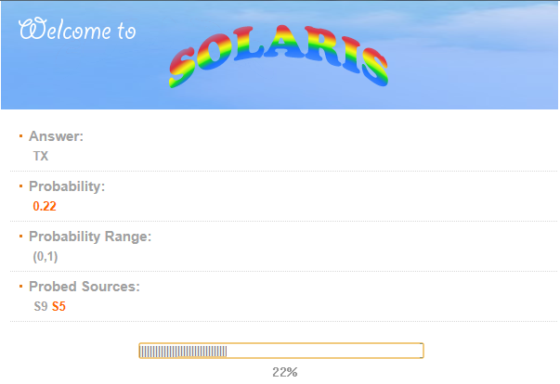
Online Data Fusion

Slide 11
Online Data Fusion

Slide 12
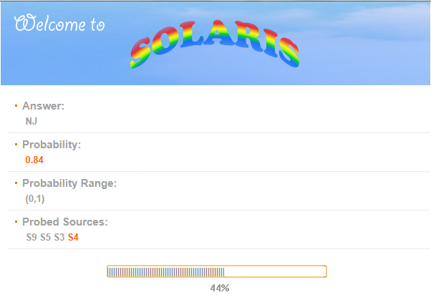
Online Data Fusion

Slide 13
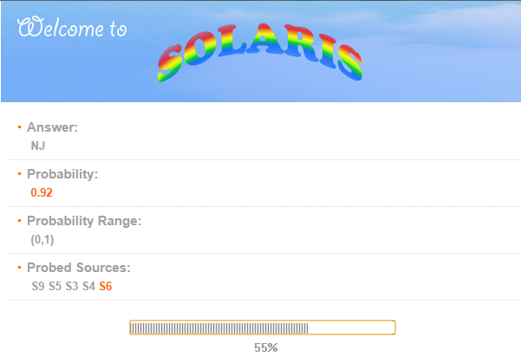
Online Data Fusion

Slide 14
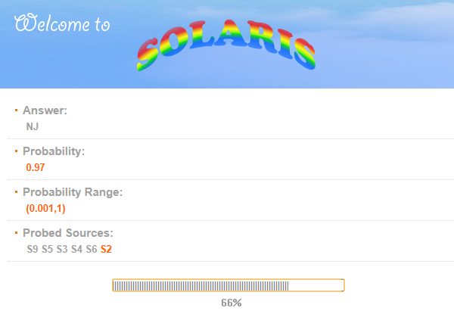
Online Data Fusion

Slide 15
Online Data Fusion

Slide 16
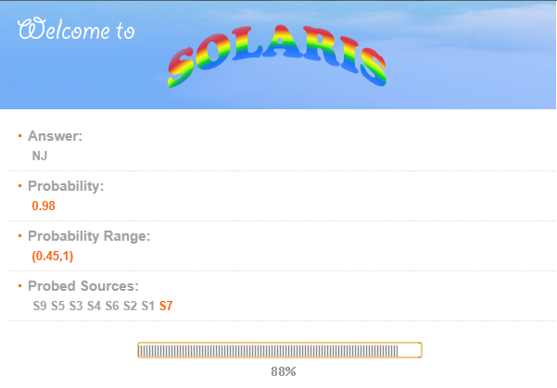
Online Data Fusion

Slide 17
Advantages of
SOLARIS
Return answers to users while probing sources, no waiting
Provide the likelihood of the correctness of the answers to the users
Terminate as early as possible once the system gains enough confidence

Slide 18
Framework
Offline
Fusion Queries
Online
Source ordering
Source probing
Probing order
Truth finding
Q1: Incremental vote counting
Q4: Ordering Sources
Probability computation
Q2: Compute probabilities
Result output
Q3: Termination justification
Terminated?
N
Y

Slide 19
Outline
Motivation & framework
Preliminaries of Online Data Fusion
Techniques
Experimental results
Conclusions

Slide 20
Problem Input
S
O₁
O₂
O₃
…
…
O_{n}
Notes:
Accuracy can be obtained by sampling

Slide 21
Problem Output

Slide 22
Preliminaries on Data Fusion
* Dong et al., VLDB 2009

Slide 23
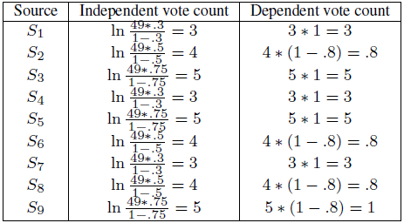
Example of Data Fusion
A
49
A copier may have independent vote count if it provides a different value from the copied source

Slide 24
Outline
Motivation & framework
Preliminaries of Online Data Fusion
Technology
Independent sources
Dependent sources
Experimental results
Conclusions

Slide 25
Probability Computation

Slide 26
Example of Independent Sources
Round | TX | NJ | NY | Result
1 | 5 | 0 | 0 | TX
2 | 5 | 5 | 0 | TX
3 | 5 | 10 | 0 | NJ
4 | 9 | 10 | 0 | NJ
5 | 9 | 10 | 4 | NJ
6 | 9 | 14 | 4 | NJ
7 | 12 | 14 | 4 | NJ
8 | 15 | 14 | 4 | TX
9 | 15 | 14 | 7 | TX
Round | TX | NJ | NY | Result
1 | 5 | 0 | 0 | TX
2 | 5 | 5 | 0 | TX
3 | 5 | 10 | 0 | NJ
4 | 9 | 10 | 0 | NJ
5 | 9 | 10 | 4 | NJ
6 | 9 | 14 | 4 | NJ
Round | TX | NJ | NY | Result
1 | 5 | 0 | 0 | TX
2 | 5 | 5 | 0 | TX
3 | 5 | 10 | 0 | NJ
4 | 9 | 10 | 0 | NJ
5 | 9 | 10 | 4 | NJ
6 | 9 | 14 | 4 | NJ
7 | 12 | 14 | 4 | NJ
8 | 15 | 14 | 4 | TX
Order
S₉
S₅
S₃
S₈
S₆
S₂
S₇
S₄
S₁
Round | TX | NJ | NY | Result
1 | 5 | 0 | 0 | TX
Round | TX | NJ | NY | Result
1 | 5 | 0 | 0 | TX
2 | 5 | 5 | 0 | TX
Round | TX | NJ | NY | Result
1 | 5 | 0 | 0 | TX
2 | 5 | 5 | 0 | TX
3 | 5 | 10 | 0 | NJ
Round | TX | NJ | NY | Result
1 | 5 | 0 | 0 | TX
2 | 5 | 5 | 0 | TX
3 | 5 | 10 | 0 | NJ
4 | 9 | 10 | 0 | NJ
Round | TX | NJ | NY | Result
1 | 5 | 0 | 0 | TX
2 | 5 | 5 | 0 | TX
3 | 5 | 10 | 0 | NJ
4 | 9 | 10 | 0 | NJ
5 | 9 | 10 | 4 | NJ
Round | TX | NJ | NY | Result
1 | 5 | 0 | 0 | TX
2 | 5 | 5 | 0 | TX
3 | 5 | 10 | 0 | NJ
4 | 9 | 10 | 0 | NJ
5 | 9 | 10 | 4 | NJ
6 | 9 | 14 | 4 | NJ
7 | 12 | 14 | 4 | NJ
Order Sources by accuracy
Terminate: minPr(v₁)>maxPr(v₂)
Terminate: minPr(v₁)>expPr(v₂)

Slide 27
Outline
Motivation & Framework
Preliminaries of Online Data Fusion
Technology
Independent sources
Dependent sources
Experimental results
Conclusions

Slide 28
Challenges and Solutions
Challenge: Independent vote count or dependent vote count?
When a copier is probed earlier than the copied source, we do not know whether they provide the same value
No-over-counting principle
For each value, among its providers that could have copying relationships on it, at any time we apply the independent vote count for at most one source

Slide 29
1. Incremental Vote Counting - Conservative
Before probing the copied source
Assumes the copier provides the same value as the copied source
Use dependent vote count
After probing the copied source
If observe a different value from the copier Dependent vote count -> Independent vote count for the copier
Features
Pro: monotonic increase of vote counts
Con: may under-counting

Slide 30
1. Incremental Vote Counting - Pragmatic
Before probing the copied source
Assumes the copier provides a different value from the copied source
Use independent vote count
After probing the copied source
If observe the same value as the copier Independent vote count -> Dependent vote count for the copier
Features
Pro: no under-counting or over-counting
Con: vote counts can decrease after seeing more sources

Slide 31
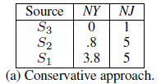
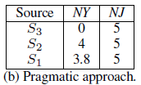
Example of Two Voting Methods
Assume probing order: S3, S2, S1
Ind: 3
Dep: 3
Ind: 4
Dep: .8
Ind: 5
Dep: 1

Slide 32
2. Probability Computation

Slide 33
3. Source Ordering
Worst case assumption
All sources are assumed to provide the same value
Pragmatic ordering
Iteratively choose the source that increases the total vote count most
Co-copier Condition: order the copied source before ordering both co-copiers

Slide 34
Example of Source Ordering
Condition vote count in each round of computing

Slide 35
Outline
Motivation & Framework
Preliminaries of Online Data Fusion
Technology
Experimental results
Conclusions

Slide 36
Experiment Settings
Dataset: Abebooks data
894 bookstores (data sources)
1263 books (objects)
24364 listings
1758 pair of copyings
Queries and measures
Query author by ISBN
Golden standard: the authors of 100 randomly selected books (manually checked from the book cover)
Measure precision by the percentage of correctly returned author lists

Slide 37
Comparison of Different Algorithms
Implementations
NAÏVE: probe all sources in a random order and repeatedly apply fusion from scratch on probed sources.
ACCU: use accuracy only.
CONSERVATIVE: use conservative ordering and vote counting
PRAGMATIC: use pragmatic ordering and vote counting

Slide 38
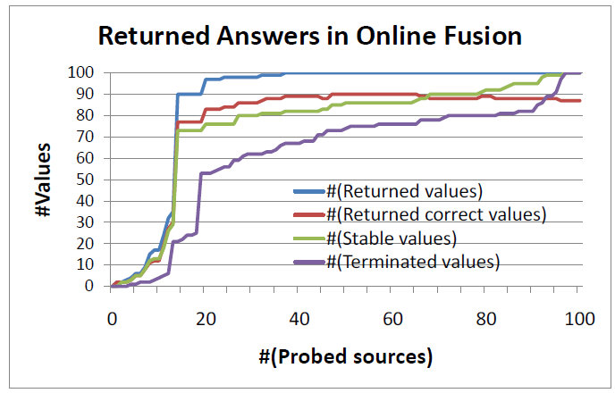
Output by Pragmatic
The number of terminated answers grows much slower
A large fraction of answers get stable quickly

Slide 39
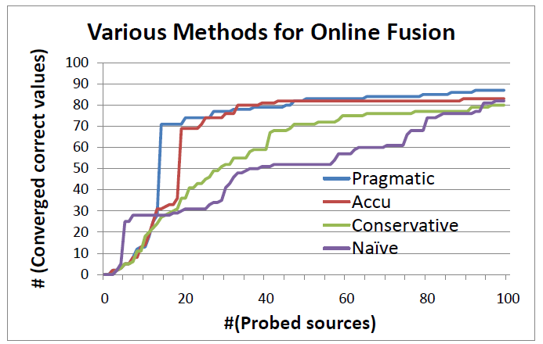
Stable Correct Values
Pragmatic performs best
Pragmatic provide more correct values than Accu
Naïve performs worst
Pragmatic dominates Conservative

Slide 40
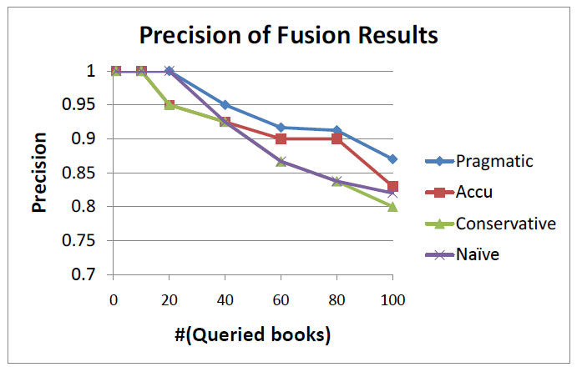
Precision of Different Methods
Pragmatic has the highest precision
Conservative may terminate with incorrect values early
Accu ignores copying

Slide 41
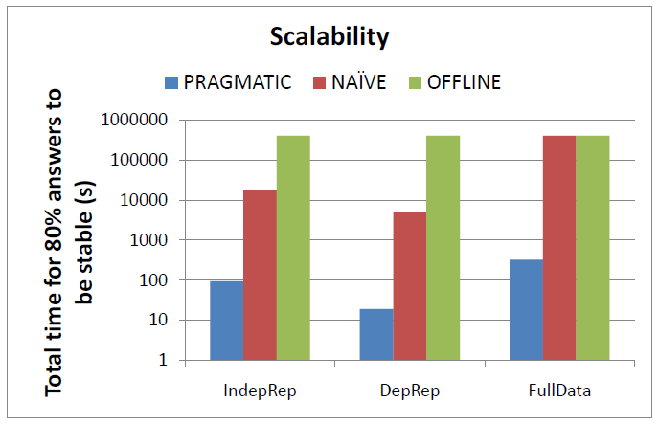
Scalability
Probing all sources before returning an
answer can take a long time
Vote counting from scratch in each iteration takes a long CPU time
Pragmatic is the fastest on each data set
Number of sources:
1000
1000
894

Slide 42
Related work
Online aggregation
[Hellerstein et al. 97]
Data fusion – resolving conflicts
[Blanco et al. 10] [Dong et al. 09] [Galland et al. 10] [Wu et al. 11] [Yin et al. 08]
Quality-aware query answering
[Mihaila et al. 00] [Naumann et al. 02] [Sarma et al. 11] [Suryanto et al. 09] [Yeganeh et al. 09]

Slide 43
Conclusions
SOLARIS
The first online data fusion system
Address challenges in building an online data fusion system
incremental vote counting
computing probabilities
termination justification
source ordering

Slide 44
Thanks!
Q & A

Slide 45
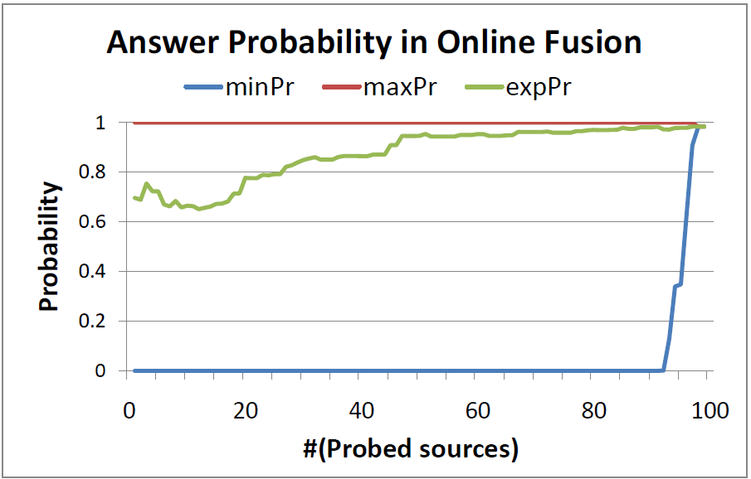
Observations of output probabilities by PRAGMATIC

Slide 46
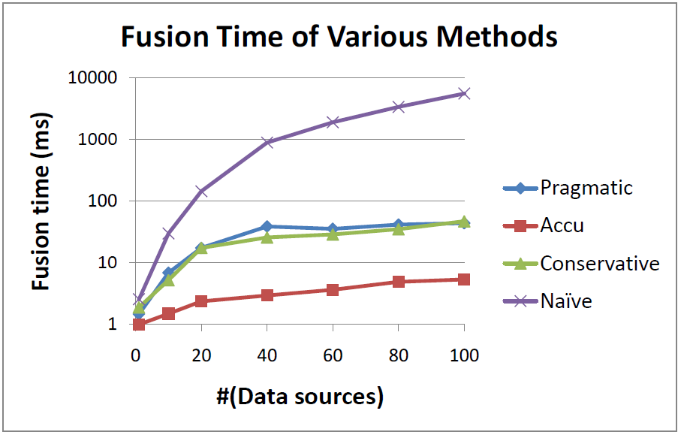
Fusion CPU time

Slide 47
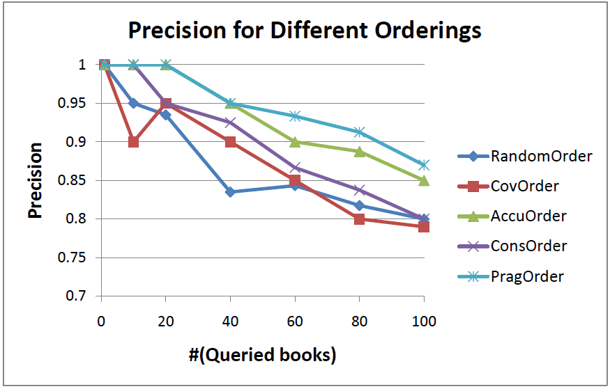
Comparison of different source ordering strategies -precision

Slide 48
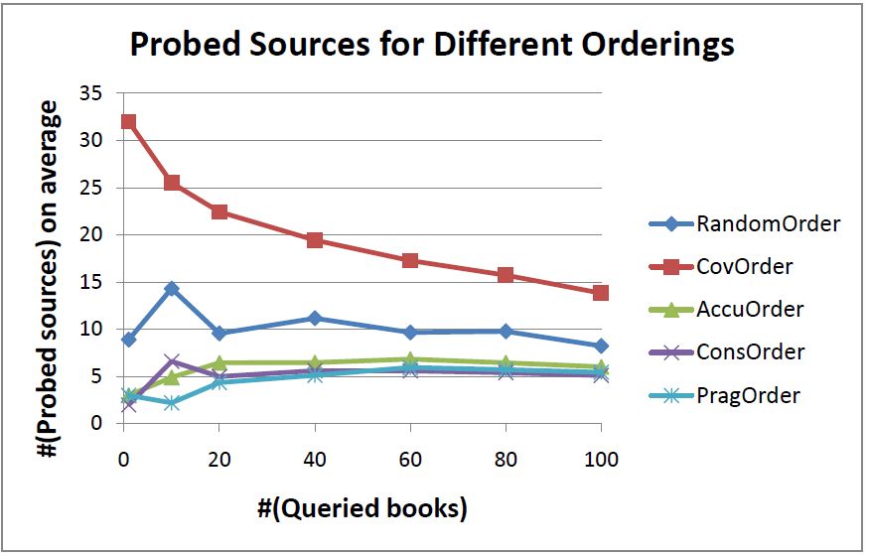
Comparison of different source ordering strategies - #probed sources

Slide 49
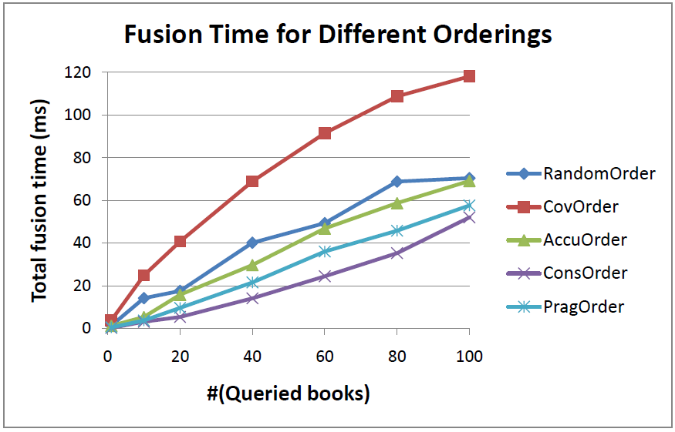
Comparison of different source ordering strategies – fusion time

Slide 50
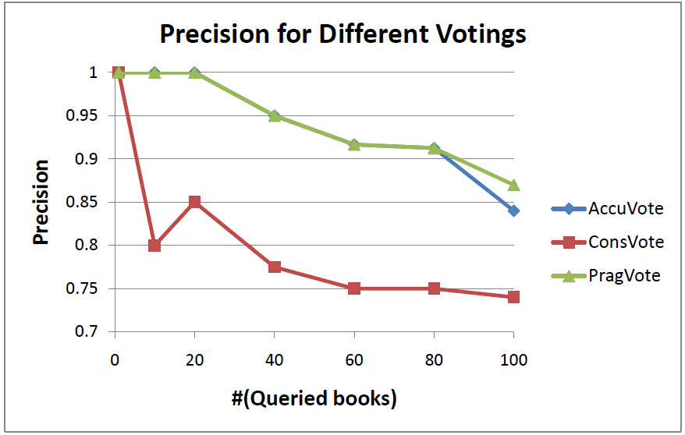
Comparison of different vote counting strategies -precision

Slide 51
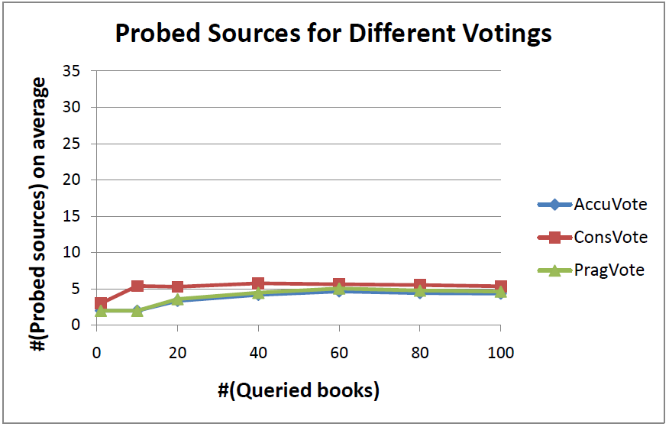
Comparison of different vote counting strategies - #probed sources

Slide 52
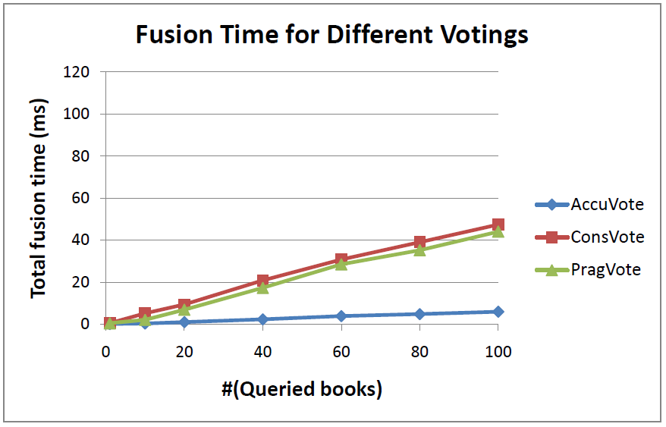
Comparison of different vote counting strategies – fusion time

Slide 53
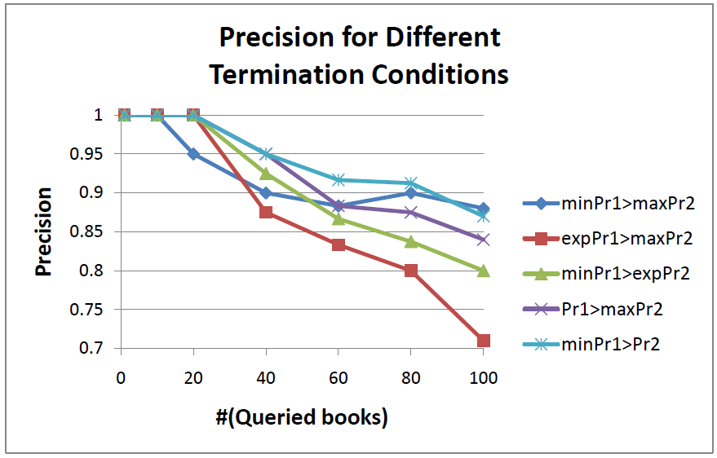
Comparison of different termination conditions - precision

Slide 54
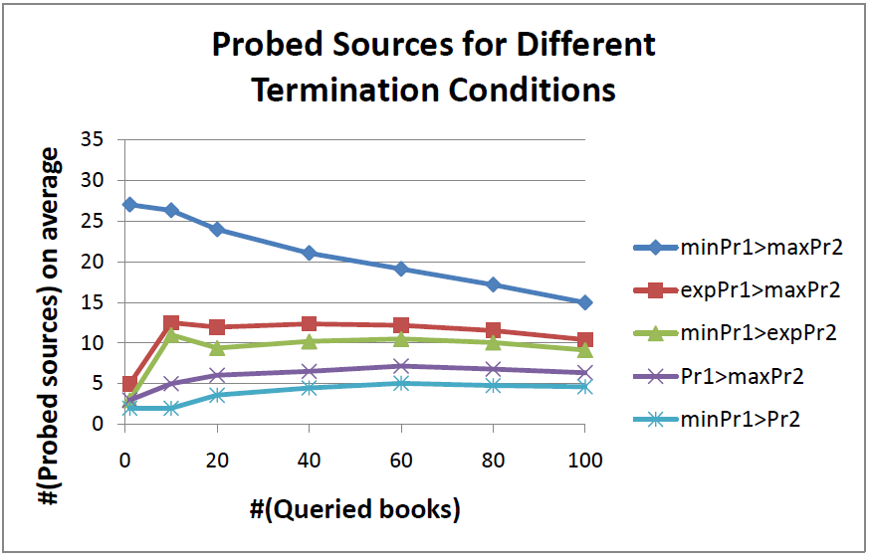
Comparison of different termination conditions - #probed sources

Slide 55
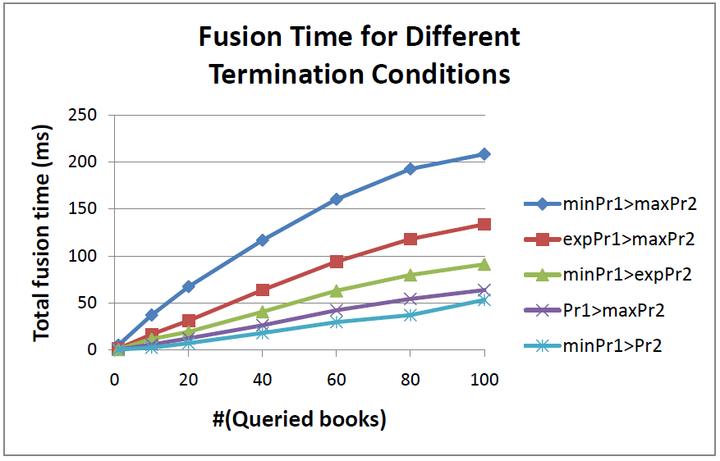
Comparison of different termination conditions – fusion time

Slide 56
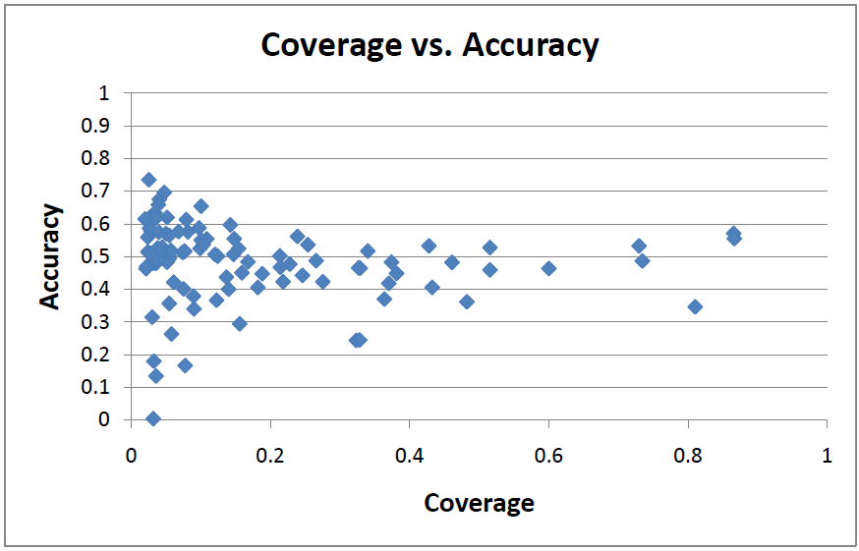
Coverage vs. accuracy

Slide 57
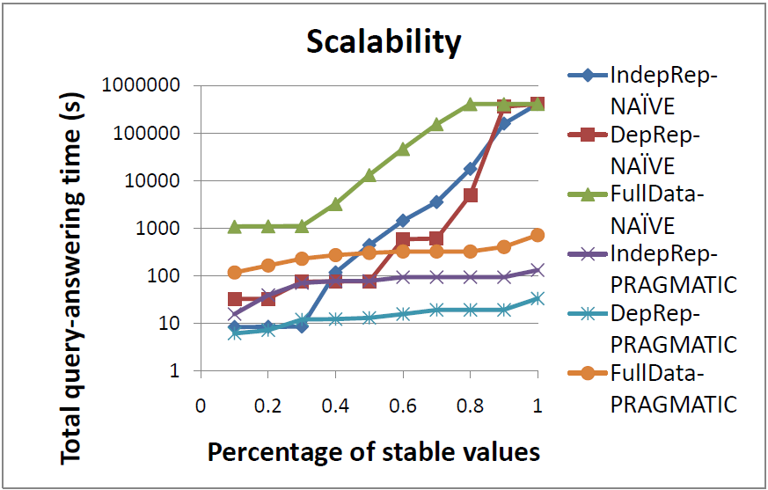
Query-answering time

Slide 58
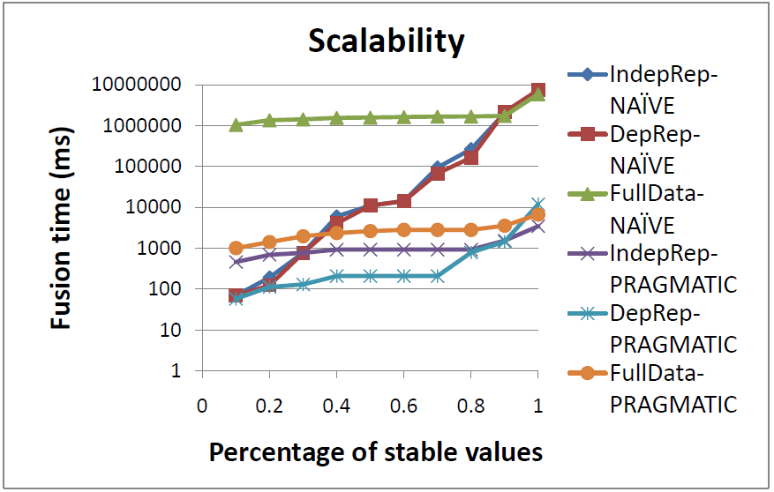
Fusion time

