Slide 1
Large-Scale Copy Detection
Xin Luna Dong
Divesh Srivastava

Slide 2
Outline
Motivation
Why does copy detection matter?
Examples of copying, not copying
Copy detection
In documents
In software
In databases
Summary

Slide 3
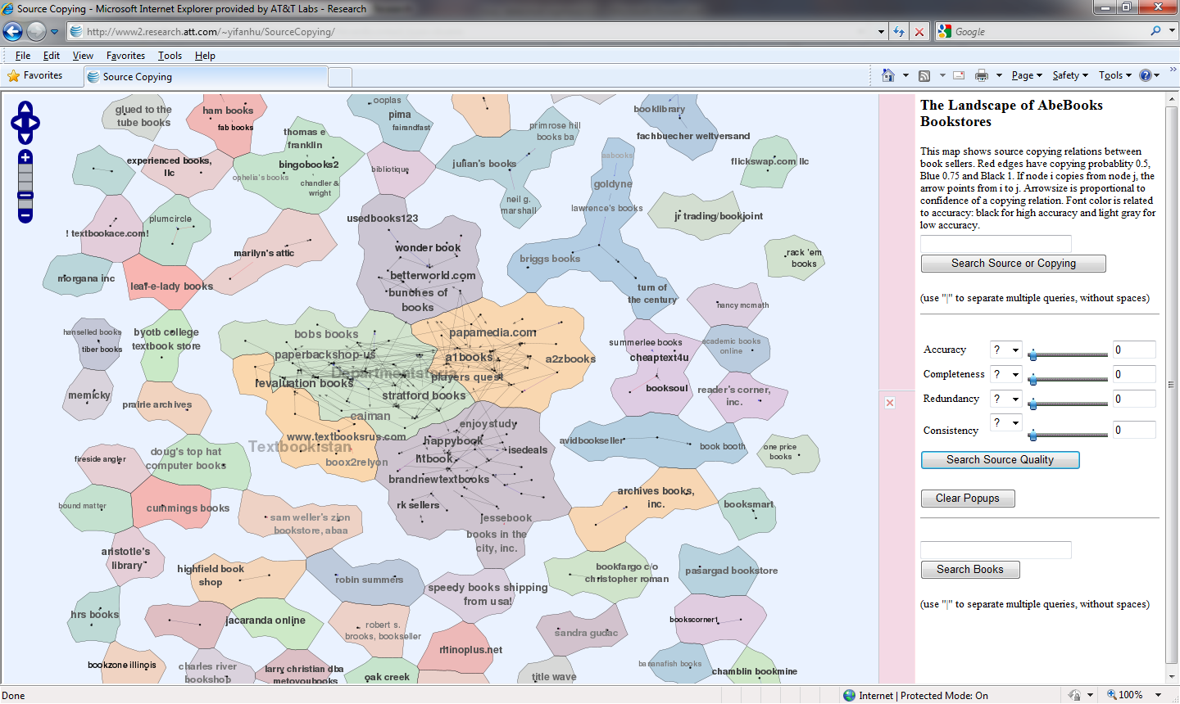
Why Does Copy Detection Matter?
Protecting rights of data providers

Slide 4
Why Does Copy Detection Matter?
Detecting plagiarism in reviews, ratings

Slide 5
Why Does Copy Detection Matter?
We ourselves use “copy-paste-modify” very frequently
Extensively used in the preparation of these slides ☺
Changes to a copy → consistently propagate to other copies
Copy from one, it's plagiarism. Copy from two, it's research.
paraphrasing playright Wilson Mizner
http://en.wikipedia.org/wiki/Wilson_Mizner
http://quotationsbook.com/quote/30426/
Focus of this tutorial: documents, software, databases
Exclude images, audio, video …

Slide 6
Plagiarism Detection in Tests
Plagiarized essays or portions of essays
Copy detection in documents
Plagiarized programming assignments
Copy detection in software
Plagiarized answers to factual questions
Copy detection in databases

Slide 7
Copying in Documents
President Bush said Thursday that his administration would not deal with Hamas, the militant group that scored a decisive victory in this week’s Palestinian elections, if it continues to pursue the destruction of Israel.
President Bush said on Thursday that his administration would not deal with Hamas, the militant group that scored a decisive victory in this week’s Palestinian elections, if it continues to pursue Israel’s destruction.

Slide 8
Copying in Documents
President Bush said Thursday that his administration would not deal with Hamas, the militant group that scored a decisive victory in this week’s Palestinian elections, if it continues to pursue the destruction of Israel. | ✓
President Bush said on Thursday that his administration would not deal with Hamas, the militant group that scored a decisive victory in this week’s Palestinian elections, if it continues to pursue Israel’s destruction.
Near-duplicate of original document
Minor edits to the original document
Comparison of document checksums is inadequate
At one end of the similarity spectrum

Slide 9
Copying in Documents
President Bush said Thursday that his administration would not deal with Hamas, the militant group that scored a decisive victory in this week’s Palestinian elections, if it continues to pursue the destruction of Israel.
The landslide victory by the militant group Hamas in this week’s Palestinian elections threatens President Bush’s quest for peace in the Middle East and underscores the perils of his push for democracy.

Slide 10
Copying in Documents
President Bush said Thursday that his administration would not deal with Hamas, the militant group that scored a decisive victory in this week’s Palestinian elections, if it continues to pursue the destruction of Israel. | X
The landslide victory by the militant group Hamas in this week’s Palestinian elections threatens President Bush’s quest for peace in the Middle East and underscores the perils of his push for democracy.
Topical similarity
Not a good answer for copy detection
Fine answer for IR style query
At other end of similarity spectrum

Slide 11
Copying in Documents
President Bush said Thursday that his administration would not deal with Hamas, the militant group that scored a decisive victory in this week’s Palestinian elections, if it continues to pursue the destruction of Israel.
President Bush said Thursday that his United States will not deal with Hamas until it renounces its aim to destroy Israel, and reflected on the meaning of Wednesday’s Palestinian elections.

Slide 12
Copying in Documents
President Bush said Thursday that his administration would not deal with Hamas, the militant group that scored a decisive victory in this week’s Palestinian elections, if it continues to pursue the destruction of Israel. | ?
President Bush said Thursday that his United States will not deal with Hamas until it renounces its aim to destroy Israel, and reflected on the meaning of Wednesday’s Palestinian elections.
Text reuse
Restatement of original document with reformulations, additions
Somewhere in the middle range of the similarity spectrum

Slide 13
Copying in Software
void sumProd(int n) { float sum = 0.0; float prod = 1.0; for (int i = 1; i <= n; i++) { sum = sum + i; prod = prod * i; } foo(sum, prod); } | void sP(int n) { float s = 0.0; float p = 1.0; for (int j = 1; j <= n; j++) { s = s + j; p = p *j; } foo(s, p); }

Slide 14
Copying in Software
void sumProd(int n) { float sum = 0.0; float prod = 1.0; for (int i = 1; i <= n; i++) { sum = sum + i; prod = prod * i; } foo(sum, prod); } | void sP(int n) { float s = 0.0; float p = 1.0; for (int j = 1; j <= n; j++) { s = s + j; p = p *j; } foo(s, p); } | ✓
Near-duplicate of original code
Renaming of variables and procedure names
At one end of the similarity spectrum

Slide 15
Copying in Software
void sumProd(int n) { float sum = 0.0; float prod = 1.0; for (int i = 1; i <= n; i++) { sum = sum + i; prod = prod * i; } foo(sum, prod); } | void sP(int n) { float s = n; float p = n; for (int j = n; j > 1; j--) { s = s + (j - 1); p = p * (j - 1); } foo(s, p); }

Slide 16
Copying in Software
void sumProd(int n) { float sum = 0.0; float prod = 1.0; for (int i = 1; i <= n; i++) { sum = sum + i; prod = prod * i; } foo(sum, prod); } | void sP(int n) { float s = n; float p = n; for (int j = n; j > 1; j--) { s = s + (j - 1); p = p * (j - 1); } foo(s, p); } | X
Has the same functionality as the original code
Quite different logic
At other end of the similarity spectrum

Slide 17
Copying in Software
void sumProd(int n) { float sum = 0.0; float prod = 1.0; for (int i = 1; i <= n; i++) { sum = sum + i; prod = prod * i; } foo(sum, prod); } | void sP(int n) { float s = 0.0; for (int j = 1; j <= n; j++) { if ((n + j) % 2 == 0) { s = s + j; } else { s = s * j; } } f(s, n); }

Slide 18
Copying in Software
void sumProd(int n) { float sum = 0.0; float prod = 1.0; for (int i = 1; i <= n; i++) { sum = sum + i; prod = prod * i; } foo(sum, prod); } | void sP(int n) { float s = 0.0; for (int j = 1; j <= n; j++) { if ((n + j) % 2 == 0) { s = s + j; } else { s = s * j; } } f(s, n); } | ?
Code reuse
Reuse of code fragments with reformulations, additions
Somewhere in the middle range of the similarity spectrum

Slide 19
Copying in Databases
1: George Washington | 1: George Washington
2: Benjamin Franklin | 2: Benjamin Franklin
3: Abraham Lincoln | 3: Abraham Lincoln
42: William Clinton | 42: William Clinton
43: Richard Cheney | 43: Richard Cheney
44: Barack Obama | 44: Barack Obama

Slide 20
Copying in Databases
1: George Washington | 1: George Washington | ✓
2: Benjamin Franklin | 2: Benjamin Franklin
3: Abraham Lincoln | 3: Abraham Lincoln
42: William Clinton | 42: William Clinton
43: Richard Cheney | 43: Richard Cheney
44: Barack Obama | 44: Barack Obama
Copying likely between S₁ and S₂

Slide 21
Copying in Databases
1: George Washington | 1: George Washington | ✓ | ✓
2: Benjamin Franklin | 2: Benjamin Franklin | X
3: Abraham Lincoln | 3: Abraham Lincoln | X
42: William Clinton | 42: William Clinton | ✓
43: Richard Cheney | 43: Richard Cheney | X
44: Barack Obama | 44: Barack Obama | ✓
Copying likely between S₁ and S₂ if they share many false values
Independent sources → low probability of sharing a false value

Slide 22
Copying in Databases
1: George Washington | 1: George Washington | ✓
2: Benjamin Franklin | 2: John Adams | X
3: Thomas Jefferson | 3: James Madison | X
42: William Clinton | 42: William Clinton | ✓
43: Richard Cheney | 43: Donald Rumsfeld | X
44: Barack Obama | 44: Barack Obama | ✓
Independent sources usually make different mistakes
Many possible false values, but only one true value

Slide 23
Copying in Databases
1: George Washington | 1: George Washington | ✓ | X
2: Benjamin Franklin | 2: John Adams | X
3: Thomas Jefferson | 3: James Madison | X
42: William Clinton | 42: William Clinton | ✓
43: Richard Cheney | 43: Donald Rumsfeld | X
44: Barack Obama | 44: Barack Obama | ✓
Independent sources usually make different mistakes
Many possible false values, but only one true value

Slide 24
Copying in Databases
1: George Washington | 1: george washington
2: John Adams | 2: john adams
3: Thomas Jefferson | 3: thomas jefferson
42: William Clinton | 42: william clinton
43: George W. Bush | 43: george w. bush
44: Barack Obama | 44: barack obama

Slide 25
Copying in Databases
1: George Washington | 1: george washington | ✓
2: John Adams | 2: john adams | ✓
3: Thomas Jefferson | 3: thomas jefferson | ✓
42: William Clinton | 42: william clinton | ✓
43: George W. Bush | 43: george w. bush | ✓
44: Barack Obama | 44: barack obama | ✓
Independent sources can provide shared true values
Databases have independent access to the real world

Slide 26
Copying in Databases
1: George Washington | 1: george washington | ✓ | ?
2: John Adams | 2: john adams | ✓
3: Thomas Jefferson | 3: thomas jefferson | ✓
42: William Clinton | 42: william clinton | ✓
43: George W. Bush | 43: george w. bush | ✓
44: Barack Obama | 44: barack obama | ✓
Independent sources can provide shared true values
Databases have independent access to the real world

Slide 27
Outline
Motivation
Why does copy detection matter?
Examples of copying, not copying
Copy detection
In documents
In software
In databases
Summary and future work

Slide 28
Document Copy Detection: Challenges
Independently created documents can share many words
Copy detection requires sharing of longer chunks of text
Copier can add, delete, modify portions of the document
Copy detection needs to be robust to small changes
Scalability is critical
Identify all pairs of copies in a large set of documents

Slide 29
Document Copy Detection: Solution 0
Use longest common subsequence (LCS)
Basis of UNIX diff
Advantages
Can identify shared long chunks, robust to small changes
Disadvantages
Time complexity = O(N₁*N₂) for documents of sizes N₁, N₂
Given a set of documents, need to compare every pair
Not robust to coarse-grained permutations

Slide 30
Using LCS
President Bush said Thursday that his administration would not deal with Hamas, the militant group that scored a decisive victory in this week’s Palestinian elections, if it continues to pursue the destruction of Israel. | ✓
President Bush said on Thursday that his administration would not deal with Hamas, the militant group that scored a decisive victory in this week’s Palestinian elections, if it continues to pursue Israel’s destruction.
Near-duplicate of original document
N₁ = 34, N₂ = 33, Length of LCS = 31

Slide 31
Using LCS
President Bush said Thursday that his administration would not deal with Hamas, the militant group that scored a decisive victory in this week’s Palestinian elections, if it continues to pursue the destruction of Israel. | X
The landslide victory by the militant group Hamas in this week’s Palestinian elections threatens President Bush’s quest for peace in the Middle East and underscores the perils of his push for democracy.
Topical similarity
Not a good answer for copy detection
N₁ = 34, N₂ = 32, Length of LCS = 10

Slide 32
Using LCS
President Bush said Thursday that his administration would not deal with Hamas, the militant group that scored a decisive victory in this week’s Palestinian elections, if it continues to pursue the destruction of Israel. | ?
President Bush said Thursday that his United States will not deal with Hamas until it renounces its aim to destroy Israel, and reflected on the meaning of Wednesday’s Palestinian elections.
Text reuse
A good answer for copy detection
N₁ = 34, N₂ = 32, Length of LCS = 13
Not robust to coarse-grained permutations

Slide 33
Document Copy Detection: Strategies
Goals:
Avoid comparison of all pairs of documents
Robust to coarse-grained additions, deletions, permutations
Solution strategies [M94, BDG95, BGM+97, SWA03, SC08]
Extract tokens, fingerprint token sequences, build small sketch
Use inverted indexes on fingerprints to find candidate matches
Advantages
Scalable, space-efficient, robust solutions

Slide 34
Using Q-grams [M94]
First space-efficient solution for document copy detection
Solution strategy:
Fingerprint each sequence of Q consecutive tokens (Q-gram)
Build sketch with Q-grams whose fingerprints are 0 mod K
Advantages
Space used is, in expectation, 1/K of size of original document
Robust to coarse-grained additions, deletions, permutations
Robust to shared individual tokens (e.g., “Bush”) in documents

Slide 35
Using Q-grams [M94]
President Bush said Thursday that his administration would not deal with Hamas, the militant group that scored a decisive victory in this week’s Palestinian elections, if it continues to pursue the destruction of Israel. | ✓
President Bush said on Thursday that his administration would not deal with Hamas, the militant group that scored a decisive victory in this week’s Palestinian elections, if it continues to pursue Israel’s destruction.
Near-duplicate of original document
Q = 2, K = 7, select each Q-gram whose fingerprint is 0 mod K
Candidate matching pair has many fingerprints in common
Not all fingerprints need to match

Slide 36
Using Q-grams [M94]
President Bush said Thursday that his administration would not deal with Hamas, the militant group that scored a decisive victory in this week’s Palestinian elections, if it continues to pursue the destruction of Israel. | X
The landslide victory by the militant group Hamas in this week’s Palestinian elections threatens President Bush’s quest for peace in the Middle East and underscores the perils of his push for democracy.
Topical similarity
Not a good answer for copy detection
Q = 2, K = 7, select each Q-gram whose fingerprint is 0 mod K
If no fingerprints match, pair is not even generated as a candidate

Slide 37
Using COPS [BDG95]
Early space-efficient solution for document copy detection
Solution strategy:
Hash tokens to define document break points (e.g., 0 mod K)
Fingerprint token sequence between consecutive break points
Advantages
Space used is, in expectation, 1/K of size of original document
Robust to coarse-grained additions, deletions, permutations
Robust to shared small token sequences in documents

Slide 38
Using COPS [BDG95]
President Bush said Thursday that his administration would not deal with Hamas, the militant group that scored a decisive victory in this week’s Palestinian elections, if it continues to pursue the destruction of Israel. | ✓
President Bush said on Thursday that his administration would not deal with Hamas, the militant group that scored a decisive victory in this week’s Palestinian elections, if it continues to pursue Israel’s destruction.
Near-duplicate of original document
K = 5, each document has 6 fingerprints

Slide 39
Using COPS [BDG95]
President Bush said Thursday that his administration would not deal with Hamas, the militant group that scored a decisive victory in this week’s Palestinian elections, if it continues to pursue the destruction of Israel. | ✓
President Bush said on Thursday that his administration would not deal with Hamas, the militant group that scored a decisive victory in this week’s Palestinian elections, if it continues to pursue Israel’s destruction.
Near-duplicate of original document
K = 5, each document has 6 fingerprints
Candidate matching pair has many fingerprints in common
Not all fingerprints need to match

Slide 40
Using COPS [BDG95]
President Bush said Thursday that his administration would not deal with Hamas, the militant group that scored a decisive victory in this week’s Palestinian elections, if it continues to pursue the destruction of Israel. | X
The landslide victory by the militant group Hamas in this week’s Palestinian elections threatens President Bush’s quest for peace in the Middle East and underscores the perils of his push for democracy.
Topical similarity
Not a good answer for copy detection
K = 5, each document has 6 fingerprints
If no fingerprints match, pair is not even generated as a candidate

Slide 41
Limitations of [M94, BDG95, BGM+97]
No worst-case guarantees for near-duplicate detection
Low probability of no matching fingerprints in near-duplicates
Easy to miss (partial) text reuse
Unbounded length gaps possible between chosen fingerprints

Slide 42
Limitations of Using Q-grams [M94]
President Bush said Thursday that his administration would not deal with Hamas, the militant group that scored a decisive victory in this week’s Palestinian elections, if it continues to pursue the destruction of Israel. | ?
President Bush said Thursday that his United States will not deal with Hamas until it renounces its aim to destroy Israel, and reflected on the meaning of Wednesday’s Palestinian elections.
Text reuse
Restatement of original document with reformulations, additions
Text reuse not detected despite sharing many Q-grams
Unbounded length gaps possible between chosen Q-grams

Slide 43
Limitations of Using COPS [BDG95]
President Bush said Thursday that his administration would not deal with Hamas, the militant group that scored a decisive victory in this week’s Palestinian elections, if it continues to pursue the destruction of Israel. | ?
President Bush said Thursday that his United States will not deal with Hamas until it renounces its aim to destroy Israel, and reflected on the meaning of Wednesday’s Palestinian elections.
Text reuse
Restatement of original document with reformulations, additions
Text reuse not detected despite sharing long token sequences
Unbounded length gaps possible between break points

Slide 44
Using Winnowing [SWA03]
Guaranteed to detect near-duplicates and text reuse
Solution strategy:
Fingerprint each sequence of Q consecutive tokens (Q-gram)
Sketch has Q-gram with smallest fingerprint in each K-window
Tie-breaking strategies to use small space
Advantages
Space used is approximately 1/K of size of original document
Guaranteed to find text reuse with length ≥ K + Q - 1

Slide 45
Using Winnowing [SWA03]
President Bush said Thursday that his administration would not deal with Hamas, the militant group that scored a decisive victory in this week’s Palestinian elections, if it continues to pursue the destruction of Israel. | ?
President Bush said Thursday that his United States will not deal with Hamas until it renounces its aim to destroy Israel, and reflected on the meaning of Wednesday’s Palestinian elections.
Text reuse
Restatement of original document with reformulations, additions
K = 5, Q = 2, guaranteed to find text reuse with length ≥ 6
Unbounded length gaps not possible between chosen Q-grams

Slide 46
Scalable Solution for All Pairs Matching
Goal: avoid comparison of all pairs of documents
Make use of inverted indexes on fingerprints
Generate R(F, S₁, S₂) of document pairs S₁, S₂ from list F
Select S₁, S₂, count(*) From R Group by S₁, S₂
Identify document pairs with high counts
Expectation: each fingerprint index list is quite small
Advantage
Scalable solution, many optimizations possible

Slide 47
Outline
Motivation
Why does copy detection matter?
Examples of copying, not copying
Copy detection
In documents
In software
In databases
Summary and future work

Slide 48
Software Copy Detection: Challenges
Software code has a considerable amount of semantics
Code structure, control dependences, data dependences
Code copying is common during software development
Modifications affect tokens, structure and dependences
Copy detection is critical for software maintenance
Errors in one copy may be replicated in other copies
Modifications to original code may need to be propagated

Slide 49
Software Copy Detection: Strategies
Text-based strategies [SWA03]
Language independent, can capture shallow semantics
Tree-based strategies [JMS+07]
Use abstract syntax trees, often in combination with metrics
Graph-based strategies [K01]
Use program dependence graphs, can capture deep semantics

Slide 50
Text-based Strategies
Winnowing used in MOSS to detect software plagiarism
Solution strategy [SWA03]:
Replace all parameters with a single constant, increase Q by 1
Use document-based winnowing to find code clones
Advantages
Scalable: space- and time-efficient
Easy to deploy: language independent

Slide 51
Using Winnowing [SWA03]
void sumProd(int n) { float sum = 0.0; float prod = 1.0; for (int i = 1; i <= n; i++) { sum = sum + i; prod = prod * i; } foo(sum, prod); } | void sP(int n) { float s = 0.0; float p = 1.0; for (int j = 1; j <= n; j++) { s = s + j; p = p *j; } foo(s, p); }
Near-duplicate of original code
Renaming of variables and procedure names

Slide 52
Using Winnowing [SWA03]
void $(int $) { float $ = 0.0; float $ = 1.0; for (int $ = 1; $ <= $; $++) { $ = $ + $; $ = $ * $; } $($, $); } | void $(int $) { float $ = 0.0; float $ = 1.0; for (int $ = 1; $ <= $; $++) { $ = $ + $; $ = $ * $; } $($, $); } | ✓
Near-duplicate of original code
Renaming of variables and procedure names
Replace all parameters with a single constant $
Easy to identify near-duplicate

Slide 53
Using Winnowing [SWA03]
void sumProd(int n) { float sum = 0.0; float prod = 1.0; for (int i = 1; i <= n; i++) { sum = sum + i; prod = prod * i; } foo(sum, prod); } | void sP(int n) { float s = 0.0; for (int j = 1; j <= n; j++) { if ((n + j) % 2 == 0) { s = s + j; } else { s = s * j; } } f(s, n); }
Code reuse
Reuse of code fragments with reformulations, additions
Replace all parameters with a single constant $

Slide 54
Using Winnowing [SWA03]
void $(int $) { float $ = 0.0; float $ = 1.0; for (int $ = 1; $ <= $; $++) { $ = $ + $; $ = $ * $; } $($, $); } | void $(int $) { float $ = 0.0; for (int $ = 1; $ <= $; $++) { if (($ + $) % 2 == 0) { $ = $ + $; } else { $ = $ * $; } } $($, $); } | ✓
Code reuse
Reuse of code fragments with reformulations, additions
Replace all parameters with a single constant $
False positives reduced (not eliminated) by having a larger Q

Slide 55
Tree-based Strategies
Goal: be robust against code modification, scalable to MLOC
Text-based strategies have false positives, false negatives
Abstract syntax trees capture static structure of program
Can use tree edit distance to find code clones [BYM+98]
Issue: not scalable, especially given a large set of programs
Deckard’s [JMS+07] solution strategy:
Characterize abstract syntax trees as numerical vectors
Cluster vectors using numerical distance to find code clones

Slide 56
Abstract Syntax Tree
for_s
for
(
decl
;
cond_e
;
incr_e
)
expr_s
int
id
=
prim_e
prim_e
<=
prim_e
prim_e
++
assign_e
;
lit
id
id
id
id
=
prim_e
+
Code fragment
for (int i = 1; i <= n; i++) sum = sum + i;
prim_e
prim_e
id
id

Slide 57
Characteristic Vector
<7, 1, 1, 1, 1, 7, 1, 1, 1>
for_s
for
(
decl
;
cond_e
;
incr_e
)
expr_s
int
id
=
prim_e
prim_e
<=
prim_e
prim_e
++
assign_e
;
lit
id
id
id
id
=
prim_e
+
Code fragment
for (int i = 1; i <= n; i++) sum = sum + i;
Vector: <id, lit, assign_e, cond_e, incr_e, prim_e, decl, expr_s, for_s>
prim_e
prim_e
id
id

Slide 58
Using Deckard [JMS+07]
Goal: be robust against code modification, scalable to MLOC
Build characteristic vectors for the abstract syntax tree
Subtree vectors for subtree nodes
Forest vectors for subtree sequences (code fragment reuse)
Cluster vectors using Hamming or Euclidean distances
Relationships between tree edit distance and vector distances
Efficiently cluster vectors using Locality Sensitive Hashing

Slide 59
Graph-based Strategies
Goal: be robust against code modification, scalable to MLOC
Reduce tradeoff between false positives and false negatives
Program dependence graphs capture deep semantics
Can use subgraph isomorphism to find code clones
Issue: not scalable, especially given a large set of programs
Krinke’s [K01] solution strategy:
Augment ASTs with fine-grained control, data dependences
Use subgraph similarity based on sets of paths for scalability

Slide 60
AST + Control, Data Dependences
for_s
for
(
decl
;
cond_e
;
incr_e
)
expr_s
int
id
=
prim_e
prim_e
<=
prim_e
prim_e
++
assign_e
;
lit
id
id
id
id
=
prim_e
+
Code fragment
for (int i = 1; i <= n; i++) sum = sum + i;
Added dependence edges reduce false positives, false negatives
prim_e
prim_e
id
id

Slide 61
Subgraph Similarity [K01]
D
E
F
13
D
C
1
A
2
B
10
A
11
A
5
B
E
B
14
A
3
A
B
E
12
B
15
8
4
6
C
C
B
16
7
17
Heuristic subgraph similarity
For every path from v₀ in G, the same path is in G’ from v₀’
{1, 2, 3, 4, 5, 6, 7} is similar to {10, 11, 12, 13, 14, 15, 16, 17}
Quite efficient, though not very scalable

Slide 62
Scalable Solution for All Pairs Matching
Goal: avoid comparison of all pairs of programs
Text-based strategies
Use scalable solution for all pairs matching for documents
Tree-based strategies
Cluster characteristic vectors of subtrees, forests of ASTs
Graph-based strategies
Use subgraph similarity based on sets of paths

Slide 63
Outline
Motivation
Why does copy detection matter?
Examples of copying, not copying
Copy detection
In documents
In software
In databases
Summary and future work

Slide 64
Database Copy Detection: Challenges
Shared values possible for accurate, independent sources
Textual similarity is insufficient evidence for copy detection
Copier can copy only a small subset of data items
Similar to text reuse or code clones
Copying relationships can be complex
Copying direction, co-copying, transitive copying

Slide 65
Using Solomon [DBS09, DBS10]
First solution for database copy detection
Solution strategy:
Build Bayesian model to compute copy probability, direction
Use value accuracy and format, coverage of data items
Advantages
Uses data semantics for copy detection
Robust to additions, deletions, modifications by copier
Linear cost in the number of data items

Slide 66
Bayesian Analysis: Copying or Not?
Pr | Independence Pr(Ф|S₁⊥S₂) |  | Copying Pr(Ф|S₁∼S₂)
O_{st} | α(S)² |  | α(S)*c + α(S)² *(1 - c)
O_{sf} | n((1 - α(S))/n)²=(1 - α(S))²/n |  | (1 - α(S))*c + (1 - α(S))²/n*(1 - c)
O_{d} | P_{d} = 1 - α(S)² - (1 - α(S))²/n |  | P_{d} *(1 - c)
Goal: Compute Pr(S₁ ⊥S₂|Ф), Pr(S₁ ∼S₂|Ф), for observation Ф
From Bayes rule, we need to know Pr(Ф|S₁ ⊥S₂), Pr(Ф|S₁ ∼S₂)
O_{st}: objs w. shared true value, O_{sf}: objs w. shared false value O_{d} : objs w. different values
α(S) = source accuracy, n = number of false values, c = copy rate

Slide 67
Bayesian Analysis: Copying or Not?
Pr | Independence Pr(Ф|S₁⊥S₂) |  | Copying Pr(Ф|S₁∼S₂)
O_{st} | α(S)² | < | α(S)*c + α(S)² *(1 - c)
O_{sf} | n((1 - α(S))/n)²=(1 - α(S))²/n | < | (1 - α(S))*c + (1 - α(S))²/n*(1 - c)
O_{d} | P_{d} = 1 - α(S)² - (1 - α(S))²/n | > | P_{d} *(1 - c)
Goal: Compute Pr(S₁ ⊥S₂|Ф), Pr(S₁ ∼S₂|Ф), for observation Ф
From Bayes rule, we need to know Pr(Ф|S₁ ⊥S₂), Pr(Ф|S₁ ∼S₂)
O_{st}: objs w. shared true value, O_{sf}: objs w. shared false value O_{d} : objs w. different values
α(S) = source accuracy, n = number of false values, c = copy rate

Slide 68
Using Solomon [DBS09]
1: George Washington | 1: George Washington | ✓ | ✓
2: Benjamin Franklin | 2: Benjamin Franklin | X
3: Abraham Lincoln | 3: Abraham Lincoln | X
42: William Clinton | 42: William Clinton | ✓
43: Richard Cheney | 43: Richard Cheney | X
44: Barack Obama | 44: Barack Obama | ✓
Intuition 1: copying without direction
For shared data, Pr(Ф|S₁ ⊥ S₂) is low (especially for false values)

Slide 69
Using Solomon [DBS09]
1: George Washington | 1: George Washington | ✓ | X
2: Benjamin Franklin | 2: John Adams | X
3: Thomas Jefferson | 3: James Madison | X
42: William Clinton | 42: William Clinton | ✓
43: Richard Cheney | 43: Donald Rumsfeld | X
44: Barack Obama | 44: Barack Obama | ✓
Intuition 1: copying without direction
For different data values, Pr(Ф|S₁ ⊥ S₂) is high

Slide 70
Using Solomon [DBS10]
1: George Washington | 1: george washington | ✓ | ?
2: John Adams | 2: john adams | ✓
3: Thomas Jefferson | 3: thomas jefferson | ✓
42: William Clinton | 42: william clinton | ✓
43: George W. Bush | 43: george w. bush | ✓
44: Barack Obama | 44: barack obama | ✓
Intuition 1: copying without direction
For shared true values in different formats, Pr(Ф|S₁ ⊥ S₂) is high
Key: prob. of true value α(S) > prob. of false value (1 - α(S))/n
Key: prob. of different formats > prob. of same formats

Slide 71
Using Solomon [DBS10]
1: | 1: |  | ✓
2: Benjamin Franklin | 2: James Madison | X
3: Abraham Lincoln | 3: John Adams | X
42: William Clinton | 42: William Clinton | ✓
43: | 43:
44: Barack Obama | 44: Barack Obama | ✓
Intuition 1: copying without direction
For shared missing, popular data, Pr(Ф|S₁ ⊥ S₂) is low

Slide 72
Using Solomon [DBS10]
1: George Washington | 1: George Washington | ✓ | ?
2: | 2:
3: | 3:
42: William Clinton | 42: William Clinton | ✓
43: Richard Cheney | 43: Donald Rumsfeld | X
44: Barack Obama | 44: Barack Obama | ✓
Intuition 1: copying without direction
For shared missing, unpopular data, Pr(Ф|S₁ ⊥ S₂) is not as low

Slide 73
Bayesian Analysis: Copying Direction
Pr | S₁ copies from S₂ Pr(Ф|S₁→S₂) |  | S₂ copies from S₁ Pr(Ф|S₂→S₁)
O_{st} | α(S₂)*c + α(S₁)*α(S₂)*(1 - c) | ≠ | α(S₁)*c + α(S₁)*α(S₂)*(1 - c)
O_{sf} | (1 - α(S₁))*(1 - α(S₂))/n*(1 - c) + (1 - α(S₂))*c | ≠ | (1 - α(S₁))*(1 - α(S₂))/n*(1 - c) + (1 - α(S₁))*c
O_{d} | P_{d} *(1 - c) | = | P_{d} *(1 - c)
Goal: Compute Pr(S₁→S₂|Ф), Pr(S₂→S₁|Ф), for observation Ф
From Bayes rule, we need to know Pr(Ф|S₁→S₂), Pr(Ф|S₂→S₁)
O_{st}: objs w. shared true value, O_{sf}: objs w. shared false value O_{d} : objs w. different values
α(S) = source accuracy of S, n = number of false values, c = copy rate

Slide 74
Using Solomon [DBS09]
1: John Kennedy | 1: George Washington | ✓
2: Benjamin Franklin | 2: Benjamin Franklin | X
3: Abraham Lincoln | 3: Abraham Lincoln | X
42: Hillary Clinton | 42: William Clinton | ✓
43: Richard Cheney | 43: Richard Cheney | X
44: John McCain | 44: Barack Obama | ✓
Intuition 2: copying with direction
S₂ is likely to copy from S₁ if the properties of the shared data are more like the properties of S₁ than the properties of S₂

Slide 75
Using Solomon [DBS09]
1: John Kennedy | 1: George Washington | ✓ | S₂
2: Benjamin Franklin | 2: Benjamin Franklin | X
3: Abraham Lincoln | 3: Abraham Lincoln | X
42: Hillary Clinton | 42: William Clinton | ✓
43: Richard Cheney | 43: Richard Cheney | X
44: John McCain | 44: Barack Obama | ✓
Intuition 2: copying with direction
S₂ is likely to copy from S₁ if the properties of the shared data are more like the properties of S₁ than the properties of S₂

Slide 76
Using Solomon [DBS10]
1: G. Washington | 1: G. Washington | ✓
2: B. Franklin | 2: james madison | X
3: J. Adams | 3: john adams | X
42: H. Clinton | 42: H. Clinton | X
43: R. Cheney | 43: donald rumsfeld | X
44: B. Obama | 44: B. Obama | ✓
Intuition 2: copying with direction
Using differences in format
S₂ is likely to copy from S₁ if the properties of the shared data are more like the properties of S₁ than the properties of S₂

Slide 77
Using Solomon [DBS10]
1: G. Washington | 1: G. Washington | ✓ | S₂
2: B. Franklin | 2: james madison | X
3: J. Adams | 3: john adams | X
42: H. Clinton | 42: H. Clinton | X
43: R. Cheney | 43: donald rumsfeld | X
44: B. Obama | 44: B. Obama | ✓
Intuition 2: copying with direction
Using differences in format
S₂ is likely to copy from S₁ if the properties of the shared data are more like the properties of S₁ than the properties of S₂

Slide 78
Complex Data [BCM+10, DBS10]
Extends techniques of [DBS09] to deal with complex data
Solution strategy:
Key: copying multiple attributes of an object or an attribute of multiple objects is more likely than copying attributes of different objects
Build Bayesian model to handle multiple object attributes
Advantages
Uses data semantics and data structure for copy detection

Slide 79
Complex Data [BCM+10, DBS10]
1: G. Washington; 1789 | 1: G. Washington; 1789 | ✓ | ✓
2: B. Franklin; 1793 | 2: B. Franklin; 1793 | X
3: T. Jefferson; 1803 | 3: T. Jefferson; 1803 | X
42: W. Clinton; 1993 | 42: W. Clinton; 1997 | X
43: R. Cheney, 2001 | 43: G. Bush; 2001 | X
44: B. Obama; 2009 | 44: B. Obama; 2009 | ✓
Copy detection using multiple attributes
Unlikely for the shared false values to be coincidence
S₁ and S₂ are more likely to be copiers if they share complex data than if they shared the same amount of atomic data

Slide 80
Complex Data [BCM+10, DBS10]
1: G. Washington; 1789 | 1: G. Washington; 1789 | ✓ | ✓
2: J. Adams; 1793 | 2: B. Franklin; 1793 | X
3: T. Jefferson; 1797 | 3: T. Jefferson; 1797 | X
42: W. Clinton; 1997 | 42: W. Clinton; 1997 | X
43: R. Cheney; 2001 | 43: G. Bush; 2001 | X
44: B. Obama; 2009 | 44: B. Obama; 2009 | ✓
Copy detection using multiple attributes
Unlikely for the shared false values to be coincidence
S₁ and S₂ are more likely to be copiers if they share complex data than if they shared the same amount of atomic data

Slide 81
Complex Data [BCM+10, DBS10]
1: G. Washington; 1789 | 1: G. Washington; 1789 | ✓ | ?
2: B. Franklin; 1797 | 2: B. Franklin; 1793 | X
3: T. Jefferson; 1797 | 3: J. Adams; 1797 | X
42: W. Clinton; 1997 | 42: W. Clinton; 1997 | X
43: G. Bush; 2001 | 43: G. Bush; 2001 | ✓
44: B. Obama; 2009 | 44: B. Obama; 2009 | ✓
Copy detection assuming independent objects
More likely for the shared false values to be coincidence

Slide 82
Global Copying Detection [DBS10]
Differentiate between multi-source, co-, transitive copying
Strategies that don’t work:
Reasoning with local copying probabilities
Counting shared values
Comparing sets of shared values

Slide 83
Copying Behaviors
S1{V1-V100}
(V81-V100 are popular values)
{V1-V50,
V101-V130}
S2
S3
{V51-V130}
Multi-source copying
S1{V1-V100}
S1{V1-V100}
S2
S3
S2
S3
{V21-V50,
V81-V100}
{V1-V50}
{V21-V70}
{V1-V50}
Co-copying
Transitive copying
Very different copying behaviors

Slide 84
Results of Local Copying [DBS10]
S1{V1-V100}
(V81-V100 are popular values)
{V1-V50,
V101-V130}
S2
S3
{V51-V130}
Multi-source copying
S1{V1-V100}
S1{V1-V100}
S2
S3
S2
S3
{V21-V50,
V81-V100}
{V1-V50}
{V21-V70}
{V1-V50}
Co-copying
Transitive copying
After local copying detection, they look identical

Slide 85
Reasoning with Copying Probabilities?
S1{V1-V100}
(V81-V100 are popular values)
1
1
{V1-V50,
V101-V130}
S2
S3
{V51-V130}
1
Multi-source copying
S1{V1-V100}
S1{V1-V100}
1
1
1
1
S2
S3
S2
S3
{V21-V50,
V81-V100}
{V1-V50}
{V21-V70}
{V1-V50}
1
1
Co-copying
Transitive copying
Reasoning with local copying probabilities doesn’t help

Slide 86
Counting Shared Values?
S1{V1-V100}
(V81-V100 are popular values)
50
50
{V1-V50,
V101-V130}
S2
S3
{V51-V130}
30
Multi-source copying
S1{V1-V100}
S1{V1-V100}
50
50
50
50
S2
S3
S2
S3
{V21-V50,
V81-V100}
{V1-V50}
{V21-V70}
{V1-V50}
30
30
Co-copying
Transitive copying
Counting shared values doesn’t help

Slide 87
Comparing Sets of Shared Values?
S1{V1-V100}
(V81-V100 are popular values)
V1-V50
V51-V100
{V1-V50,
V101-V130}
S2
S3
{V51-V130}
V101-V130
Multi-source copying
S1{V1-V100}
S1{V1-V100}
V1-V50
V21-V70
V1-V50
V21-V50, V81-V100
S2
S3
S2
S3
{V21-V50,
V81-V100}
{V1-V50}
{V21-V70}
{V1-V50}
V21-V50
V21-V50
Co-copying
Transitive copying
Comparing sets of shared values doesn’t help

Slide 88
Global Copying Detection [DBS10]
Differentiate between multi-source, co-, transitive copying
Need to reason for each data item in a principled way
Solution strategy:
Find copyings R that significantly influence rest of the copyings
Adjust copying probability for rest of the copyings

Slide 89
Global Copying Detection [DBS10]
S1{V1-V100}
(V81-V100 are popular values)
V1-V50
V51-V100
R={S3→S1}, Pr(Ф(S3))= Pr(Ф(S3)|R) for V101-V130
?
R={S3→S1}, Pr(Ф(S3))<<Pr(Ф(S3)|R) for V21-V50
{V1-V50,
V101-V130}
S2
S3
{V51-V130}
V101-V130
Multi-source copying
S1{V1-V100}
S1{V1-V100}
?
X
V1-V50
V21-V70
V1-V50
V21-V50, V81-V100
X
?
S2
S3
S2
S3
{V21-V50,
V81-V100}
{V1-V50}
{V21-V70}
{V1-V50}
V21-V50
V21-V50
Co-copying
R={S3→S2}, Pr(Ф(S3))<<Pr(Ф(S3)|R) for V21-V50
Pr(Ф(S3)) is high for V81-V100
Transitive copying

Slide 90
Outline
Motivation
Why does copy detection matter?
Examples of copying, not copying
Copy detection
In documents
In software
In databases
Summary and future work

Slide 91
Evidence vs Tolerance
 |  | Evidence | Tolerance
Document |  | Reuse of text | Minor-medium edit
Software | Text | Reuse of code | Minor-medium edit; renaming
 | Tree | Common syntax trees | Adding/deleting/changing statements
 | Graph | Common control/data dependencies | Medium change of implementations of the same function
Database |  | Sharing the same rare value/format/object; inconsistency of data (direction) | Adding/deleting/changing values; reformatting

Slide 92
Scalability vs Robustness
 |  | Robustness to change
 |  | Near-duplicate (minor edits) | Fragment reuse (minor edits) | Significant reformulation
Scalability | Low |  |  | Software (tree) Software (graph) Database (global)
 | Medium |  | Software (text) Software (tree) | Document Database (local)
 | High | Software (text) | Document Database (local)

Slide 93
Future Work
5 killer applications for Web data
How well can we do now?
How can we improve?

Slide 94
App I. Finding Originality of Rumor
Numerous rumors after the Japan earthquake and tsunami
“[Please spread the word] From my friend living in Chiba Prefecture. The weather forecast says it will rain from Monday. People living around Chiba, please be careful. The explosion at the Cosmo oil refinery will cause harmful substance to rise to clouds and become toxic rain. So when you go out, take your umbrella or raincoat, and make sure the rain doesn’t touch your body!”
“The creator of Pokemon died today in the #tsunami, #Japan. RIP: Satoshi Tajiri. #prayforjapan.” By xCyrusAndLovato “The Creator of Hello Kitty, Yuko Yamaguchi, died today in Japan. #prayforjapan”
Relief aid from individuals In order to avoid confusion, we ask that you please refrain [from distributing relief supplies].
Chain letters with specific bank account information for donations are getting sent around.
Please Help Japan! Earthquake Weapons caused Tsunami

Slide 95
App I. Finding Originality of Rumor
How well can we do now?
Detect copied document and return the earliest post
Improve I. Robust and precise detection of copying
The first post may only start a topic (not a rumor)
Posts of similar topics; e.g., donation
Re-wording in copying
Improve II. Consider cross copying between Twitter, Blogs, chain emails, etc.

Slide 96
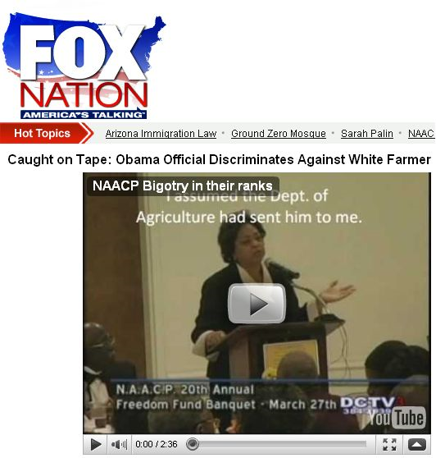
App II. Finding Manipulated Data
Posted by Andrew Breitbart
In his blog
…

Slide 97
App II. Finding Manipulated Data
How well can we do now?
Detect copying, but cannot distinguish malicious copying and rewording
Improve I. Light-weight solution than natural language processing
Improve II. Need to do this with text, database, image, video

Slide 98
App III. Finding Truth on the Web
From structured data
Provided by Bradley Meyer

Slide 99
finance.boston.com
finance.bostonmerchant.com
financial.businessinsider.com
markets.chron.com
finance.abc7.com

Slide 100
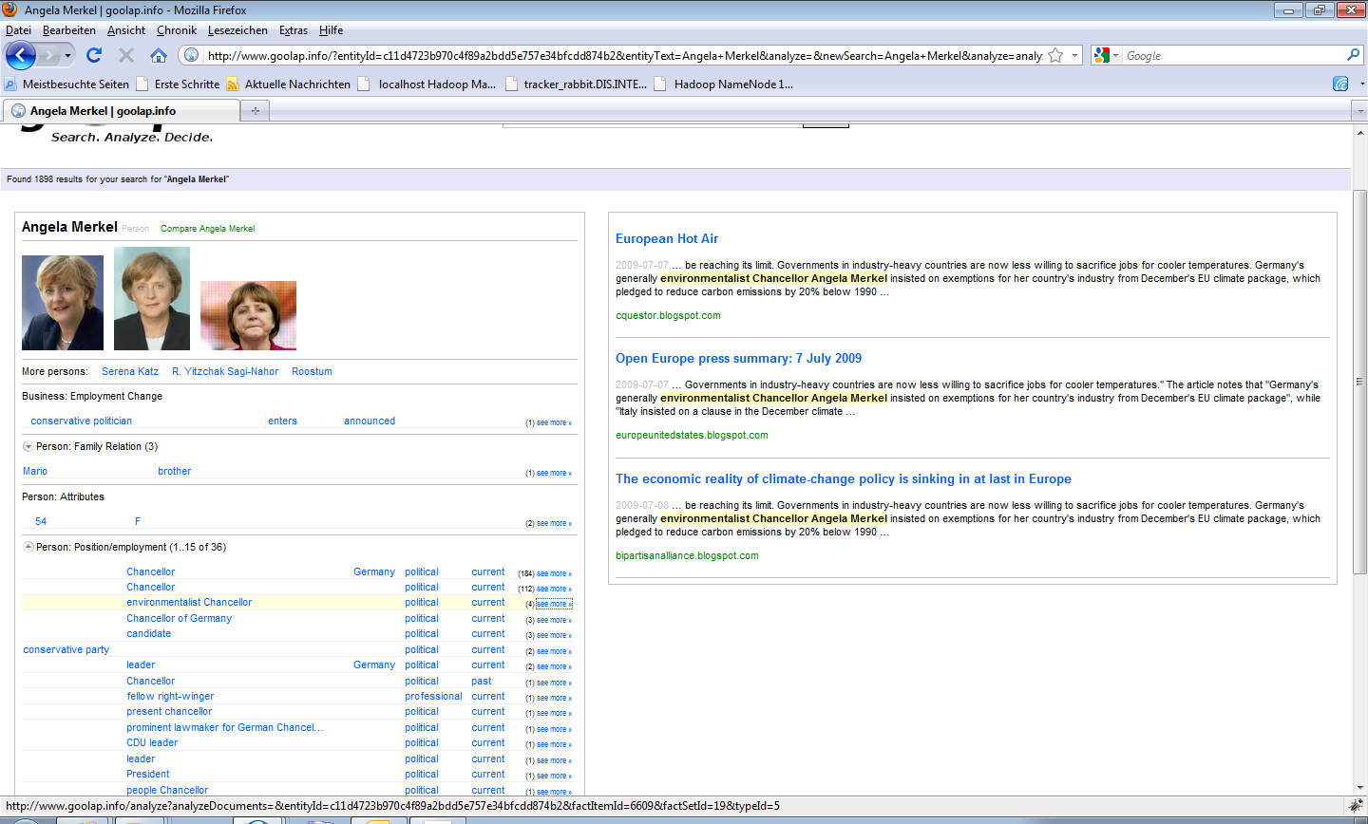
App III. Finding Truth on the Web
From extracted data
Angela Merkel, environmentalist Chancellor
GoOLAP.info by Alexander Löser

Slide 101
App III. Finding Truth on the Web

Slide 102
App III. Finding Truth on the Web
How well can we do now?
Detect copying on DB, and apply in data fusion [DBS09]
Detect copying on text, and remove duplicates from extraction
Detect copying on dynamic DB data [DBS09b]
Additional evidence for copying on structured data
Schema of data, layout of webpage, surrounding text, HTML source code
Additional evidence for copying on extracted data
Surrounding text

Slide 103
App III. Finding Truth on the Web
Improve I. Combine various of evidence
Need to decide the granularity to consider for surrounding text
Improve II. Consider partial copying
Copy a category of data
Loop copying
Improve III. Improve scalability both in the size of data and the number of sources

Slide 104
App IV. Finding Consensus of Opinions
Users: (135,031 votes) 847 reviews | Critics: 504 reviews
Metascore: 79/100 (based on 42 reviews from Metacritic.com)

Slide 105
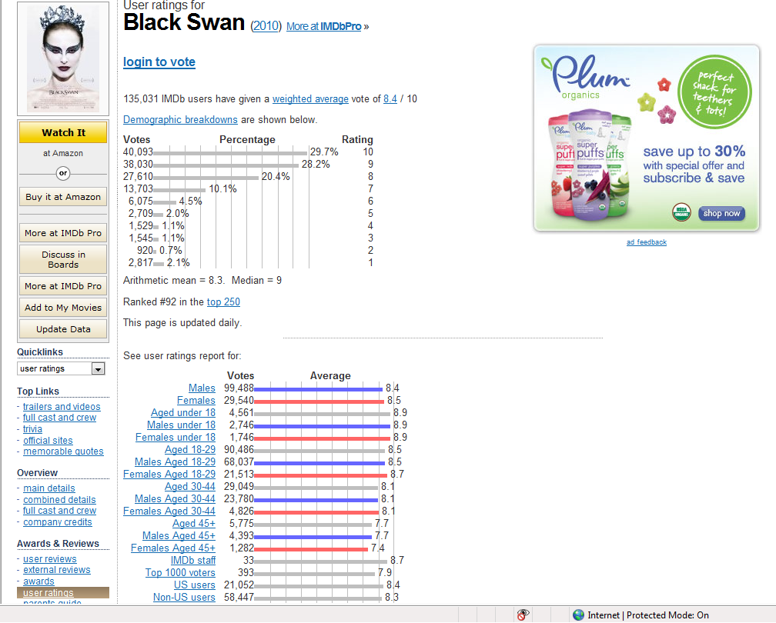
App IV. Finding Consensus of Opinions

Slide 106
App IV. Finding Consensus of Opinions
How well can we do now?
Detect review duplicates
Improve I. Detect influence of reviews/ratings
Correlation between ratings for a pair of users
Improve II. From copied review fragments to influence of ratings

Slide 107
App V. Protecting Data Providers
[Solomon, DBHS’10]

Slide 108
App V. Protecting Data Providers
How well can we do now?
Global copy detection on databases
Improve I. Global detection on other types of data
Consider missing sources
Improve II. Provide informative explanation
Why A is a copier of B but not the other direction
Why A but not B is a copier of C
Why A is a copier of B but not C
What if this value is not considered as wrong

Slide 109
Take Aways
Copy detection is important
There is a fair amount of work on copy detection for documents, software, databases, (images/videos,) etc.
Killer applications on the Web call for improved techniques

Slide 110
THANK YOU

