Slide 1
Linking Records with Value Diversity
Xin Luna Dong
Database Department, AT&T Labs-Research
Collaborators: Pei Li, Andrea Maurino (Univ. of Milan-Bicocca),
Songtao Guo (ATTi), Divesh Srivastava (AT&T)
December, 2012

Slide 2
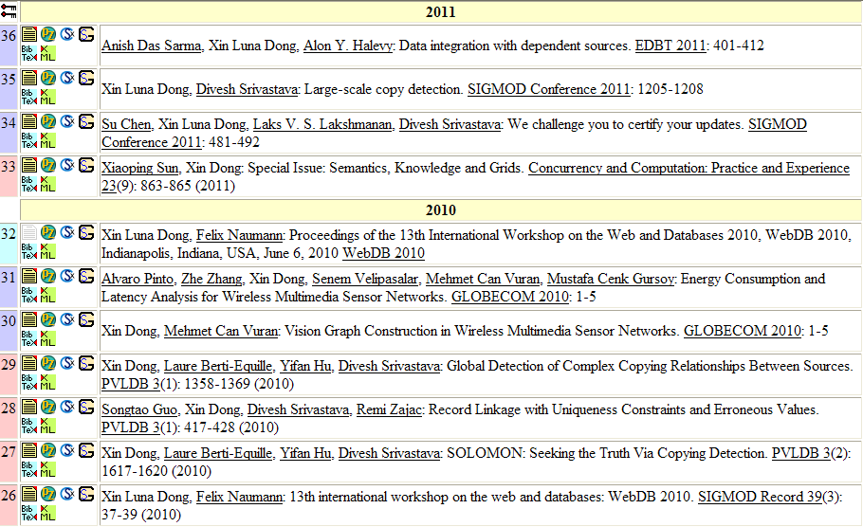
Real Stories (I)
Notes:
But still, there are mistakes on her records. E.g, These two papers are wrongly merged.

Slide 3
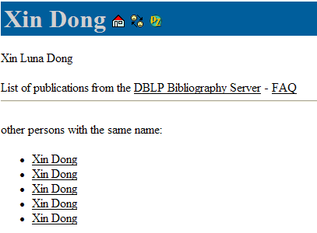
Real Stories (II)
Luna’s DBLP entry
Notes:
Our co-author Luna has motivated a lot on this work from her own experience. She used to two different DBLP entries with disjoint sets of papers. And she had to email to Mecheal before coming to the job-market.

Slide 4
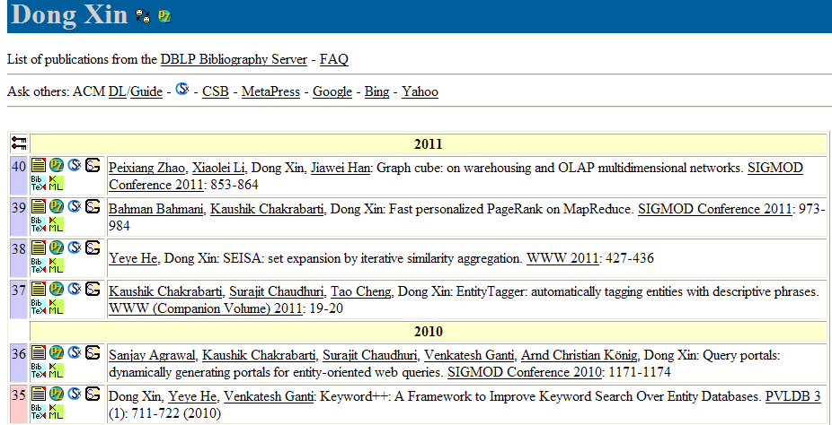
Real Stories (III)
Lab visiting
Sorry, no entry is found for Xin Dong
Notes:
Another story happened when Luna was visiting a research lab, where she tested an e-library system by searching her name. However, the system returned no results, ‘cause it mistakenly merged her papers with the publication of another author Dong Xin, whose first name is the same as Luna’s last name, and whose last name is Luna’s first name.

Slide 5
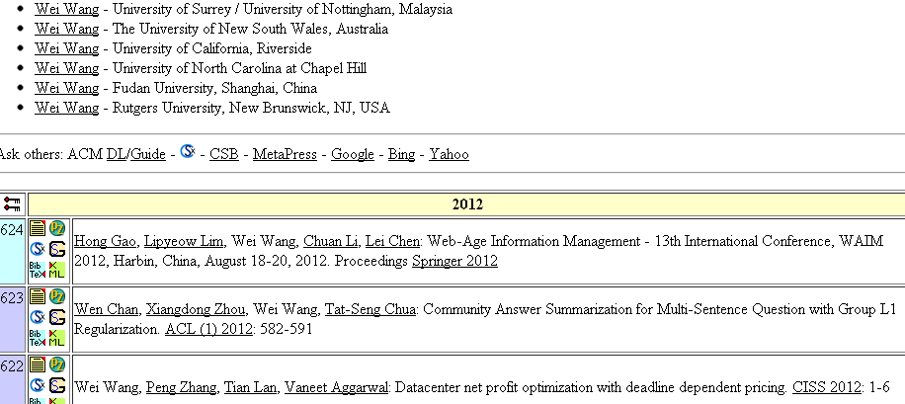
Another Example from DBLP
How many Wei Wang’s are there?
What are their authoring histories?
Notes:
There are many applications that benefit from record linkage. However, Record linkage can be tricky.
Here is an example from DBLP. We find more than 18 authors named WW, and
the biggest potpourri contains more than 500 papers. We may wonder how many wei wang are there and what are their authoring histories?
Update snapshot

Slide 6
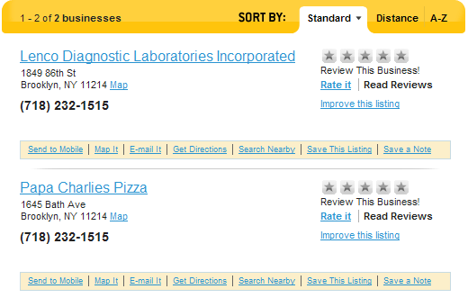
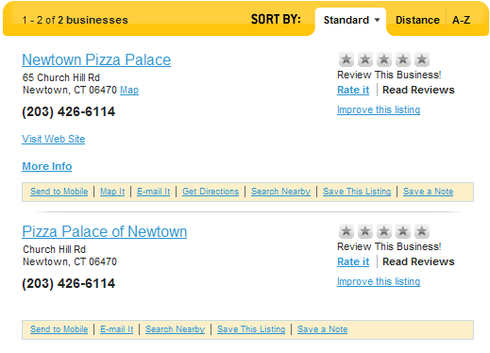
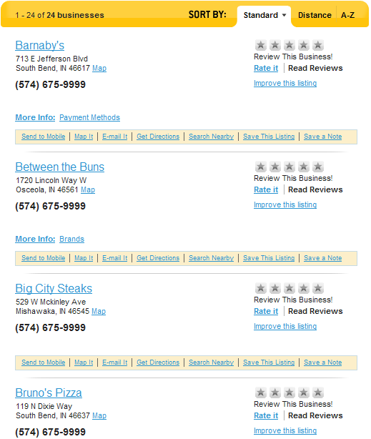
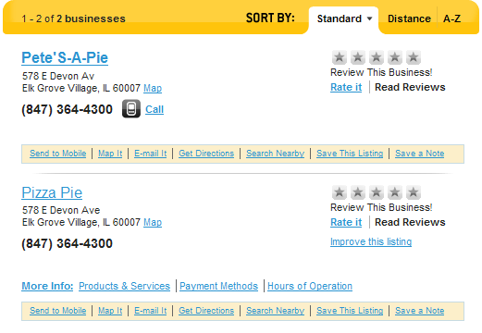
An Example from YP.com
- Are they the same business?
A: the same business
B: different businesses sharing the same phone#
C: different businesses, only one correctly associated with the given phone#

Slide 7
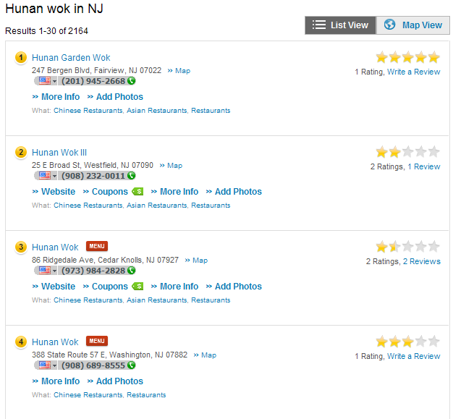
Another Example from YP.com
Are there any business chains?
If yes, which businesses are their members?
Notes:
Another example can be found in Yellow Pages. E.g., I found more than 2000 restaurants in NJ named Hunan Wok. A very challenging task is to discover if there exist any hunan wok chains, and which busineses are their members.

Slide 8
Record Linkage
What is record linkage (entity resolution)?
Input: a set of records
Output: clustering of records
A critical problem in data integration and data cleaning
“A reputation for world-class quality is profitable, a ‘business maker’.” – William E. Winkler
Current work (surveyed in [Elmagarmid, 07], [Koudas, 06]) :
assume that records of the same entities are consistent
often focus on different representations of the same value
E.g., “IBM” and “International Business Machines”
Notes:
To summarize, record linkage takes ... As input and find ... That refer to the same ...
Existing work: assume ... Fairly consistent; often focus on ..., e.g.
Each cluster refers to a real-world entity
Different clusters refer to different entities
W

Slide 9
New Challenges
In reality, we observe value diversity of entities
Values can evolve over time
Catholic Healthcare (1986 - 2012) → Dignity Health (2012 -)
Different records of the same group can have “local” values
Some sources may provide erroneous values
ID | Name | Address | Phone | URL
001 | F.B. Insurance | Vernon 76384 TX | 877 635-4684 | txfb-ins.com
002 | F.B. Insurance #1 | Lufkin 75901 TX | 936 634-7285 | txfb.org
003 | F.B. Insurance #5 | Cibolo 78108 TX | 877 635-4684
ID | Name | URL | Source
001 | Meekhof Tire Sales & Service Inc | www.meekhoftire.com | Src. 1
002 | Meekhof Tire Sales & Service Inc | www.napaautocare.com | Src. 2
••• 9
Notes:
In reality…. We observe the following reasons that cause value diversity:
First, value can evolve over time. e.g., the Catholic Healthcare is a California-based public benefit corporation and changed its name to Dignity Health in 2012.
Second, different members of the same group can have diversity. E.g., the three records belong to TX F.B. Insurance, where r1 and r3 is associated by a primary 800 phone number of the company, and r2 is associated w. its local phone #;
third, in the process of data integration, some sources may provide erroneous data. E.g., the two records provided by two sources refer to the same company, and r2 has a wrong url.

Slide 10
Our Goal
To improve the linkage quality of integrated data with fairly high diversity
Linking temporal records
[VLDB ’11] [VLDB ’12 demo][FCS Journal ’12]
Linking records of the same group
[Under submission]
Linking records with erroneous values
[VLDB’10]
Notes:
Based on the above motivation, I study the problems of record linkage that require tolerance to high diversity of values. Specifically, I focus on two sub-problems. 1. linking temporal records, where values of real-world entities change over time; 2. linking group records, where values diverse among different members of the same group.

Slide 11
Outline
Motivation
Linking temporal records
Decay
Temporal clustering
Demo
Linking records of the same group
Linking records with erroneous values
Related work
Conclusions
Notes:
1. We will take in more details first; 2 only briefly on group

Slide 12
r1: Xin Dong
R. Polytechnic Institute
r4: Xin Luna Dong
University of Washington
r2: Xin Dong
University of Washington
r5: Xin Luna Dong
AT&T Labs-Research
r3: Xin Dong
University of Washington
r6: Xin Luna Dong
AT&T Labs-Research
How many authors?
What are their authoring histories?
1991
1991
2004
1991
2005
1991
2006
1991
2007
2008
2009
2010
2011
r11: Dong Xin
Microsoft Research
r8:Dong Xin
University of Illinois
r12: Dong Xin
Microsoft Research
r9: Dong Xin
Microsoft Research
r10: Dong Xin
University of Illinois
r7: Dong Xin
University of Illinois
Notes:
Here are 12 records from DBLP, each extracted from one publication record
with author name, affiliation, and publishing year.
The questions we’ll answer are: 1. how many authors are there? 2. what are their authoring histories?

Slide 13
r1: Xin Dong
R. Polytechnic Institute
r4: Xin Luna Dong
University of Washington
r2: Xin Dong
University of Washington
r5: Xin Luna Dong
AT&T Labs-Research
r3: Xin Dong
University of Washington
r6: Xin Luna Dong
AT&T Labs-Research
Ground truth
1991
1991
2004
1991
2005
1991
2006
1991
2007
2008
2009
2010
2011
r11: Dong Xin
Microsoft Research
r8:Dong Xin
University of Illinois
3 authors
r12: Dong Xin
Microsoft Research
r9: Dong Xin
Microsoft Research
r10: Dong Xin
University of Illinois
r7: Dong Xin
University of Illinois
Notes:
In reality, these 12 records belong to 3 authors.
First one,
First one, name change; affiliation move
Second one, Dong Xin (name-surname), affiliation move

Slide 14
r1: Xin Dong
R. Polytechnic Institute
r4: Xin Luna Dong
University of Washington
r2: Xin Dong
University of Washington
r5: Xin Luna Dong
AT&T Labs-Research
r3: Xin Dong
University of Washington
r6: Xin Luna Dong
AT&T Labs-Research
Solution 1:
requiring high value consistency
1991
1991
2004
1991
2005
1991
2006
1991
2007
2008
2009
2010
2011
r11: Dong Xin
Microsoft Research
5 authors
false negative
r8:Dong Xin
University of Illinois
r12: Dong Xin
Microsoft Research
r9: Dong Xin
Microsoft Research
r10: Dong Xin
University of Illinois
r7: Dong Xin
University of Illinois
Notes:
A very common solution is to require high value consistency. So if two records have the same/similar author names, the same affiliation, we will merge them.
It results in 5 authors. this solution causes false negative.

Slide 15
r1: Xin Dong
R. Polytechnic Institute
r4: Xin Luna Dong
University of Washington
r2: Xin Dong
University of Washington
r5: Xin Luna Dong
AT&T Labs-Research
r3: Xin Dong
University of Washington
r6: Xin Luna Dong
AT&T Labs-Research
Solution 2:
matching records w. similar names
1991
1991
2004
1991
2005
1991
2006
1991
2007
2008
2009
2010
2011
r11: Dong Xin
Microsoft Research
2 authors
false positive
r8:Dong Xin
University of Illinois
r12: Dong Xin
Microsoft Research
r9: Dong Xin
Microsoft Research
r10: Dong Xin
University of Illinois
r7: Dong Xin
University of Illinois
Notes:
Another solution is to match records once they have similar names. Then we will have two clusters, and in the worst case, we may even merge all records together.

Slide 16
Opportunities
Continuity of history
Smooth transition
ID | Name | Affiliation | Co-authors | Year
r1 | Xin Dong | R. Polytechnic Institute | Wozny | 1991
r2 | Xin Dong | University of Washington | Halevy, Tatarinov | 2004
r7 | Dong Xin | University of Illinois | Han, Wah | 2004
r3 | Xin Dong | University of Washington | Halevy | 2005
r4 | Xin Luna Dong | University of Washington | Halevy, Yu | 2007
r8 | Dong Xin | University of Illinois | Wah | 2007
r9 | Dong Xin | Microsoft Research | Wu, Han | 2008
r10 | Dong Xin | University of Illinois | Ling, He | 2009
r11 | Dong Xin | Microsoft Research | Chaudhuri, Ganti | 2009
r5 | Xin Luna Dong | AT&T Labs-Research | Das Sarma, Halevy | 2009
r6 | Xin Luna Dong | AT&T Labs-Research | Naumann | 2010
r12 | Dong Xin | Microsoft Research | He | 2011
Seldom erratic changes
Notes:
Despite the above challenges, temporal information actually presents additional evidence for record linkage.
First, record values typically transit smoothly. E.g., after Dong Xin moved to MSR, he still keeps some co-authors from the former affiliation.
Second, record values seldom change erratically. In reality, it is not likely that an author was in UI in 2004, and moved to UW one year later, and moved back to UI in 2007.
Third, records that refer to the same real-world entity often observe continuity. E.g., when we see a record with author name Xin Dong in 1991, and another one with the same name 13 years later, we are not so confident to say these two records belong to the same author.

Slide 17
Intuitions
ID | Name | Affiliation | Co-authors | Year
r1 | Xin Dong | R. Polytechnic Institute | Wozny | 1991
r2 | Xin Dong | University of Washington | Halevy, Tatarinov | 2004
r7 | Dong Xin | University of Illinois | Han, Wah | 2004
r3 | Xin Dong | University of Washington | Halevy | 2005
r4 | Xin Luna Dong | University of Washington | Halevy, Yu | 2007
r8 | Dong Xin | University of Illinois | Wah | 2007
r9 | Dong Xin | Microsoft Research | Wu, Han | 2008
r10 | Dong Xin | University of Illinois | Ling, He | 2009
r11 | Dong Xin | Microsoft Research | Chaudhuri, Ganti | 2009
r5 | Xin Luna Dong | AT&T Labs-Research | Das Sarma, Halevy | 2009
r6 | Xin Luna Dong | AT&T Labs-Research | Naumann | 2010
r12 | Dong Xin | Microsoft Research | He | 2011
Less reward on the same value over time
Less penalty on different values over time
Consider records in time order for clustering
Notes:
Given these motivations, our intuitions for temporal record linkage are as follows:
We’d like to give less penalty on different values over time. E.g., even r2 and r5 have different affiliations (after 5 years), it is not a strong indicator for us to split them;
We’d like to give less reward on same values over time. E.g., even r1 and r2 have the same author name, it is not a strong indicator for us to merge them.
We’d consider the records in time order (what benefit we can get; global evidence; show in the example)
Such that we can get a global view of the evolution, e.g., XD@UW 2004-2007, moving after 5 yrs is reasonble

Slide 18
Outline
Motivation
Linking temporal records
Decay
Temporal clustering
Demo
Linking records of the same group
Linking records with erroneous values
Related work
Conclusions
Notes:
1. We will take in more details first; 2 only briefly on group

Slide 19
Disagreement Decay
Intuition: different values over a long time is not a strong indicator of referring to different entities.
University of Washington (01-07)
AT&T Labs-Research (07-date)
Definition (Disagreement decay)
Disagreement decay of attribute A over time ∆t is the probability that an entity changes its A-value within time ∆t.
Notes:
Luna move from … to… we don’t want to panlize …
Our RL techniques leverage temporal info. in two ways.
First, when computing record similarity, we introduce the concept of time decay that captures the effect of elapsed time on value evolution.
The first notion is disagreement decay.
The intuition of disagreement decay is that different values over a long time is not a strong indicator of referring to different entities.
e.g., Luna was in UW from 2001 to 2007 and works in AT&T since 2007. the different affiliation values should not prevent us from merging the two records.
We give the formal definition of disagreement decay.

Slide 20
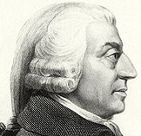
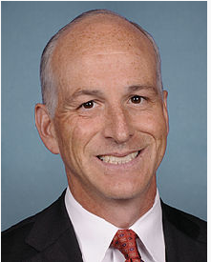
Agreement Decay
Intuition: the same value over a long time is not a strong indicator of referring to the same entities.
Adam Smith: (1723-1790)
Adam Smith: (1965-)
Definition (Agreement decay)
Agreement decay of attribute A over time ∆t is the probability that different entities share the same A-value within time ∆t.
Notes:
Two adam, we do not want to overaward the name similarity
Similarly, we have the notion of agreement decay. The intuition is, …
e.g., obviously, these are two different people, even though they have the same names.
We give the formal definition of agreement decay:

Slide 21
Decay Curves
Decay curves of address learnt from European Patent data
Patent records: 1871
Real-world inventors: 359
In years: 1978 - 2003
Disagreement decay
Agreement decay
Notes:
e.g., disagreement decay, 2 year, 10 year, 20 year, change aff. Prob.
Move data-set (359 inventors, in year)
5 year:
15 year:
annimation

Slide 22
Learning Disagreement Decay
1. Full life span: [t, tnext)
A value exists from t to tnext, for time (tnext-t)
2. Partial life span: [t, tend+1)*
A value exists since t, for at least time (tend-t+1)
Lp={1, 2, 3}, Lf={4, 5}
d(∆t=1)=0/(2+3)=0
d(∆t=4)=1/(2+0)=0.5
d(∆t=5)=2/(2+0)=1
R. P. Institute
E1
1991
∆t=1
UW
AT&T
AT&T
E2
2004
2009
2010
∆t=5
∆t=2
UIUC
MSR
MSR
E3
2004
2008
2010
∆t=4
∆t=3
Change & last time point
Change point
Last time point
Full life span
Partial life span
Notes:
We can learn decay from sampled data sets, where we know if two records refer to the same entity.
To compute decay, we first collect two types of statistics:
A full life span: e.g., the affi. of E2 had been UW since 2004 and changed in 2009; so we have a full life span of 5 years.
2. A partial life span: e.g., the affi. Of E3 had been MSR since 2008 and we haven’t seen any change by 2010, so we know it hasn’t change for 3 years, but we are not sure if it will change in the future. so we have a partial life span of 3 years
We compute disagreement decay by the following formula.
e.g., When \delta t=1, we haven’t seen any change of affiliation within one year. So the decay is 0.
When \delta t=4, among two affi. Changes, we see one entity changing aff. Within 4 years, for the three partial life spans, their life span is below 4. we are not sure if any of them will change in 4 years.
we are not sure if any entity keeps aff. For more than 4 years. So the decay is .5.

Slide 23
Applying Decay
E.g.
r1 <Xin Dong, Uni. of Washington, 2004>
r2 <Xin Dong, AT&T Labs-Research, 2009>
No decayed similarity:
w(name)=w(affi.)=.5
sim(r1, r2)=.5*1+.5*0=.5
Decayed similarity
w(name, ∆t=5)=1-dagree(name , ∆t=5)=.95,
w(affi., ∆t=5)=1-ddisagree(affi. , ∆t=5)=.1
sim(r1, r2)=(.95*1+.1*0)/(.95+.1)=.9
Un-match
Match
Notes:
No decayed first
Instead of using uniform weight, we assign weight according to decay. Name, agree,
We use this formula to compute decayed similarity, where the weight of attributes are the compensation of their decays.
Given two record r1, r2, since name of the two records are the same, we use agreement decay, and the weight for name is compensation of decay; Similarly, affiliations of the two records are different, we use disagreement decay, and the weight of affiliation is .1. The overall decay similarity of r1, r2 is .9, which will probably allow us to merge the two records.
However, the no decayed simi. Is .5. given such a low sim, we will consider r1 and r2 as unmatch.

Slide 24
Applying Decay
ID | Name | Affiliation | Co-authors | Year
r1 | Xin Dong | R. Polytechnic Institute | Wozny | 1991
r2 | Xin Dong | University of Washington | Halevy, Tatarinov | 2004
r7 | Dong Xin | University of Illinois | Han, Wah | 2004
r3 | Xin Dong | University of Washington | Halevy | 2005
r4 | Xin Luna Dong | University of Washington | Halevy, Yu | 2007
r8 | Dong Xin | University of Illinois | Wah | 2007
r9 | Dong Xin | Microsoft Research | Wu, Han | 2008
r10 | Dong Xin | University of Illinois | Ling, He | 2009
r11 | Dong Xin | Microsoft Research | Chaudhuri, Ganti | 2009
r5 | Xin Luna Dong | AT&T Labs-Research | Das Sarma, Halevy | 2009
r6 | Xin Luna Dong | AT&T Labs-Research | Naumann | 2010
r12 | Dong Xin | Microsoft Research | He | 2011
☹All records are merged into the same cluster!!
☺ Able to detect changes!

Slide 25
Decayed Similarity & Traditional Clustering
Decay improves recall over baselines by 23-67%
Patent records: 1871
Real-world inventors: 359
In years: 1978 - 2003
Notes:
Motivation
Baseline: spesific
Recall, high; precision, low; f-measure, still improves (5 mins)

Slide 26
Outline
Motivation
Linking temporal records
Decay
Temporal clustering
Demo
Linking records of the same group
Linking records with erroneous values
Related work
Conclusions
Notes:
1. We will take in more details first; 2 only briefly on group

Slide 27
Early Binding
Compare a new record with existing clusters
Make eager merging decision for each record
Maintain the earliest/latest timestamp for its last value
Notes:
The first one is called early binding. (2 min)
The eager decision is ?

Slide 28
Early Binding
ID | Name | Affiliation | Co-authors | From | To
C1
r1 | Xin Dong | R. P. Institute | Wozny | 1991 | 1991
r2 | Xin Dong | Univ. of Washington | Halevy, Tatarinov | 2004 | 2004
r3 | Xin Dong | Univ. of Washington | Halevy | 2004 | 2005
r4 | Xin Luna Dong | Univ. of Washington | Halevy, Yu | 2004 | 2007
r10 | Dong Xin | University of Illinois | Ling, He | 2009 | 2009
C2
ID | Name | Affiliation | Co-authors | From | To
☹earlier mistakes prevent later merging!!
r7 | Dong Xin | University of Illinois | Han, Wah | 2004 | 2004
r8 | Dong Xin | University of Illinois | Wah | 2004 | 2007
☺ Avoid a lot of false positives!
r9 | Dong Xin | Microsoft Research | Wu, Han | 2008 | 2008
r11 | Dong Xin | Microsoft Research | Chaudhuri, Ganti | 2008 | 2009
r12 | Dong Xin | Microsoft Research | He | 2008 | 2011
C3
ID | Name | Affiliation | Co-authors | From | To
r5 | Xin Luna Dong | AT&T Labs-Research | Das Sarma, Halevy | 2009 | 2009
r6 | Xin Luna Dong | AT&T Labs-Research | Naumann | 2009 | 2010
Notes:
“2004”
R7 cannot be merged to c1, because r2 and 7 are in the same year
When we see r10, C2 has aff. Of MSR in 2008, changing aff. In 1 year seems unlikely. While C1 has aff. Of UW since 2004; changing affi. in 5 years is more possible. So we merge r10 with C1.
Give ☺ and ☹
We avoid a lot of fp
Because of a wrong decision for r10, we are unable to
Give red, ☺; black, ☹
We still merge r1 with …

Slide 29
Late Binding
Keep all evidence in record-cluster comparison
Make a global decision at the end
Facilitate with a bi-partite graph

Slide 30
Late Binding
r1
XinDong@R.P.I -1991
1
C1
r1 | X.D | R.P. I. | Wozny | 1991 | 1
r2 | X.D | UW | Halevy, Tatarinov | 2004 | .5
r7 | D.X | UI | Han, Wah | 2004 | .33
0.5
r2
XinDong@UW -2004
0.5
C2
r2 | D.X | UW | Halevy, Tatarinov | 2004 | .5
r7 | D.X | UI | Han, Wah | 2004 | .22
0.22
0.33
r7
DongXin@UI -2004
0.45
C3
r7 | D.X | UI | Han, Wah | 2004 | .45
create C2
p(r2, C1)=.5, p(r2, C2)=.5
Choose the possible world with highest probability
create C3
p(r7, C1)=.33, p(r7, C2)=.22, p(r7, C3)=.45
Notes:
Bi-partite graph, record on one side; cluster on the other side;
We assign pob. According to the similarity of record and cluster. New cluster prob. Derived from existing clusters,
Example weight on edges
Read probability for r2, r7

Slide 31
Late Binding
ID | Name | Affiliation | Co-authors | Year
r1 | Xin Dong | R. Polytechnic Institute | Wozny | 1991
r2 | Xin Dong | University of Washington | Halevy, Tatarinov | 2004
r3 | Xin Dong | University of Washington | Halevy | 2005
r4 | Xin Luna Dong | University of Washington | Halevy, Yu | 2007
r5 | Xin Luna Dong | AT&T Labs-Research | Das Sarma, Halevy | 2009
r6 | Xin Luna Dong | AT&T Labs-Research | Naumann | 2010
r7 | Dong Xin | University of Illinois | Han, Wah | 2004
r8 | Dong Xin | University of Illinois | Wah | 2007
r9 | Dong Xin | Microsoft Research | Wu, Han | 2008
r11 | Dong Xin | Microsoft Research | Chaudhuri, Ganti | 2009
r12 | Dong Xin | Microsoft Research | He | 2011
r10 | Dong Xin | University of Illinois | Ling, He | 2009
C1
C2
☺ Correctly split r1, r10 from C2
C3
C4
☹ Failed to merge C3, C4, C5
C5
Notes:
Global view, we didn’t merge
Late binding is conservative in assigning probability, so we fail to …
Red block, ☺: r10 not merged to r10; r1 is also split
Black: ☹

Slide 32
Adjusted Binding
Compare earlier records with clusters created later
Proceed in EM-style
Initialization: Start with the result of early/late binding
Estimation: Compute record-cluster similarity
Maximization: Choose the optimal clustering
Termination: Repeat until the results converge or oscillate
Notes:
Compare earlier records with cluster formed later
Keep in mind: no late binding;
E: derieve a prob. that each record belongs to a cluster
Optimal clustering: for each cluster, compute the prob., choose max

Slide 33
Adjusted Binding
Compute similarity by
Consistency: consistency in evolution of values
Continuity: continuity of records in time
sim(r, C)=cont(r, C)*cons(r, C)
Case 1:
r.t
C.early
C.late
Case 2:
C.late
r.t
C.early
Case 3:
r.t
C.early
C.late
Case 4:
C.late
C.early
r.t
record time stamp
cluster time stamp
Notes:
Case 2,3 record is close to cluster; in 1 and 4, is far away from cluster C1, C4.
Use equation, use example to

Slide 34
Adjusted Binding
r7
DongXin@UI -2004
C3
Once r8 is merged to C4, r7 has higher continuity with C4
r8
DongXin@UI -2007
r8 has higher continuity with C4
r9
DongXin@MSR -2008
C4
r10
DongXin@UI -2009
C5
r11
DongXin@MSR -2009
r10 has higher continuity with C4
r12
DongXin@MSR -2011
Notes:
Recall the four cases in previous slide, r10 has the highst cont. with C4. similary, r8 has the highest contiuity with c4.
Why r10 has higher cont?
1:30 36; decay: 37; clustering 42; exp: 48; related 53

Slide 35
Adjusted Binding
ID | Name | Affiliation | Co-authors | Year
r1 | Xin Dong | R. Polytechnic Institute | Wozny | 1991
r2 | Xin Dong | University of Washington | Halevy, Tatarinov | 2004
r3 | Xin Dong | University of Washington | Halevy | 2005
r4 | Xin Luna Dong | University of Washington | Halevy, Yu | 2007
r5 | Xin Luna Dong | AT&T Labs-Research | Das Sarma, Halevy | 2009
r6 | Xin Luna Dong | AT&T Labs-Research | Naumann | 2010
r7 | Dong Xin | University of Illinois | Han, Wah | 2004
r8 | Dong Xin | University of Illinois | Wah | 2007
r9 | Dong Xin | Microsoft Research | Wu, Han | 2008
r10 | Dong Xin | University of Illinois | Ling, He | 2009
r11 | Dong Xin | Microsoft Research | Chaudhuri, Ganti | 2009
r12 | Dong Xin | Microsoft Research | He | 2011
C1
C2
☺ Correctly cluster all records
C3
Notes:
R1 r2 are not merged, because of low contnity

Slide 36
Temporal Clustering
Full algorithm has the best result
Adjusted Clustering improves recall without reducing precision much
Patent records: 1871
Real-world inventors: 359
In years: 1978 - 2003
Notes:
Only clustering, w./o. decay,
3-4 mins

Slide 37
Comparison of Clustering Algorithms
Adjust improves over both
Early has a lower precision
Late has a lower recall
Notes:
Early, late has its own benefits.
Adjust has higher recall because … ; without precison much, given the global view.

Slide 38
Accuracy on DBLP Data – Xin Dong
Data set: Xin Dong data set from DBLP
72 records, 8 entities, in 1991-2010
Compare name, affiliation, title & co-authors
Golden standard: by manually checking
Adjust improves over baseline by
37-43%
Notes:
We have tested on Xin Dong data set from DBLP that …
Our solution improved over baseline methods by 43%

Slide 39
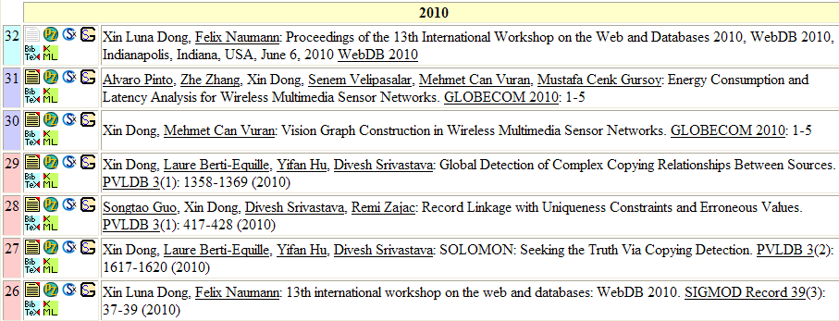
Error We Fixed
Records with affiliation University of Nebraska–Lincoln
Notes:
We fixed an error in DBLP: it correctly separates the records with affiliation UNL from Luna’s records

Slide 40
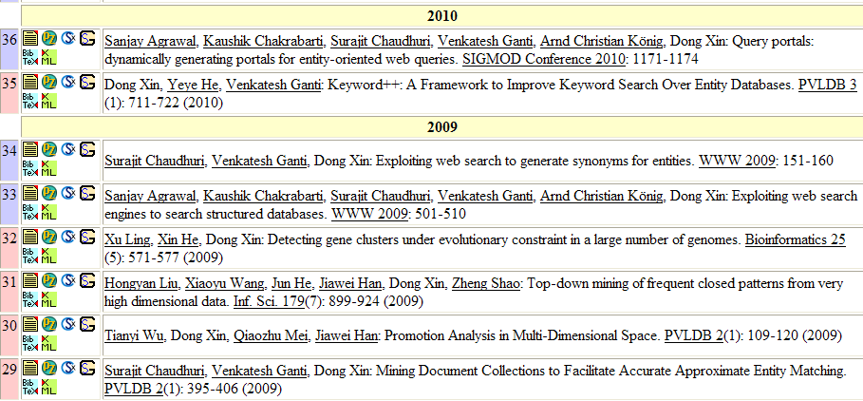
We Only Made One Mistake
Author’s affiliation on Journal papers are out of date
Notes:
It makes one mistake: it split two records from Dong Xin records. This is because the two records correspond to two journal papers and the author affiliation is out of date.

Slide 41
Accuracy on DBLP Data (Wei Wang)
Data set: Wei Wang data set from DBLP
738 records, 18 entities + potpourri, in 1992-2011
Compare name, affiliation & co-authors
Golden standard: from DBLP + manually checking
Adjust improves over baseline by
11-15%
High precision (.98) and high recall (.97)
Notes:
700 records for 18 identified authors.
Again adjust has the best results.
For 18 entities: extremly high recall & precision .98/.97
We experimented on Wei Wang data set on DBLP that…
Our approach improves over baseline methods by 15%. Notice that on this hardest data set, our approach obtains both high precision and high recall.

Slide 42
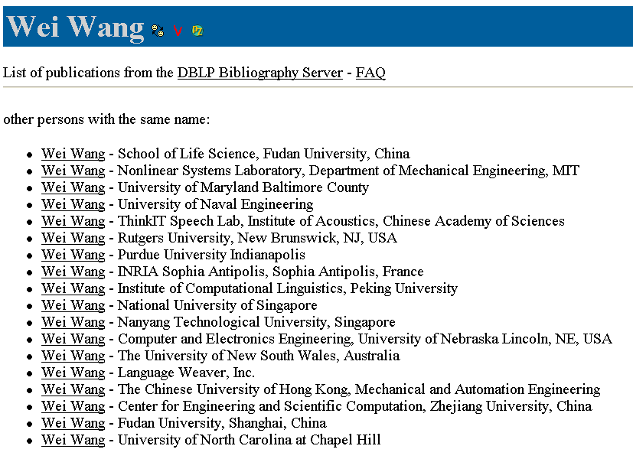
Mistakes We Made
1 record @ 2006
72 records @ 2000-2011
Notes:
We also make several mistakes on existing ww entries:
e.g., we merged this w w that contains only one record with the big w w cluster that contains 72 records, because they work in the same uni. and their time stamps are quite close.

Slide 43
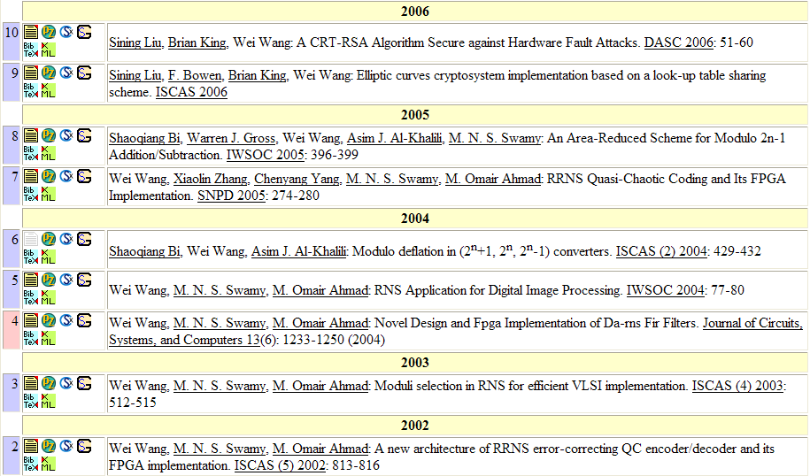
Mistakes We Made
Purdue University
Univ. of Western Ontario
Concordia University
Notes:
Another type of mistake is because of frequent changes. E.g., this researcher changed 3 affi. Within 4 years. And is considered as different researchers by our system.

Slide 44
Errors We Fixed … despite some mistakes
546 records in potpourri
Correctly merged 63 records to existing Wei Wang entries
Wrongly merged 61 records
26 records: due to missing department information
35 records: due to high similarity of affiliation
E.g., Northwest University of Science & Technology
Northeast University of Science & Technology
Precision and recall of .94 w. consideration of these records
Notes:
Identified other 130 authors
422 records : 2.7 records / author
Besides 18 entries in DBLP, there are also 546 records that do not have independent entries on DBLP and are merged together.
For 422 records, we have identified 130 authors. The average record per author is 2.7.
For the rest 124 records, we have correctly merged 63 records to the existing WW entries on DBLP.
We wrongly merged 26 records to WW entries, because several wei wang works in the same university. Without department info, we failed to separate them.
We also wrongly merged 35 records, because their affi. Is higher similar.

Slide 45
Demonstration
CHRONOS: Facilitating History Discovery by Linking Temporal Records

Slide 46
Outline
Motivation
Linking temporal records
Decay
Temporal clustering
Demo
Linking records of the same group
Linking records with erroneous values
Related work
Conclusions
Notes:
1. We will take in more details first; 2 only briefly on group

Slide 47
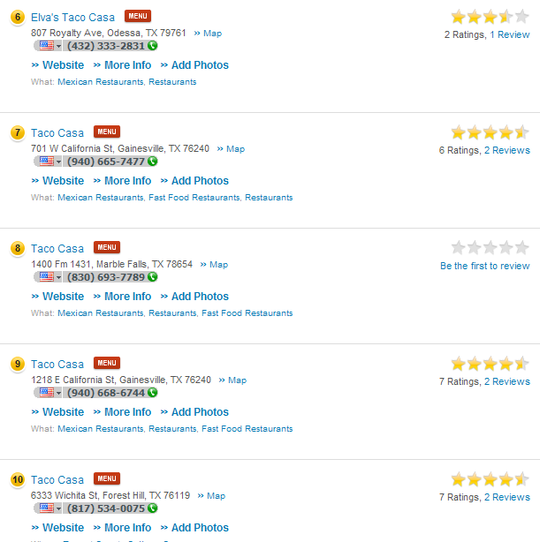
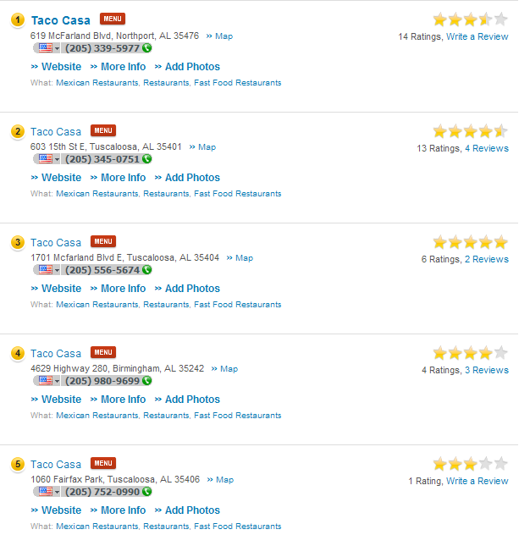
Are there any business chains?
If yes, which businesses are their members?
Notes:
Here are 10 business listings found in YP, each w. business name, address, phone number, website URL, etc.
We’d like to know if there are any Taco Casa fast food chains in USA. And if yes, which listings are their chain stores.

Slide 48
2 chains
Ground Truth
Notes:
In reality, there are two Taco Casa chains.

Slide 49
0 chain
Solution 1:
Require high value consistency
Notes:
Again, if we require high value consistency, we may not find any chains,
since each listing has its local info. e.g., different address, different phone #, some different url
which is different from others.

Slide 50
1 chain
Solution 2:
Match records w. same name
Notes:
If we match records once they have highly similar names, we may find one chain.

Slide 51
Challenges
Erroneous values
ID | name | phone | state | URL domain
r1 | Taco Casa |  | AL | tacocasa.com
r2 | Taco Casa | 900 | AL | tacocasa.com
r3 | Taco Casa | 900 | AL | tacocasa.com, tacocasatexas.com
r4 | Taco Casa | 900 | AL
r5 | Taco Casa | 900 | AL
r6 | Taco Casa | 701 | TX | tacocasatexas.com
r7 | Taco Casa | 702 | TX | tacocasatexas.com
r8 | Taco Casa | 703 | TX | tacocasatexas.com
r9 | Taco Casa | 704 | TX
r10 | Elva’s Taco Casa |  | TX | tacodemar.com
Scalability 18M Records
Different local values
Notes:
The challenges of the problem are as follows. First, real-world data can contain erroneous values provided from different data sources; second, records of the same business chain can vary a lot, e.g., r6-r8 each has a local phone number. Another challenge is scalability. E.g., in the data set for experiments, we have 6.8 M records.
What

Slide 52
Two-Stage Linkage – Stage I
Stage I: Identify cores containing listings very likely to belong to the same chain
Require robustness in presence of possibly erroneous values → Graph theory
High Scalability
ID | name | phone | state | URL domain
r1 | Taco Casa |  | AL | tacocasa.com
r2 | Taco Casa | 900 | AL | tacocasa.com
r3 | Taco Casa | 900 | AL | tacocasa.com, tacocasatexas.com
r4 | Taco Casa | 900 | AL
r5 | Taco Casa | 900 | AL
r6 | Taco Casa | 701 | TX | tacocasatexas.com
r7 | Taco Casa | 702 | TX | tacocasatexas.com
r8 | Taco Casa | 703 | TX | tacocasatexas.com
r9 | Taco Casa | 704 | TX
r10 | Elva’s Taco Casa |  | TX | tacodemar.com
Notes:
Given the challenges, we propose a two-stage approach. In the first stage, we group records that are highly likely to belong to the same chain, which we call the results cores of the chains.
R4-r5, same phone
R6-r8, same url
R3 not in any chain, because of errors;
We apply graph theory to guarantee the quality of cores in presence of possibly erroneous values.
E.g., given the possible errors in r3, we identified two cores.

Slide 53
Two-Stage Linkage – Stage II
Stage II: Cluster cores and remaining records into chains.
Collect strong evidence from cores and leverage in clustering
No penalty on local values
Reward strong evidence
ID | name | phone | state | URL domain
r1 | Taco Casa |  | AL | tacocasa.com
r2 | Taco Casa | 900 | AL | tacocasa.com
r3 | Taco Casa | 900 | AL | tacocasa.com, tacocasatexas.com
r4 | Taco Casa | 900 | AL
r5 | Taco Casa | 900 | AL
r6 | Taco Casa | 701 | TX | tacocasatexas.com
r7 | Taco Casa | 702 | TX | tacocasatexas.com
r8 | Taco Casa | 703 | TX | tacocasatexas.com
r9 | Taco Casa | 704 | TX
r10 | Elva’s Taco Casa |  | TX | tacodemar.com
Notes:
The second stage we cluster cores and the remaining records. The main idea is to reward strong evidence collected from cores, and apply no penalty on local values.
E.g., we merge r2, r3 w. the first cores, since they share the same primary phone #.

Slide 54
Two-Stage Linkage – Stage II
Stage II: Cluster cores and remaining records into chains.
Collect strong evidence from cores and leverage in clustering
No penalty on local values
Reward strong evidence
ID | name | phone | state | URL domain
r1 | Taco Casa |  | AL | tacocasa.com
r2 | Taco Casa | 900 | AL | tacocasa.com
r3 | Taco Casa | 900 | AL | tacocasa.com, tacocasatexas.com
r4 | Taco Casa | 900 | AL
r5 | Taco Casa | 900 | AL
r6 | Taco Casa | 701 | TX | tacocasatexas.com
r7 | Taco Casa | 702 | TX | tacocasatexas.com
r8 | Taco Casa | 703 | TX | tacocasatexas.com
r9 | Taco Casa | 704 | TX
r10 | Elva’s Taco Casa |  | TX | tacodemar.com
Notes:
Then r1 is merged to the same cluster, since it shares the same primary URL.

Slide 55
Two-Stage Linkage – Stage II
Stage II: Cluster cores and remaining records into chains.
Collect strong evidence from cores and leverage in clustering
No penalty on local values
Apply weak evidence
ID | name | phone | state | URL domain
r1 | Taco Casa |  | AL | tacocasa.com
r2 | Taco Casa | 900 | AL | tacocasa.com
r3 | Taco Casa | 900 | AL | tacocasa.com, tacocasatexas.com
r4 | Taco Casa | 900 | AL
r5 | Taco Casa | 900 | AL
r6 | Taco Casa | 701 | TX | tacocasatexas.com
r7 | Taco Casa | 702 | TX | tacocasatexas.com
r8 | Taco Casa | 703 | TX | tacocasatexas.com
r9 | Taco Casa | 704 | TX
r10 | Elva’s Taco Casa |  | TX | tacodemar.com
Notes:
Can remove
We merge r9 with the second core, because it shares the same state, which is considered as weak evidence
One only chain in TX, merge r9
R10, not merged because of errors

Slide 56
Two-Stage Linkage – Stage II
Stage II: Cluster cores and remaining records into chains.
Collect strong evidence from cores and leverage in clustering
No penalty on local values
No penalty on local values
ID | name | phone | state | URL domain
r1 | Taco Casa |  | AL | tacocasa.com
r2 | Taco Casa | 900 | AL | tacocasa.com
r3 | Taco Casa | 900 | AL | tacocasa.com, tacocasatexas.com
r4 | Taco Casa | 900 | AL
r5 | Taco Casa | 900 | AL
r6 | Taco Casa | 701 | TX | tacocasatexas.com
r7 | Taco Casa | 702 | TX | tacocasatexas.com
r8 | Taco Casa | 703 | TX | tacocasatexas.com
r9 | Taco Casa | 704 | TX
r10 | Elva’s Taco Casa |  | TX | tacodemar.com
Notes:
Can remove
Notice that we don’t apply any penalty on local phone # to cluster records to the second chain

Slide 57
Experimental Evaluation
Data set
18M records from YP.com
Effectiveness:
Precision / Recall / F-measure (avg.): .96 / .96 / .96
Efficiency:
8.3 hrs for single-machine solution
40 mins for Hadoop solution
.6M chains and 2.7M listings in chains
Chain name | # Stores
SUBWAY | 21,912
Bank of America | 21,727
U-Haul | 21,638
USPS - United States Post Office | 19,225
McDonald's | 17,289
Notes:
Sample data
Subway > McD > KFC
Biggest chain: USPS,
Edward Jones: what is
In a data set of 6.8 M records, the algo. runs in total for less than 7 hrs. and identified 80, 000 chains. These are tops chains identified by the algo.

Slide 58
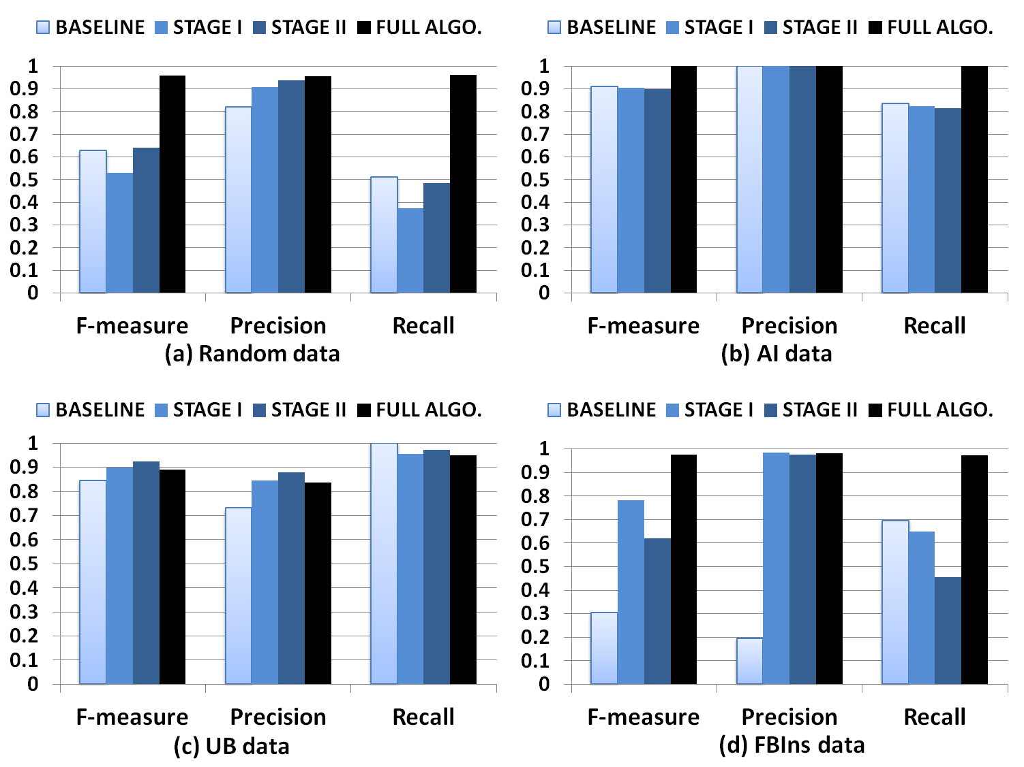
Experimental Evaluation II
Sample | #Records | #Chains | Chain size | #Single-biz records
Random | 2062 | 30 | [2, 308] | 503
AI | 2446 | 1 | 2446 | 0
UB | 322 | 7 | [2, 275] | 5
FBIns | 1149 | 14 | [33, 269] | 0
Notes:
We also compared different components of our techniques w. several baseline approaches. We find that core improves over baseline on precision but has a lower recall. Cluster performs better than baseline, applying clustering on the result of cluster does not change the results. However, when we apply clustering on the results of core, we obtain the best results.
Back up
Core – stage 1
Core – stage 2
Change record linkage -> traditional
Mention data sets: delete perturbed FBIns

Slide 59
Outline
Motivation
Linking temporal records
Decay
Temporal clustering
Demo
Linking records of the same group
Linking records with erroneous values
Related work
Conclusions
Notes:
1. We will take in more details first; 2 only briefly on group

Slide 60
Limitations of Current Solution
SOURCE | NAME | PHONE | ADDRESS
s1 | Microsofe Corp. | xxx-1255 | 1 Microsoft Way
 | Microsofe Corp. | xxx-9400 | 1 Microsoft Way
 | Macrosoft Inc. | xxx-0500 | 2 Sylvan W.
s2 | Microsoft Corp. | xxx-1255 | 1 Microsoft Way
 | Microsofe Corp. | xxx-9400 | 1 Microsoft Way
 | Macrosoft Inc. | xxx-0500 | 2 Sylvan Way
s3 | Microsoft Corp. | xxx-1255 | 1 Microsoft Way
 | Microsoft Corp. | xxx-9400 | 1 Microsoft Way
 | Macrosoft Inc. | xxx-0500 | 2 Sylvan Way
s4 | Microsoft Corp. | xxx-1255 | 1 Microsoft Way
 | Microsoft Corp. | xxx-9400 | 1 Microsoft Way
 | Macrosoft Inc. | xxx-0500 | 2 Sylvan Way
s5 | Microsoft Corp. | xxx-1255 | 1 Microsoft Way
 | Microsoft Corp. | xxx-9400 | 1 Microsoft Way
 | Macrosoft Inc. | xxx-0500 | 2 Sylvan Way
s6 | Microsoft Corp. | xxx-2255 | 1 Microsoft Way
 | Macrosoft Inc. | xxx-0500 | 2 Sylvan Way
s7 | MS Corp. | xxx-1255 | 1 Microsoft Way
 | Macrosoft Inc. | xxx-0500 | 2 Sylvan Way
s8 | MS Corp. | xxx-1255 | 1 Microsoft Way
 | Macrosoft Inc. | xxx-0500 | 2 Sylvan Way
s9 | Macrosoft Inc. | xxx-0500 | 2 Sylvan Way
s10 | MS Corp. | xxx-0500 | 2 Sylvan Way
(Microsoft Corp. ,Microsofe Corp., MS Corp.)
(XXX-1255, xxx-9400)
(1 Microsoft Way)
(Macrosoft Inc.)
(XXX-0500)
(2 Sylvan Way, 2 Sylvan W.)
Erroneous values may prevent correct matching
Traditional techniques may fall short when exceptions to the uniqueness constraints exist
✓
Locally resolving conflicts for linked records may overlook important global evidence
✓
✗

Slide 61
Our Solution
Perform linkage and fusion simultaneously
Able to identify incorrect value from the beginning, so can improve linkage
Make global decisions
Consider sources that associate a pair of values in the same record, so can improve fusion
Allow small number of violations for capturing possible exceptions in the real world

Slide 62
Clustering Performance
MDM:
Our Model:
Precision | Recall | F-measure
0.981 | 0.868 | 0.923
Precision | Recall | F-measure
0.946 | 0.963 | 0.954
Notes:
11%

Slide 63
Example I (True Positive)
 | SRC_ID | SRC | NAME | PHONE# | ADDRESS
1 | 40430735 | A | Yepes Olga Lucia DDS | (818) 242-9595 | 1217 S CENTRAL AVE
2 | 17003624 | CI | Yepes Olga Lucia DDS | (818) 242-9595 | 1217 S CENTRAL AVE
3 | 17003624 | SP | Yepes Olga Lucia DDS | (818) 242-9595 | 1217 S CENTRAL AVE
4 | 37977223 | V | Olga Lucia Dds | (818) 242-9595 | 1217 S CENTRAL AVE
5 | 12318966 | V | Olga Lucia DDS | (818) 242-9595 | 1217 S CENTRAL AVE
6 | 247896 | CS | Yepes, Olga Lucia, Dds - Olga Yepes Professional Dental | (818) 242-9595 | 1217 S CENTRAL AVE
MDM clusters
Cluster1: YP_ID = 9622348 [1,2,3,4,5]
Yepes Olga Lucia DDS, (818) 242-9595, 1217 S CENTRAL AVE
Cluster2: YP_ID = 22548385 [6]
Yepes, Olga Lucia, Dds - Olga Yepes Professional Dentall, (818) 242-9595, 1217 S CENTRAL AVE
Our cluster
Cluster1:
CLUSTER REPRESENTATIVES={Yepes Olga Lucia DDS,8182429595,1217 S CENTRAL AVE}
BUSINESS_NAME(s):Yepes, Olga Lucia, Dds - Olga Yepes Professional Dental|Yepes Olga Lucia DDS|Yepes Olga Lucia Dds
PHONE(s): 8182429595
ADDRESS(es): 1217 S CENTRAL AVE

Slide 64
Example II (True Positive)
 | SRC_ID | SRC | NAME | PHONE# | ADDRESS
1 | 12317074 | V | Standard Parking Corporation | 8189565880 | 330 N BRAND BLVD
2 | 37975426 | V | Standard Parking Corporation | 8189565880 | 330 N BRAND BLVD
3 | 145031720 | SP | Standard Parking Corporation | 8189565880 | 330 N BRAND BL
4 | 37975400 | V | Standard Parking Corp of Calif | 8185458560 | 330 N BRAND BLVD
5 | 12317051 | V | Standard Parking Corp of Calif | 8185458560 | 330 N BRAND BLVD
6 | 17138241 | SP | Standard Parking | 8185458560 | 330 N BRAND BL
7 | 12636915 | A | Standard Parking Corporation | 8189565880 | 330 N BRAND BLVD
MDM clusters
Cluster1: YP_ID = 2304258 [1,2,3]
Standard Parking Corporation (null) (818) 956-5880
Cluster2: YP_ID = 8037494 [4,5,6,7]
Standard Parking Corporation 330 N Brand Blvd (818) 545-8560
Our cluster
Cluster1:
CLUSTER REPRESENTATIVES={Standard Parking Corporation, 8189565880, 330 N BRAND BLVD}
BUSINESS_NAME(s):Standard Parking Corp of Calif | Standard Parking | Standard Parking Corporation
PHONE(s): 8189565880
ADDRESS(es): 330 N BRAND BLVD

Slide 65
Example III (True Positive)
 | SRC_ID | SRC | NAME | PHONE# | ADDRESS
1 | 151827586 | D | Brandwood Hotel | 8182443820 | 33912 N BRAND BLVD
2 | 151827586 | A | Brandwood Hotel | 8182443820 | 3391 2 N BRAND BLVD
3 | 245891 | CS | Brentwood Hotel | 8182443820 | 339 1/2 N BRAND BLVD
4 | 136879332 | D | Brandwood Hotel | 8182443820 | 339 1/2 N BRAND BLVD
5 | 12316985 | V | Brandwood Hotel | 8182443820 | 339 1/2 N BRAND BLVD
6 | 37975338 | V | Brandwood Hotel | 8182443820 | 339 1/2 N BRAND BLVD
7 | 136879332 | SP | Brandwood Hotel | 8182443820 | 339 1-2 N BRAND BL
8 | 2031962 | A | Brandwood Hotel | 8182443820 | 339 1/2 N BRAND BLVD
9 | 159061355 | A | Brandwood Hotel | 8182443820 | 302 N BRAND BLVD
10 | 159061355 | A | Brandwood Hotel | 8182443820 | 302 N BRAND BLVD
MDM clusters
Cluster1: YP_ID = 20464165 [1,2]
Brandwood Hotel (null) (818) 244-3820
Cluster2: YP_ID = 1045190 [3,4,5,6,7,8]
Brandwood Hotel 339 1/2 N Brand Blvd (818) 244-3820
Cluster3: YP_ID = 17959938 [9,10]
Brandwood Hotel 302 N Brand Blvd (818) 244-3820
Our cluster
Cluster1:
CLUSTER REPRESENTATIVES={Brandwood Hotel, 8182443820, 339 1/2 N BRAND BLVD}
BUSINESS_NAME(s): Brandwood Hotel|Brentwood Hotel
PHONE(s):8182443820
ADDRESS(es): 33912 N BRAND BLVD|3391 2 N BRAND BLVD|339 1/2 N BRAND BLVD|339 1-2 N BRAND BL

Slide 66
Example IV (False Positive)
 | SRC_ID | SRC | NAME | PHONE# | ADDRESS
1 | 247195 | CS | Gwynn Allen Chevrolet | (818) 240-5720 | 1400 S BRAND BLVD
2 | 24963507 | VLT | Allen Gwynn Chevrolet | (818) 240-5720 | 1400 S BRAND BLVD
3 | 25807138 | VLT | Allen Gwynn Chevrolet | (818) 551-7266 | 1400 S BRAND BLVD
4 | 147986010 | SP | Allen Gwynn Chevrolet | (818) 241-0440 | 1400 S BRAND BLVD
5 | 147986009 | SP | Allen Gwynn Chevrolet | (818) 240-2878 | 1400 S BRAND BLVD
6 | 200901140JPMW61 | CMR | Allen Gwynn Chevrolet | (888) 799-7733 | 1400 S BRAND BLVD
7 | 37977470 | VLT | Chevrolet Authorized Sales & Service Allen Gwynn Chevrolet | (818) 551-7266 | 1400 S BRAND BLVD
8 | 22779608 | VLT | Chevrolet Authorized Sales & Service /Allen Gwynn Chevrolet | (818) 551-7266 | 1400 S BRAND BLVD
9 | 12319256 | VLT | Gwynn Allen Chevrolet | (818) 240-5720 | 1400 S BRAND BLVD
10 | 12319255 | VLT | Chevrolet Authorized Sales & Service | (818) 240-5720 | 1400 S BRAND BLVD
11 | 144348375 | SP | Chevy Authorized Sales & Service | (818) 551-7266 | 1400 S BRAND BLVD
12 | 85774433 | SP | Chevy Authorized Sales & Service | (818) 551-7266 | 1400 S BRAND BLVD
13 | 67270550 | AMA | Allen Gwynn Chevrolet | (818) 240-0000 | 1400 S BRAND BLVD
14 | 22779606 | VLT | Allen Gwynn Chevrolet | (818) 551-7266 | 1400 S BRAND BLVD
15 | 21348765 | VLT | Allen Gwynn Chevrolet | (818) 242-2232 | 1400 S BRAND BLVD
16 | 12319301 | VLT | Allen Gwynn Chevrolet | (818) 240-0000 | 1400 S BRAND BLVD
17 | 147049159 | SP | Allen Gwynn Chevrolet | (818) 242-2232 | 1400 S BRAND BL
18 | 147137314 | SP | Allen Gwynn Chevrolet | (818) 240-5720 | 1400 S BRAND BL
19 | 42595980 | CS | Chevrolet-Allen Gwynn | (818) 240-5612 | 1400 S BRAND BLVD
20 | 19561543 | SP | Chevrolet-Allen Gwynn | (818) 240-5612 | 1400 S BRAND BLVD
21 | 143813191 | SP | Chevrolet-Allen Gwynn | (818) 240-5612 | 1400 S BRAND BL

Slide 67
Example V (False Positive)
 | SRC_ID | SRC | NAME | PHONE# | ADDRESS
1 | 37973654 | VLT | Geo Systems of Calif. Inc. | (818) 500-9533 | 312 WESTERN AVE
2 | 12315143 | VLT | Geo Systems of Calif. Inc. | (818) 500-9533 | 312 WESTERN AVE
3 | 143812833 | SP | Geo Systems of Calif. Inc. | (818) 500-9533 | 312 WESTERN AVE
4 | 12315142 | VLT | Cal Geosystems Inc. | (818) 500-9533 | 312 WESTERN AVE
5 | 85156451 | SP | Cal. Geosystems Inc. | (818) 500-9533 | 312 WESTERN AVE
6 | 12315274 | VLT | Geosystems Of California | (818) 500-9533 | 1545 VICTORY BLVD
7 | 37973770 | VLT | Geosystems of California | (818) 500-9533 | 1545 VICTORY BLVD
8 | 144127258 | SP | Calif. Geo-Systems Inc | (818) 500-9533
9 | 143812831 | SP | Calif Geo-Systems Inc | (818) 500-9533
10 | 685180616 | AMA | Cal Geosystems Inc | (818) 500-9533 | 1545 VICTORY BLVD
11 | 685180617 | AMA | Calif Geo Systems Inc See Geo Systems of Calif Inc | (818) 500-9533 | 1545 VICTORY BLVD

Slide 68
Related Work
Record similarity:
Probabilistic linkage
Classification-based approaches: classify records by probabilistic model [Felligi, ’69]
Deterministic linkage
Distance-base approaches: apply distance metric to compute similarity of each attribute, and take the weighted sum as record similarity [Dey,08]
Rule-based approaches: apply domain knolwedge to match record [Hernandez,98]
Record clustering
Transitive rule [Hernandez,98]
Optimization problem [Wijaya,09]
…

Slide 69
Conclusions
In some applications record linkage needs to be tolerant with value diversity
When linking temporal records, time decay allows tolerance on evolving values
When linking group members, two-stage linkage allows leveraging strong evidence and allows tolerance on different local values
Notes:
To conclude.

Slide 70
Thanks!
Notes:
Big data: 3 v;
On data cleaning; data integration;
Don’t be too out
Map-reduce: basic; system;
Don’t talk too much on what you don’t know
How can I help; how can I help others?
Don’t down-weight your own topic (proud, confident)

