Slide 1
Next-Generation Intelligent Assistants
for AR/VR Devices
This talk does not represent the company’s point of view
Xin Luna Dong @ Meta
7/2022

Slide 2
Everyone Deserves An Assistant

Slide 3
What is A Virtual Intelligent Assistant?
Respond to commands
“Hey Siri, set a timer to 7pm”
“Ok, added to today’s reminders”

Slide 4
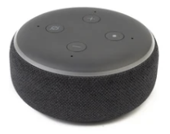
What is A Virtual Intelligent Assistant?
Control devices
“Hey Alexa, turn off bedroom lights”

Slide 5
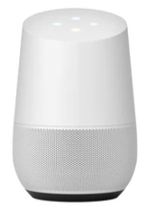
What is A Virtual Intelligent Assistant?
Provide information
“Hey, Google, when does summer start?”
“Summer began on Tuesday, June 21”

Slide 6
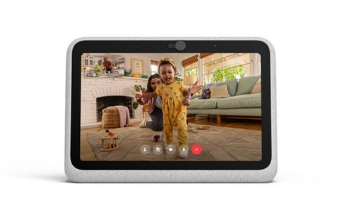
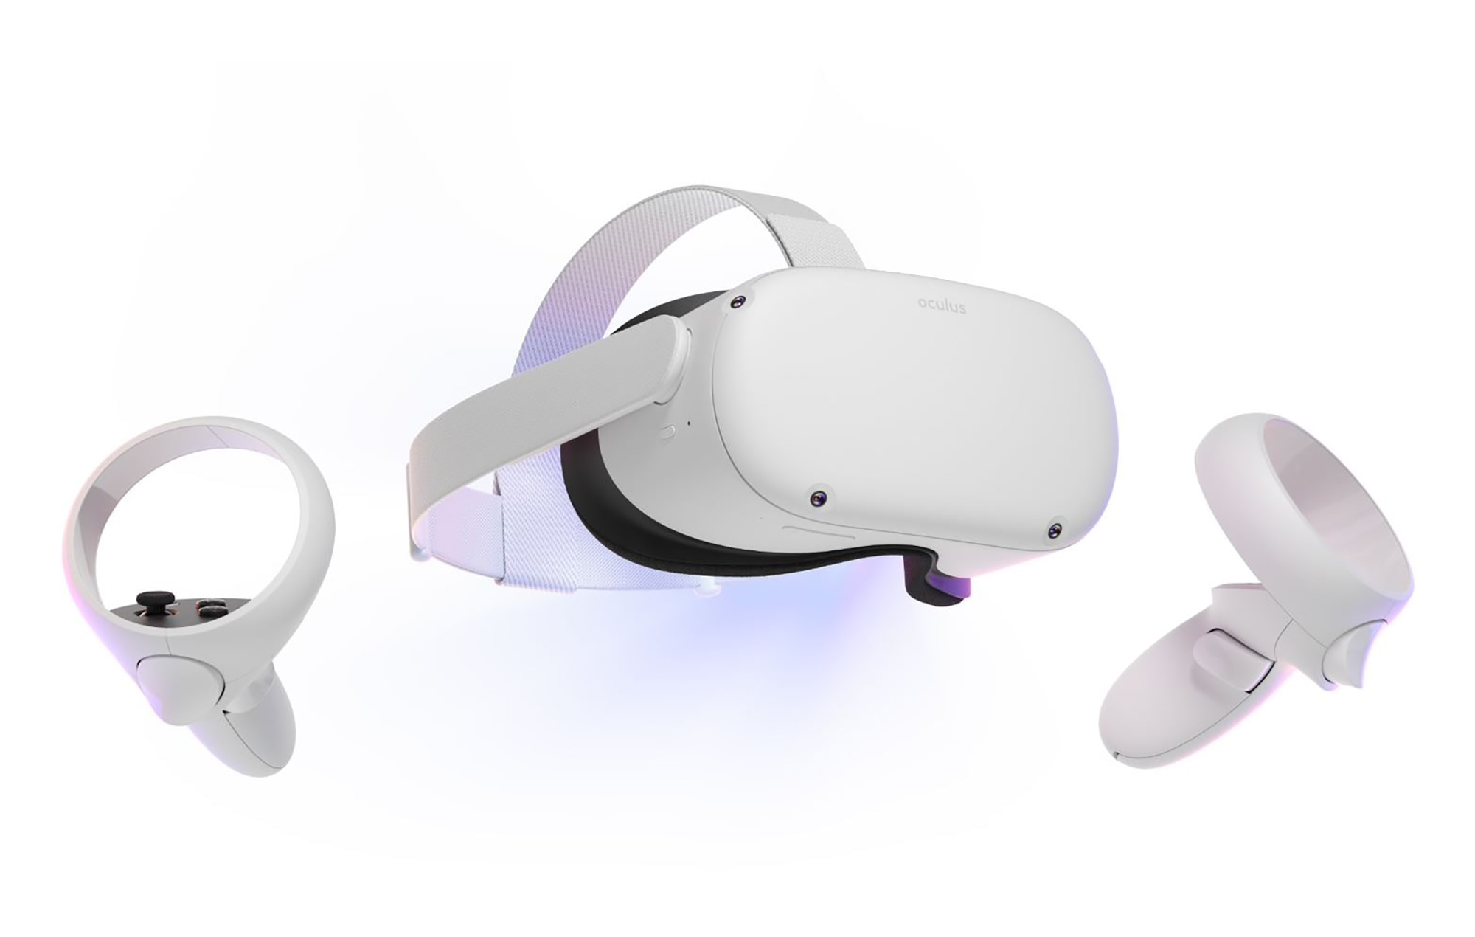
Meta’s Assistant
Empowering connection to people and experiences in your life
Facebook Portal
“Hey Portal”
- Hop on a call hands-free
- Get help with music, timers, alarms, weather, show photos from your Facebook profile, and more.
Meta Quest 2
“Hey Facebook” (double press the button on your controller)
“Who’s online?”--meet up with friends
“Open Beat Saber”--jump straight in the game, and more.
Ray-Ban Stories
“Hey Facebook, take a picture” --capture moments hands-free
“Hey Facebook”--call friends on Messenger, manage device settings, and more.

Slide 7
Montage by Ray-Ban Stories
Empowering connection to people and experiences in your life

Slide 8
What is An Ideal Assistant?
Follow instructions
Know your needs
Capable
Knowledgeable

Slide 9
What is An Ideal Virtual Intelligent Assistant?
An intelligent assistant should be an agent that knows you and the world, can receive your requests or predict your needs, and provide you the right services at the right time with your permission.

Slide 10
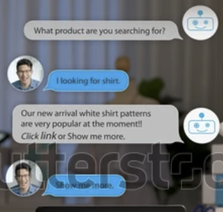
Three Generations of Intelligent Assistant
V0.1 Chatbot
Text input
V1. Voice Asst
Voice input
V2. AR/VR Asst
Voice + Visual + Context

Slide 11
Structure of the Talk
Outline
What is an Intelligent Assistant?
Techniques to support current intelligent assistants
Challenges and initial solutions for the next generation of intelligent assistants
Goals
Introduce you the interesting research problems for Intelligent Assistants
Impress you with the important roles KGs play for Intelligent Assistants
Invite you to open new doors to build next-generation Intelligent Assistants

Slide 12
Technologies to Support Current Intelligent Assistants

Slide 13
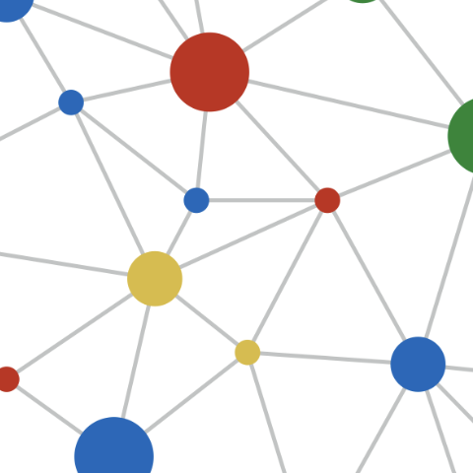
Two Types of Commands to Intelligent Assistants
Intelligent Assistant
E.g., Set a timer
Apps
E.g., Turn on lights
Devices
E.g., When is Easter?
KG/Web

Slide 14
Two Types of Commands to Intelligent Assistants
Task driven
Intelligent Assistant
E.g., Set a timer
Apps
E.g., Turn on lights
Devices
E.g., When is Easter?
KG/Web
Info driven

Slide 15
Int. Asst. Is Essentially a Conversation System
Intelligent Assistant
{Intent: DEVICE_TURNON; Device: Lights #1}
“Turn on lights”
Apps
ASR (Automatic Speech Recognizer)
NLU (Natural Lang. Understanding)
Dialog State Tracker
{Agent: SMART_LIGHT;
Action: TURN_ON; Device: Lights #1}
{ActType: TURNON; Device: Lights #1;
Status: Off}
{ActType: TURNON; Device: Lights #1;
Status: On}
Devices
“Lights turned on”
{Status: SUCCESS}
TTS (Text-To -Speech Synthesizer)
NLG (Natural Language Generator)
Dialog Policy
KG/Web
One round: Confirmation

Slide 16
Int. Asst. Is Essentially a Conversation System
Intelligent Assistant
{Intent: DEVICE_TURNON; Device: ??}
Rnd 1. “Turn on lights”
Apps
ASR (Automatic Speech Recognizer)
NLU (Natural Lang. Understanding)
Dialog State Tracker
{ActType: TURNON}
Devices
“Which lights to turn on?”
{Status: MISSING_DEVICE}
TTS (Text-To -Speech Synthesizer)
NLG (Natural Language Generator)
Dialog Policy
KG/Web
One round: Confirmation
Two rounds: Clarification questions

Slide 17
Int. Asst. Is Essentially a Conversation System
Intelligent Assistant
Rnd 2. “Bedroom lights”
{Device: Lights #2}
Apps
ASR (Automatic Speech Recognizer)
NLU (Natural Lang. Understanding)
Dialog State Tracker
{Agent: SMART_LIGHT;
Action: TURN_ON; Device: Lights #2}
{ActType: TURNON}
{ActType: TURNON; Device: Lights #2;
Status: On}
Devices
“Bedroom lights are turned on”
{Status: SUCCESS}
TTS (Text-To -Speech Synthesizer)
NLG (Natural Language Generator)
Dialog Policy
KG/Web
One round: Confirmation
Two rounds: Clarification questions

Slide 18
Int. Asst. Is Essentially a Conversation System
Intelligent Assistant
{Intent: DEVICE_DIM; Device: Lights #2}
Rnd 3. “Dim the lights”
Apps
ASR (Automatic Speech Recognizer)
NLU (Natural Lang. Understanding)
Dialog State Tracker
{Agent: SMART_LIGHT;
Action: DIM; Device: Lights #2}
{ActType: DIM; Device: Lights #2;
Status: On}
Devices
“Bedroom lights are dimmed to 5”
{Status: SUCCESS}
TTS (Text-To -Speech Synthesizer)
NLG (Natural Language Generator)
Dialog Policy
KG/Web
One round: Confirmation
Two rounds: Clarification questions
Multi rounds: Follow-up requests

Slide 19
Int. Asst. Is Essentially a Conversation System
Intelligent Assistant
Rnd 4. “How many people does it take to change its bulb?”
Apps
ASR (Automatic Speech Recognizer)
NLU (Natural Lang. Understanding)
Dialog State Tracker
Devices
“Three. One to hold the bulb and two to turn the ladder.”
TTS (Text-To -Speech Synthesizer)
NLG (Natural Language Generator)
Dialog Policy
KG/Web
One round: Confirmation
Two rounds: Clarification questions
Multi rounds: Follow-up requests

Slide 20
Int. Asst. Is Essentially a Conversation System
Intelligent Assistant
Understanding
Planning
Apps
ASR (Automatic Speech Recognizer)
NLU (Natural Lang. Understanding)
Dialog State Tracker
Devices
Responding
TTS (Text-To -Speech Synthesizer)
NLG (Natural Language Generator)
Dialog Policy
KG/Web

Slide 21
Int. Asst. Is Essentially a Conversation System
Intelligent Assistant
Speech
Dialog
Apps
ASR (Automatic Speech Recognizer)
NLU (Natural Lang. Understanding)
Dialog State Tracker
Devices
TTS (Text-To -Speech Synthesizer)
NLG (Natural Language Generator)
Dialog Policy
KG/Web

Slide 22
Int. Asst. Is Essentially a Conversation System
Variation 1
Intelligent Assistant
Speech
E2E Dialog
Apps
ASR (Automatic Speech Recognizer)
NLU (Natural Lang. Understanding)
Dialog State Tracker
Devices
TTS (Text-To -Speech Synthesizer)
NLG (Natural Language Generator)
Dialog Policy
KG/Web

Slide 23
Int. Asst. Is Essentially a Conversation System
Variation 2
Meta-Assistant
Speech
Dialog
Specialized Assistants
ASR (Automatic Speech Recognizer)
NLU (Natural Lang. Understanding)
Dialog State Tracker
TTS (Text-To -Speech Synthesizer)
NLG (Natural Language Generator)
Dialog Policy

Slide 24
Related Research Areas
KG, QA, Information Retrieval
Intelligent Assistant
Speech
Dialog
Apps
ASR (Automatic Speech Recognizer)
NLU (Natural Lang. Understanding)
Dialog State Tracker
Conversational AI
(Semantic parsing, Entity linking, Co-referencing, Dialog status tracking, lang gen, etc.)
Devices
Speech Recognition
TTS (Text-To -Speech Synthesizer)
NLG (Natural Language Generator)
Dialog Policy
KG/Web

Slide 25
The Role of KGs to Support Intelligent Assistants
Intelligent Assistant
Speech
Dialog
Apps
ASR (Automatic Speech Recognizer)
NLU (Natural Lang. Understanding)
Dialog State Tracker
Devices
Personal KG
TTS (Text-To -Speech Synthesizer)
NLG (Natural Language Generator)
Dialog Policy
KG/Web
Public KG

Slide 26
What Can Be Improved?
How to increase accuracy?
How to allow easy scale-up to new tasks, new domains, and new languages?
How to make the multi-turn conversations smoother?
How to make the assistants a know-it-all?
etc.

Slide 27
Ideal Assistant Revisited–Missing Pieces
An intelligent assistant should be an agent that knows you and the world, can receive your requests or predict your needs, and provide you the right services at the right time with your permission.

Slide 28
Challenges and Initial Solutions to Next-Generation AR/VR Assistants

Slide 29
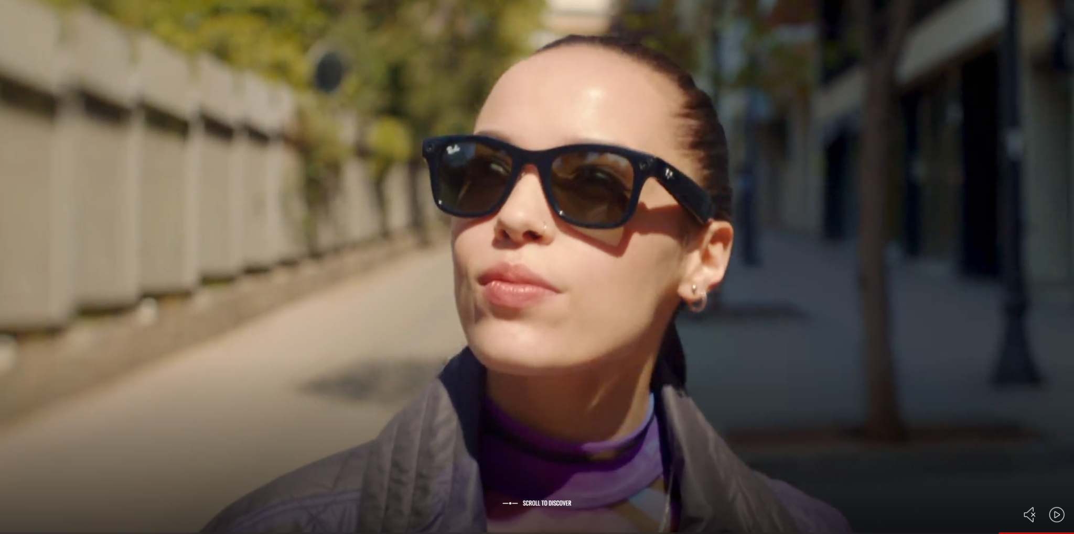
What Is Different for An AR/VR Assistant?
You see through it
You wear it everywhere
May not have connection
You wear for a long time

Slide 30
From Voice-Only to Multi-Modal
“How tall is Empire State Building?”
“What’s the name of this building and how tall is it?”

Slide 31
From Context-Agnostic to Context-Aware
“Show my shopping list”
“Remember to buy apples and bananas at the grocery store around the corner”

Slide 32
From Reactive to Proactive
“What’s the weather today?”
“Today is sunny, 70 degree. Would you like to play your favorite morning music?”

Slide 33
From Server-Side to On-Device
+ Privacy!!!

Slide 34
Direction 1. On-Device Machine Learning
Intelligent Assistant
Speech
Dialog
Apps
ASR (Automatic Speech Recognizer)
NLU (Natural Lang. Understanding)
Dialog State Tracker
Devices
TTS (Text-To -Speech Synthesizer)
NLG (Natural Language Generator)
Dialog Policy
KG/Web
On-device Learning

Slide 35
Direction 1. On-Device Machine Learning
Traditional Autoregressive Semantic Parsing
Pros
High accuracy
Cons: Prohibitively expensive
⇒ Server-side modeling
Flaky user experiences w. spotty internet connectivity
High latency
Compromised user data privacy
Seq2seq
Akshat Shrivastava, et al. Span pointer networks for non-autoregressive task-oriented semantic parsing. EMNLP 2021.

Slide 36
Direction 1. On-Device Machine Learning
Non-Autoregressive Semantic Parsing: Parallel prediction
Seq2seq
Akshat Shrivastava, et al. Span pointer networks for non-autoregressive task-oriented semantic parsing. EMNLP 2021.

Slide 37
Direction 1. On-Device Machine Learning
Non-Autoregressive Semantic Parsing: Parallel prediction
Seq2seq
Akshat Shrivastava, et al. Span pointer networks for non-autoregressive task-oriented semantic parsing. EMNLP 2021.

Slide 38
Direction 1. On-Device Machine Learning
Non-Autoregressive Semantic Parsing: Parallel prediction
Seq2seq
Akshat Shrivastava, et al. Span pointer networks for non-autoregressive task-oriented semantic parsing. EMNLP 2021.

Slide 39
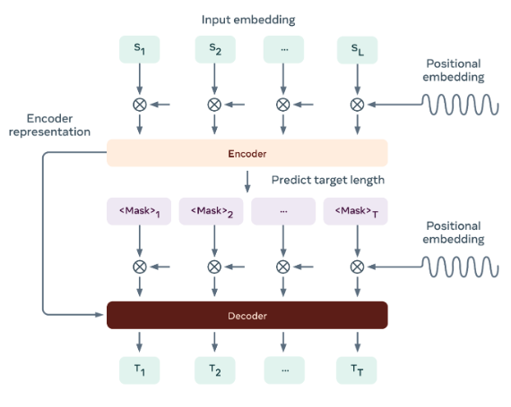
Direction 1. On-Device Machine Learning
Akshat Shrivastava, et al. Span pointer networks for non-autoregressive task-oriented semantic parsing. EMNLP 2021.

Slide 40
Direction 1. On-Device Machine Learning
Memory usage: -83%
Latency: -70%
Quality: +1.2% vs. non-AutoRegressive STOA
Cross-lingual: +14% vs. AutoRegressive baseline
Akshat Shrivastava, et al. Span pointer networks for non-autoregressive task-oriented semantic parsing. EMNLP 2021.

Slide 41
Direction 2. Multi-Modal Assistant
Intelligent Assistant
Understanding
Planning
Apps
ASR
Multi-modal Understanding
Dialog State Tracker
CV (Comp. Vision)
Devices
Responding
TTS
NLG
Dialog Policy
KG/Web
Others
Image Gen
Computer
Vision
Multi-modal Conversation

Slide 42
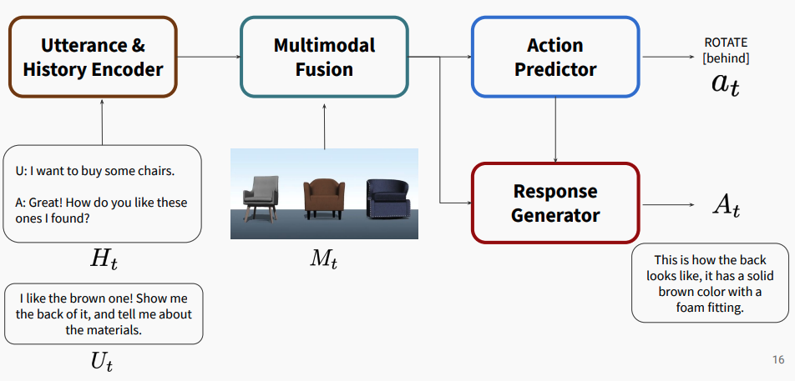
Direction 2. Multi-Modal Assistant
Seungwhan Moon, et al., Situated and interactive multimodal conversations. COLING, 2020.

Slide 43
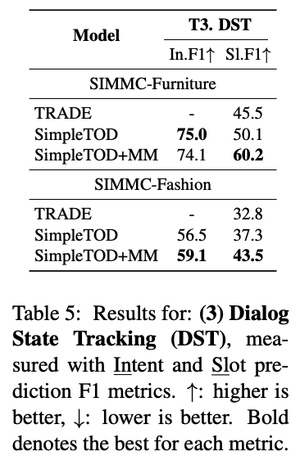
Direction 2. Multi-Modal Assistant
The MultiModal model improves intent classification and slot filling.
Seungwhan Moon, et al., Situated and interactive multimodal conversations. COLING, 2020.

Slide 44
Direction 3. Context-Aware Assistant
Intelligent Assistant
Understanding
Context-Aware Planning
Apps
ASR
Multi-modal & Context-aware Understanding
Dialog State Tracker
CV
Devices
Context
Responding
TTS
NLG
Dialog Policy
KG/Web
Others
Image Gen
Contextual AI

Slide 45
Direction 3. Context-Aware Assistant
Context-aware assistants - examine your surroundings, and - use this context to personalize a product experience.

Slide 46
Direction 3. Context-Aware Assistant
Context-aware assistants - examine your surroundings, and - use this context to personalize services
Context (Time, Location, Scene, Activity, Event, etc.)
When is it?
Where are you?
What are you doing?
Whom are you together with?
What’s surrounding you?

Slide 47
Direction 3. Context-Aware Assistant
Context-aware assistants - examine your surroundings, and - use this context to personalize services
Context (Time, Location, Scene, Activity, Event, etc.)
Agents
Improving reactive services
Enabling proactive services
When is it?
Where are you?
What are you doing?
Whom are you together with?
What’s surrounding you?
Context-aware ranking
Contextual recommendation
Contextual reminder, etc.

Slide 48
Direction 3. Context-Aware Assistant
Context-aware assistants - examine your surroundings, and - use this context to personalize services
Context (Time, Location, Scene, Activity, Event, etc.)
Agents
Improving reactive services
Enabling proactive services
When is it?
Where are you?
What are you doing?
Whom are you together with?
What’s surrounding you?
Context-aware ranking
Contextual recommendation
Contextual reminder, etc.

Slide 49
Direction 3. Context-Aware Assistant
(2020-) Contextual Adaptation
(2000-2020) Statistical Learning
(1980-2000) Handcrafted Knowledge
Reference: A DARPA Perspective on Artificial Intelligence

Slide 50
Direction 4. Assistant Recom.
Intelligent Assistant
Understanding
Context-Aware Planning
Apps
ASR
Multi-modal & Context-aware Understanding
Dialog State Tracker
CV
Devices
Context
Proactive Trigger
Responding
TTS
NLG
Dialog Policy
KG/Web
Others
Image Gen
Personalization, Federated Learning

Slide 51
Direction 4. Assistant Recommendation
Reactive conversational
recommendation
Proactive service
recommendation
Personal knowledge (preferences, routines, etc.)
Challenges: Leveraging personal action log, preferences, routines, etc., to improve context-aware recommendation w/o sacrificing privacy.

Slide 52
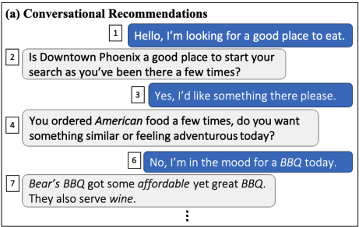
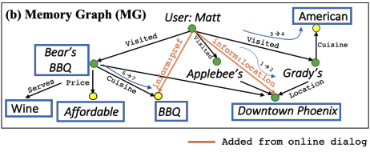
4-1. Conversational Recommendation
Personal KG
Public KG
Hu Xu, Seungwhan Moon, Honglei Liu, Bing LIu, Pararth Shah, Bing Liu, Philip S. Yu. User memory reasoning for conversational recommendation. COLING 2020.

Slide 53
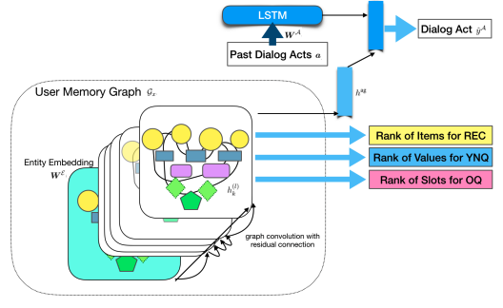
4-1. Conversational Recommendation
Hu Xu, Seungwhan Moon, Honglei Liu, Bing LIu, Pararth Shah, Bing Liu, Philip S. Yu. User memory reasoning for conversational recommendation. COLING 2020.

Slide 54
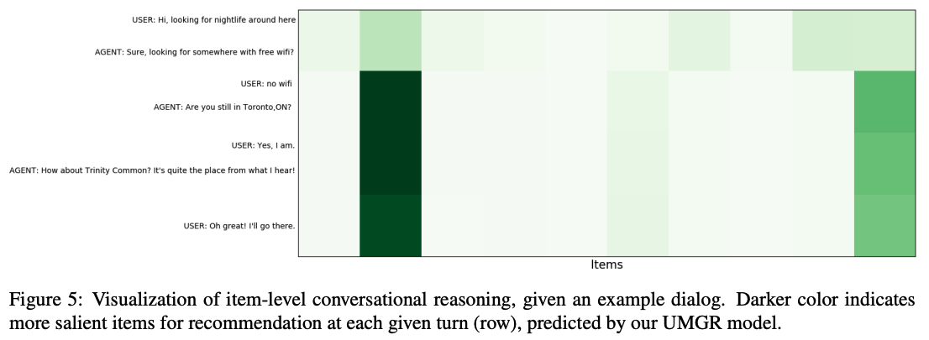
4-1. Conversational Recommendation
Hu Xu, Seungwhan Moon, Honglei Liu, Bing LIu, Pararth Shah, Bing Liu, Philip S. Yu. User memory reasoning for conversational recommendation. COLING 2020.

Slide 55
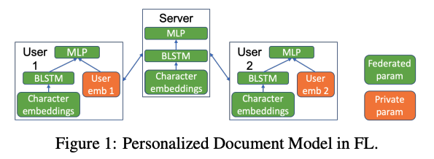
4-2. Federated Learning
Push data to model → Push models to data
Duc Bui, Kshitiz Malik, Jack Goetz, Honglei Liu, Seungwhan Moon, Anuj Kumar, Kang G. Shin. . Federated user representation learning. ArXiv, 2019

Slide 56
Recap: New Architecture & Research Areas
Intelligent Assistant
Understanding
Context-Aware Planning
Apps
ASR
Multi-modal & Context-aware Understanding
Dialog State Tracker
CV
Devices
Context
Proactive Trigger
Responding
TTS
NLG
Dialog Policy
KG/Web
Others
Image Gen
Computer
Vision
Multi-modal Conversation
Contextual AI
On-device Learning, Personalization, Federated Learning

Slide 57
Research Problems for KGs
How to leverage KGs for on-device ML?
How to link visual input to KG entities for multi-modal conversations?
How to leverage KGs to best understand contexts?
How to leverage public and personal KGs to improve context-aware recommendation w/o sacrificing privacy?

Slide 58
Take-Aways
An intelligent assistant should be an agent that knows you and the world, can receive your requests or predict your needs, and provide you the right services at the right time with your permission
An intelligent assistant is essentially a conversation system, task-driven or information-driven
Next-generation AR/VR assistants require new research on on-device learning, multi-modal, contextual AI, federated learning, etc.
Public and personal KGs play critical roles to make intelligent assistants knowledgeable

Slide 59
Thank You
Q&A?

