Slide 1
Next-Generation Intelligent Assistants
for Wearable Devices
This talk does not represent the company’s point of view
Xin Luna Dong, Meta Reality Labs
SigKDD ADS Invited Talk, 8/2024

Slide 2
Everyone Deserves An Assistant

Slide 3
What is An Ideal Assistant?
Follow instructions
Know your needs
Capable
Knowledgeable

Slide 4
What is An Ideal Virtual Intelligent Assistant?
An intelligent assistant should be an agent that knows you and the world, can receive your requests or predict your needs, and provide you the right services at the right time with your permission.

Slide 5
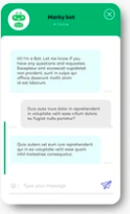
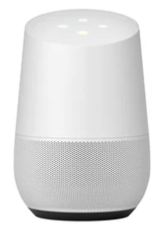
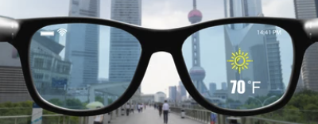
Stages of Intelligent Assistants
I. Chatbot
Text input
II. Voice Asst
Voice input
III. Wearable Asst
Voice + Visual + Context

Slide 6
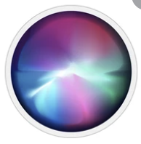
An Intelligent Voice Assistant
Respond to commands
“Hey Siri, set a timer to 7pm”
“Ok, added to today’s reminders”

Slide 7
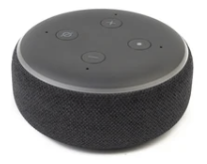
An Intelligent Voice Assistant
Control devices
“Hey Alexa, turn off bedroom lights”

Slide 8
An Intelligent Voice Assistant
Provide information
“Hey, Google, what’s the weather?”
“The weather at X is partly cloudy, 30-44 degree Fahrenheit”

Slide 9
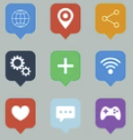
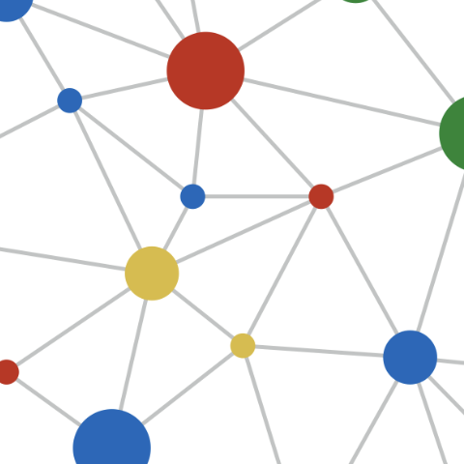
Assistant Architecture—A Conversation System
Intelligent Assistant
{Intent: DEVICE_TURNON; Device: Lights #1}
“Turn on lights”
Apps
ASR (Automatic Speech Recognizer)
NLU (Natural Lang. Understanding)
Dialog State Tracker
{Agent: SMART_LIGHT;
Action: TURN_ON; Device: Lights #1}
{ActType: TURNON; Device: Lights #1;
Status: Off}
{ActType: TURNON; Device: Lights #1;
Status: On}
Devices
“Lights turned on”
{Status: SUCCESS}
TTS (Text-To -Speech Synthesizer)
NLG (Natural Language Generator)
Dialog Policy
KG/Web
One round: Confirmation

Slide 10
Older-Generation Assistant vs. Ideal Assistant
An intelligent assistant should be an agent that knows you and the world, can receive your requests or predict your needs, and provide you the right services at the right time with your permission.
Older-generation assistants are essentially an interface to existing features served in a reactive fashion

Slide 11
Stages of Intelligent Assistant
I. Chatbot
Text input
II. Voice Asst
Voice input
III. Wearable Asst
Voice + Visual + Context

Slide 12
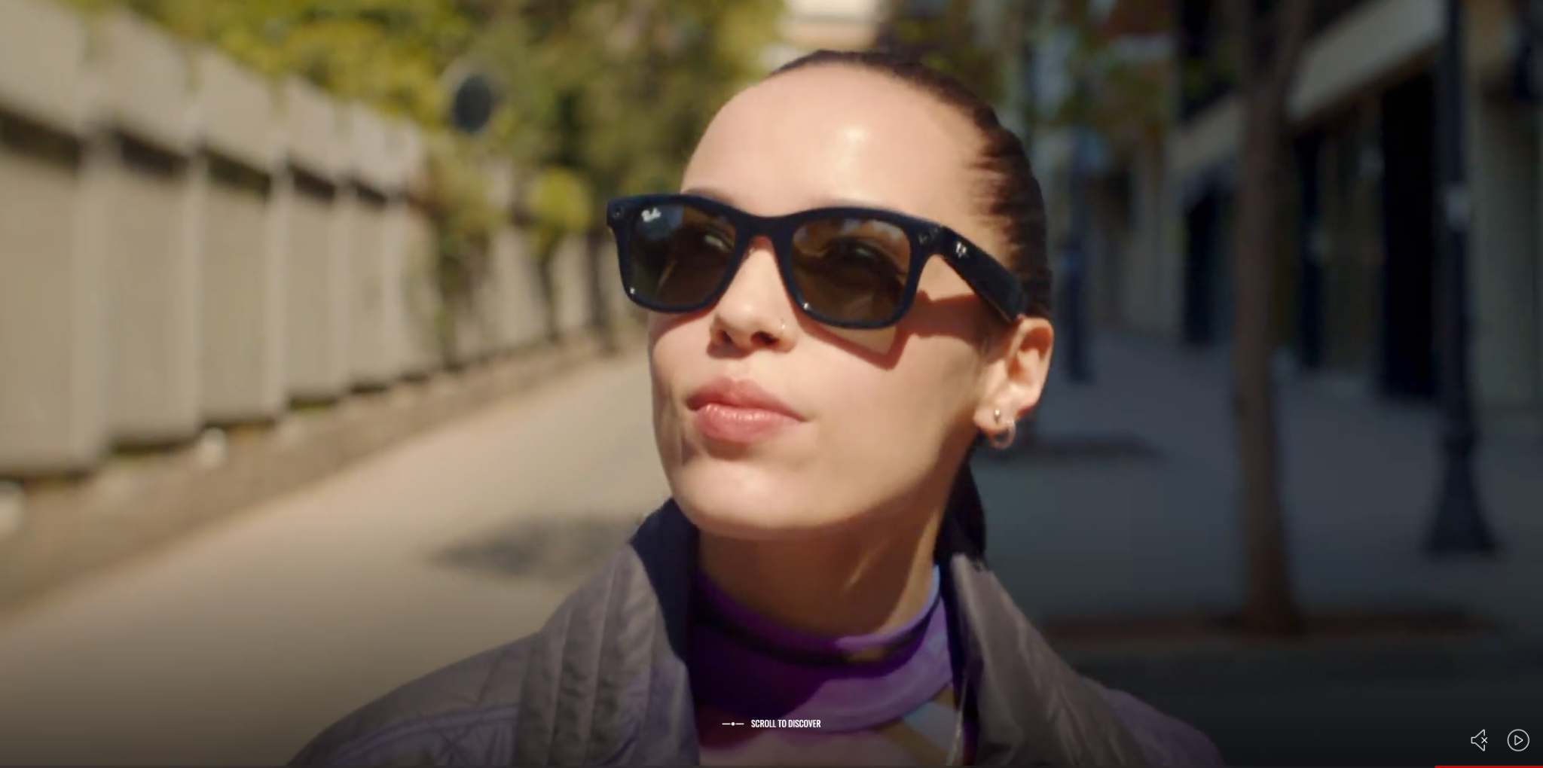
What Is Different for A Wearable Assistant?
You see through it
You wear it everywhere
You learn from it
You wear for a long time

Slide 13
From Voice-Only to Multi-Modal
“How tall is Empire State Building?”
“What’s the name of this Cathedral and when will it be finished?”

Slide 14
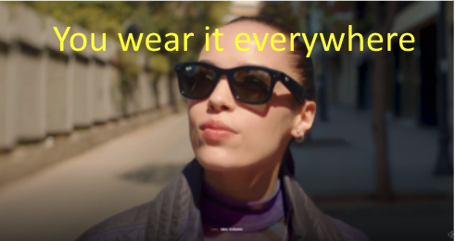
From Context-Agnostic to Context-Aware
“Show my shopping list”
“Remember to buy apples and bananas at the grocery store around the corner”

Slide 15
From Reactive to Proactive & Personalized
“What’s the weather today?”
“Today is sunny, 70 degree. Would you like to play your favorite morning music?”

Slide 16
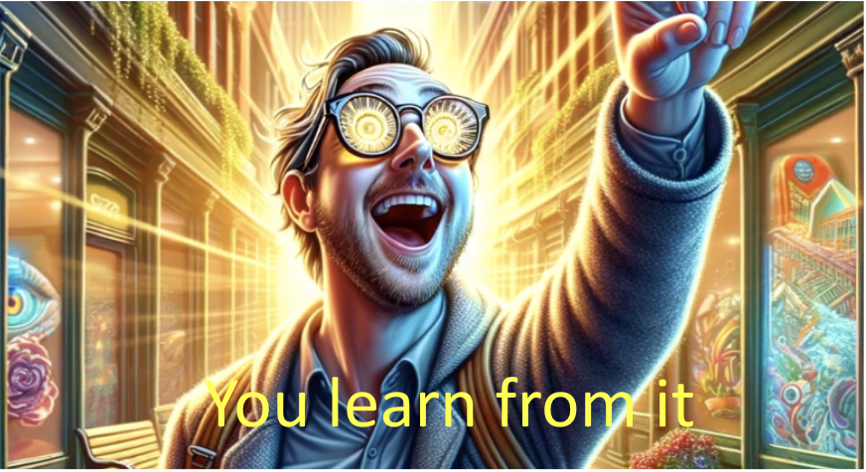
From An Interface to A Know-It-All
“What’s the weather in Barcelona?”
“I’m visiting Barcelona next week. What shall I prepare?”

Slide 17
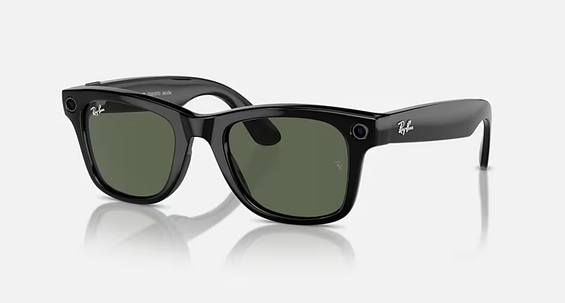
Ray-ban Meta
Video (0:24, 4:22)

Slide 18
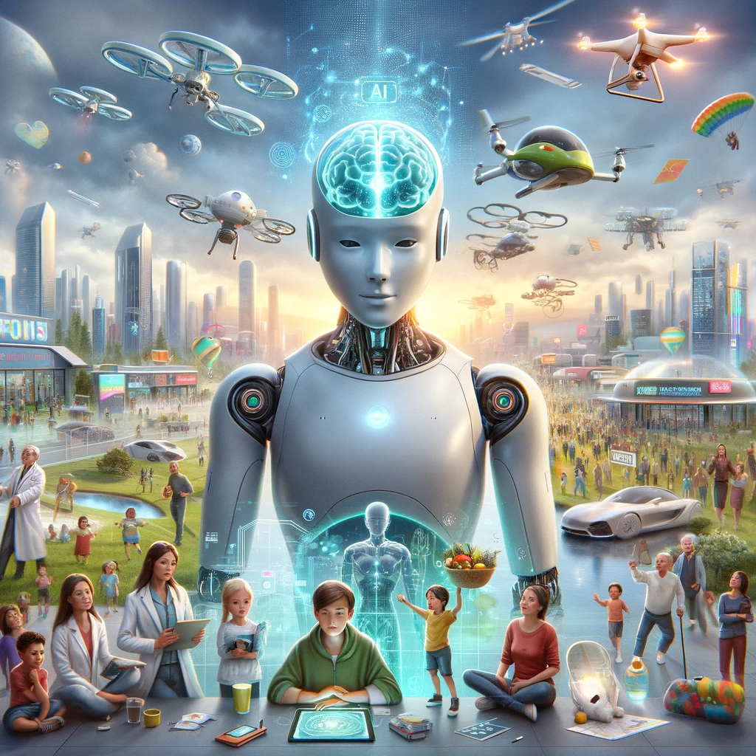
What Are Key Technical Enablers?
LLM

Slide 19
Pillars for Next-Generation Assistants
Multi-modal Assistant
Knowledge
Augmentation (Web, KG, Real-time APIs, Social network)
Multi-Modal
Personalization
(Memory search, Personalization)
Visual Understanding
Scene Text Recognition
Contextualization
Text LLM
Voice Assistant

Slide 20
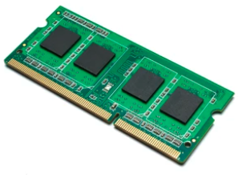
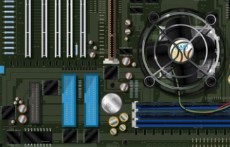
Hardware Constraints for Wearable Assistants
Memory
Battery
Thermal

Slide 21
Technical Enablers to Next-Generation Assistants
Series of Optimizations
Core Solution

Slide 22
Direction 1. Knowledge Augmentation
Multi-modal Assistant
Knowledge
Augmentation (Web, KG, Real-time APIs, Social network)
Multi-Modal
Personalization
(Memory search, Personalization)
Scene Text Recognition
Visual Understanding
Contextualization
Text LLM
Voice Assistant

Slide 23
Question Answering Examples
User Ask | Assistant Answer
What are visa requirements for visiting Barcelona? | If you plan to visit Barcelona, Spain, the visa requirements depend on your nationality and the duration of your stay. Here are the general guidelines: …
Where should I visit in Barcelona? | Barcelona is a vibrant city with a rich history, stunning architecture, and a lively cultural scene. Here are some must-visit places in Barcelona:...
S. Moon, A. Madotto, Z. Lin, T. Nagarajan, et al. AnyMAL: An efficient and scalable any-modality augmented language model. arXiv, 2023.

Slide 24
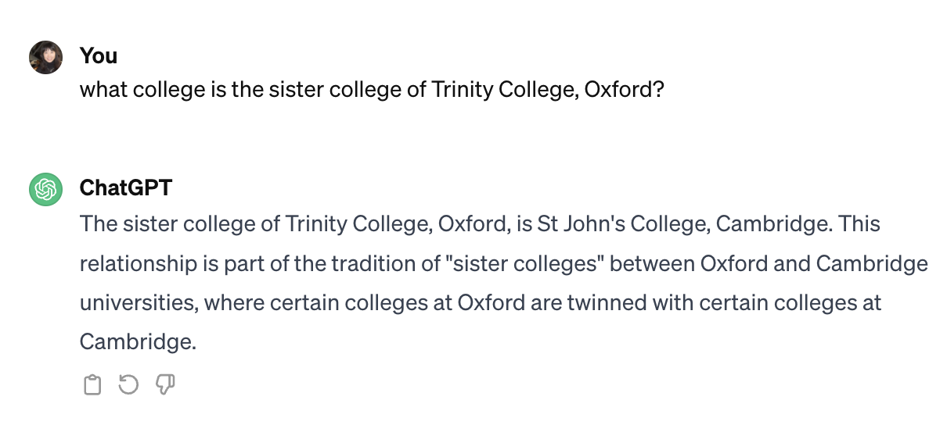
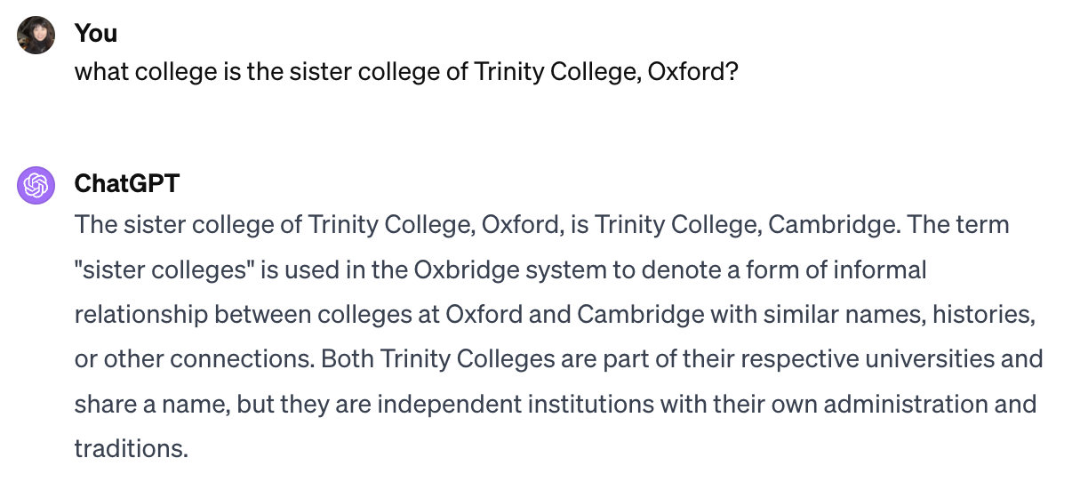
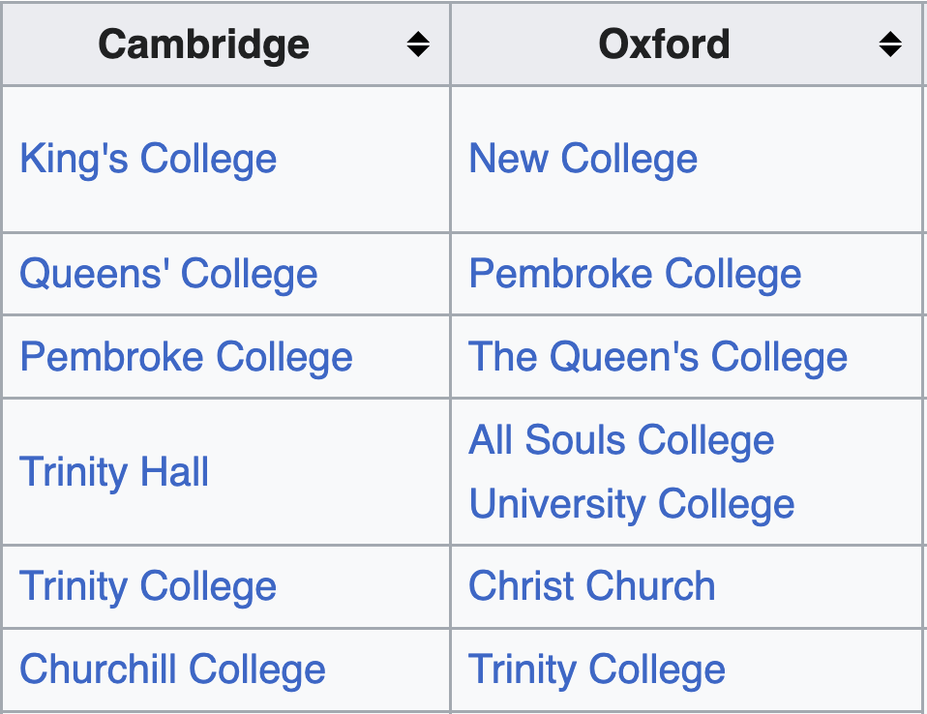
Meme 1. LLMs Can Answer All Our Questions
Ground truth

Slide 25
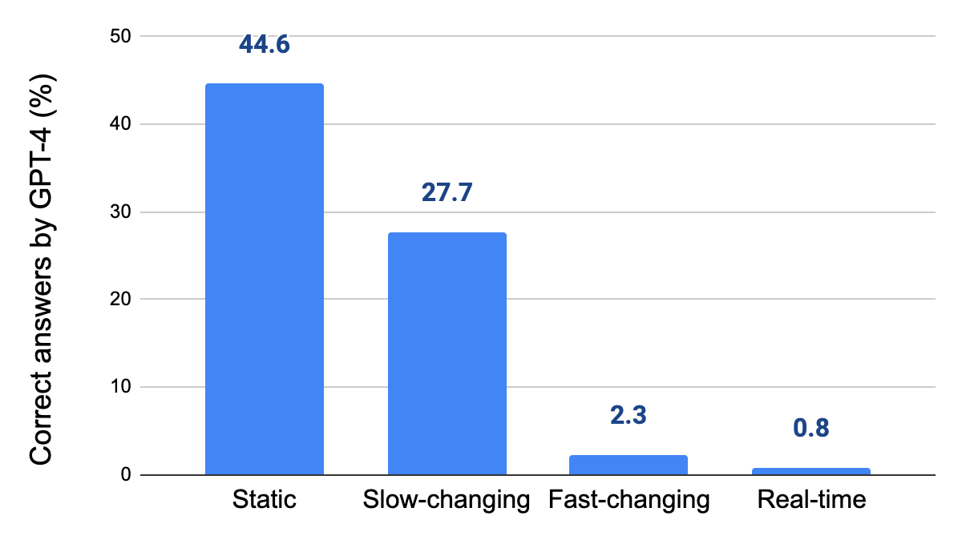
LLM QA for Facts of Different Dynamisms
Very low accuracy for fast changing facts
Low accuracy even for static and slow-changing facts
Vu, Iyyer, Wang, Constant, Wei, Wei, Tar, Sung, Zhou, Le, Luong. FreshLLMs: Refreshing LLMs with Search Engine Augmentation. arXiv, 2023. Xiao Yang, Kai Sun, Hao Xin, Yushi Sun, et al. CRAG–Comprehensive RAG Benchmark. arXiv, 2024.

Slide 26
LLM QA for Facts of Different Dynamisms
Very low accuracy for fast changing facts
Low accuracy even for static entities
Vu, Iyyer, Wang, Constant, Wei, Wei, Tar, Sung, Zhou, Le, Luong. FreshLLMs: Refreshing LLMs with Search Engine Augmentation. arXiv, 2023. Xiao Yang, Kai Sun, Hao Xin, Yushi Sun, et al. CRAG–Comprehensive RAG Benchmark. arXiv, 2024.

Slide 27
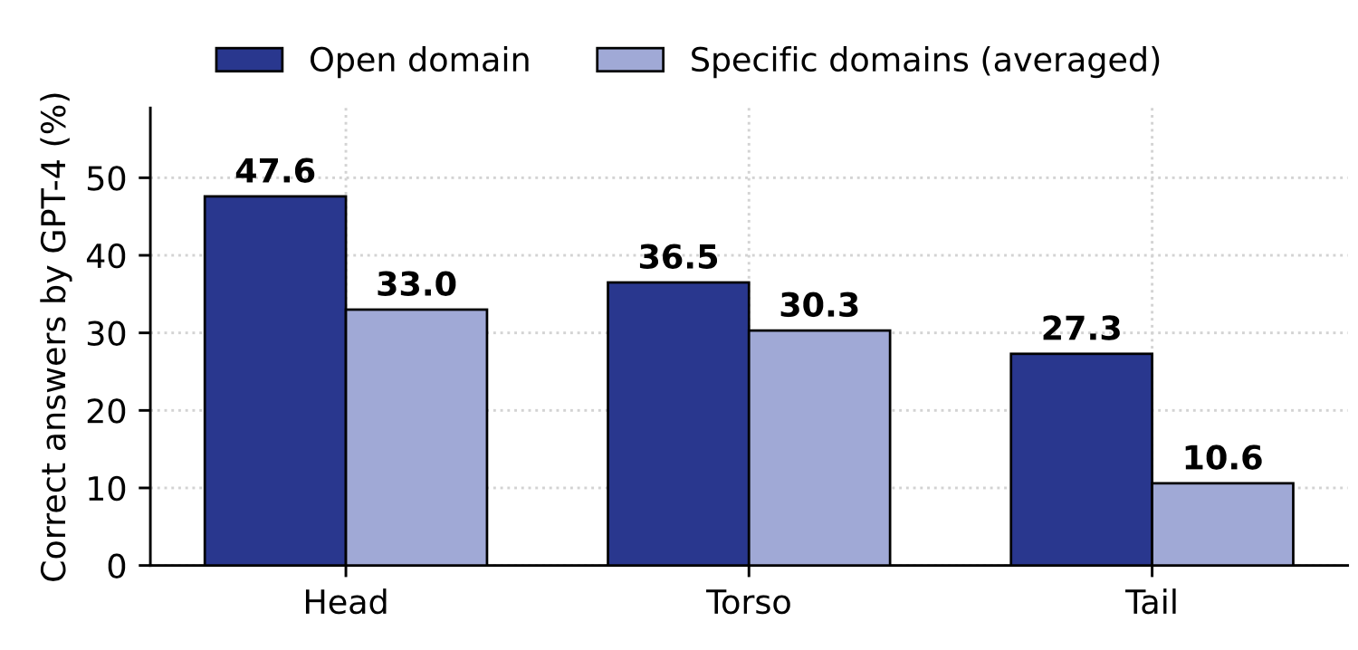
LLM QA for Entities of Different Popularities
Low accuracy even for popular entities
Sun et al. Head-to-Tail: How Knowledgeable are Large Language Models (LLM)?A.K.A. Will LLMs Replace Knowledge Graphs? NAACL, 2024.

Slide 28
LLM QA for Entities of Different Popularities
Low accuracy even for popular entities
Sun et al. Head-to-Tail: How Knowledgeable are Large Language Models (LLM)?A.K.A. Will LLMs Replace Knowledge Graphs? NAACL, 2024.

Slide 29
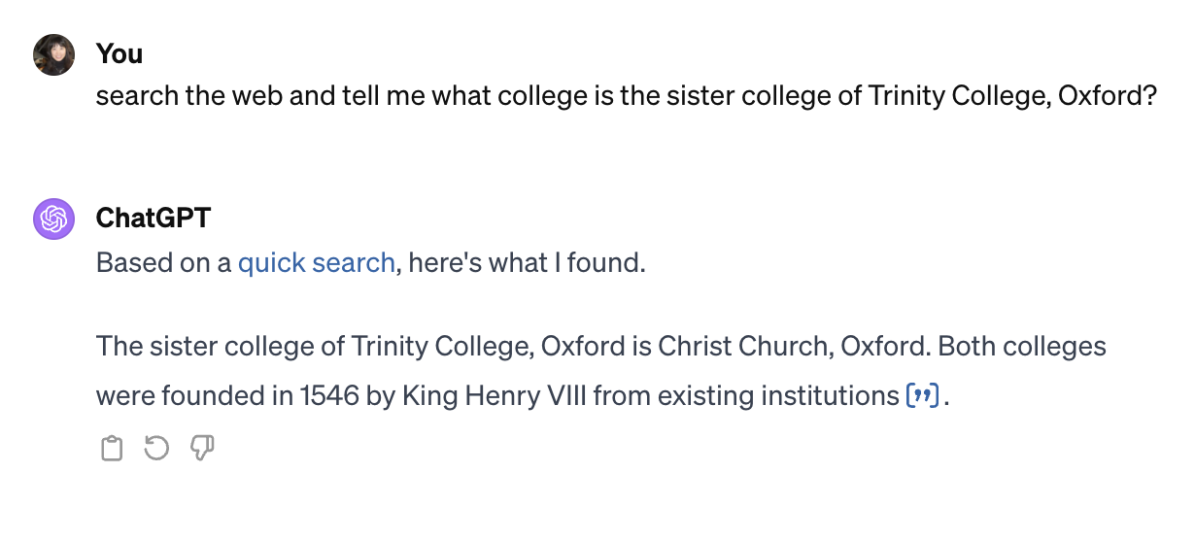
Meme 2. LLM+Web Search Solved the Problem
Ground truth

Slide 30
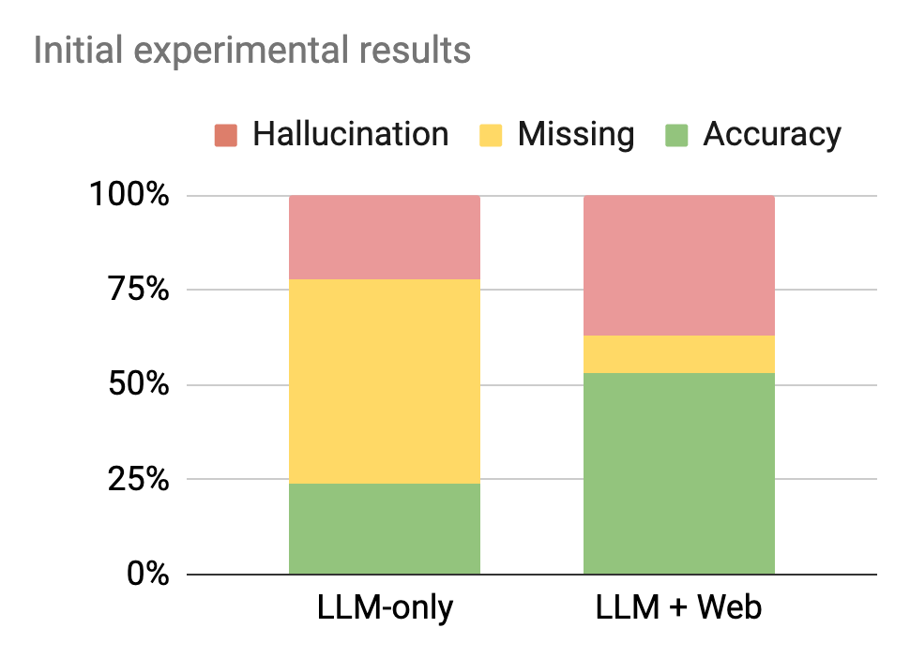
Early RAG Results
Accuracy increased
But more hallucinations

Slide 31
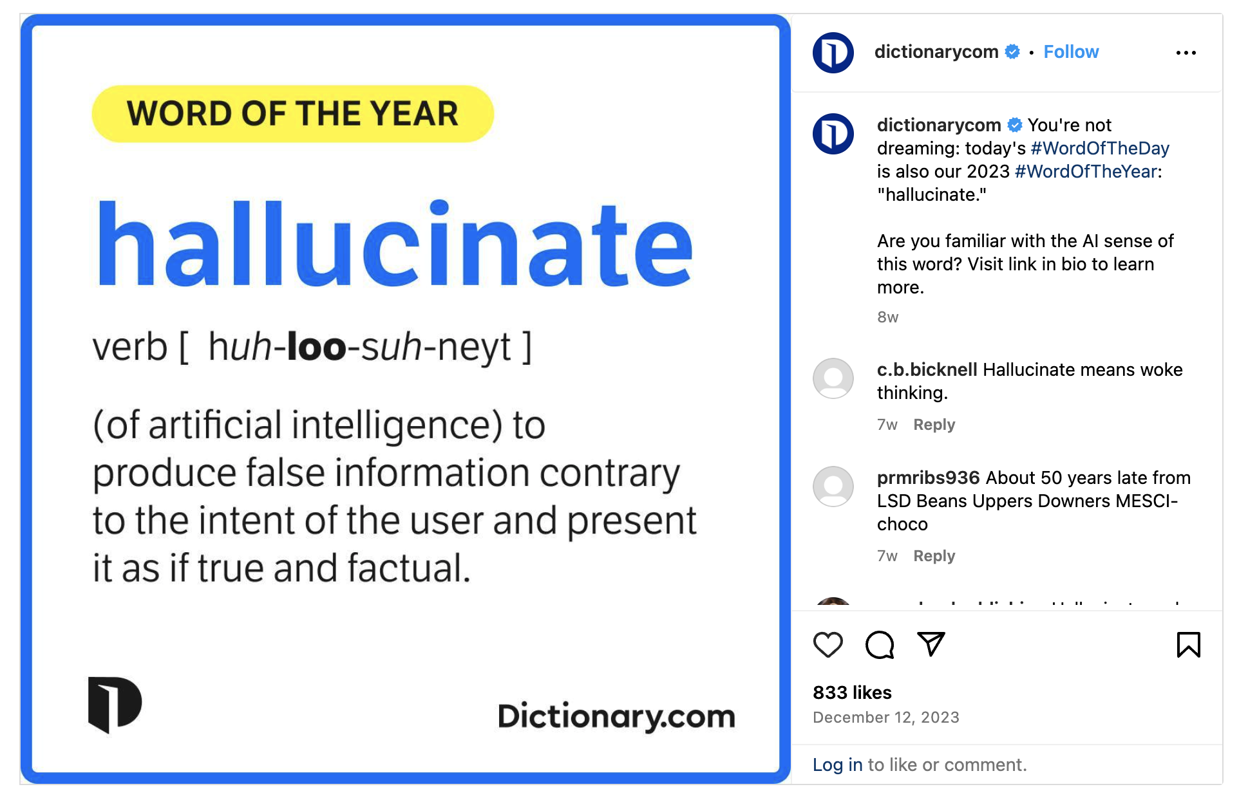

Slide 32
Core Solution: Federated RAG to Leverage KG
Contributions from Web vs. KG Retrieval
In our initial experiment
Key advantages
KG retrieval results, when successful, are precise and concise, allowing >99% answer accuracy
KG retrieval saves latency by >1 sec. An early stopping on web search can cut E2E latency significantly
Sources | Web | KG | Union
Retrieval coverage | 64% | 38% | 77%
Answer accuracy | 91% | 99% | 92%
Latency | ~1300 ms | ~200ms | -

Slide 33
Architecture and Optimizations
#1. Planning: Distill planning to a smaller LLM w. domain specific training examples
#2. Retrieval: Early stop web search w. confident KG output
#3. Summarization: Fine tune LLM to reduce hallucinations, especially on numbers and dates
#4. Latency: Parallelization and relentless optimizations to reduce latency
#5. Metrics: Optimize the right metrics: Truthfulness = Accuracy - HalluRate
Knowledge Grounding Services
LLM Planning
Data Service Plug-ins
Intent Detection
&
Query Rewriting
Planner-and- Executor
Web Search
LLM Summarization
Result Aggregation
Prompt Enrichment
LLM
Knowledge Graph Search
Chitchat call in parallel, and terminate in case the planning phase decide to go to plug-ins

Slide 34
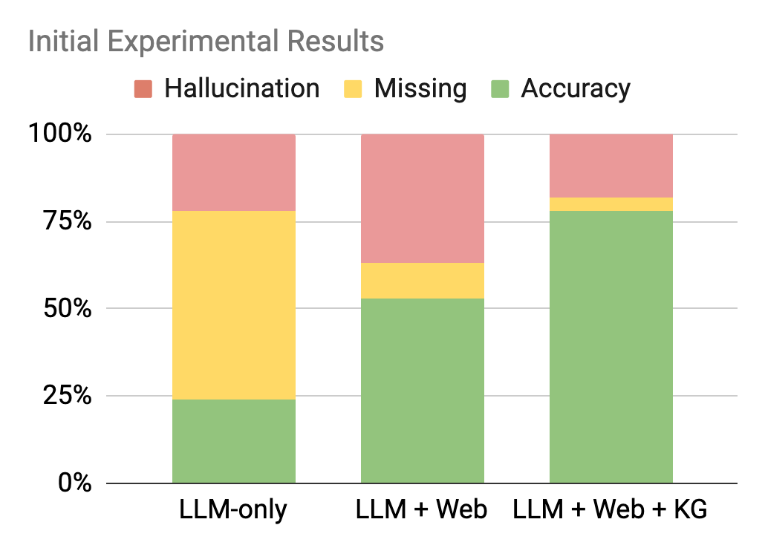
Federated RAG Quality
Accuracy increased
Hallucination NOT sacrificed

Slide 35
2300+ participants, 384 teams, 5600+ submissions
CRAG benchmark paper is listed in Hugging Face "Daily papers"
Lot of media attention

Slide 36
Xiao Yang, Kai Sun, Hao Xin, Yushi Sun, et al. CRAG–Comprehensive RAG Benchmark. arXiv, 2024.

Slide 37
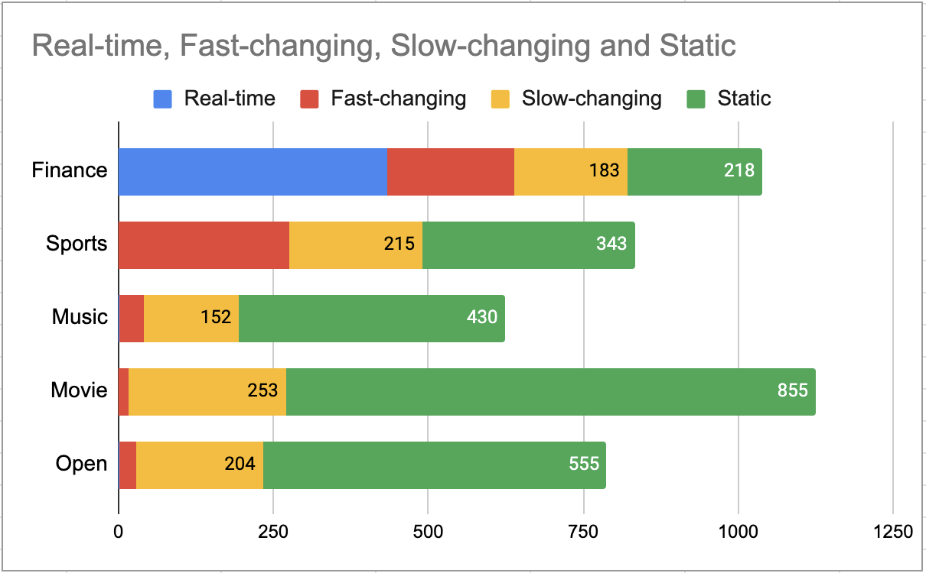
Rich and Insightful Question-Answer Set
4400+ QA pairs from 5 domains (Finance, Sports, Music, Movie, Encyclopedia)
Questions for static, slow-changing, fast-changing, and real-time information
Questions for head, torso, and tail entities
Simple-fact questions and complex questions
434
204
275
Total | Simple | Simple w. Cond | Set | Comparison | Aggregation | Multi-hop | Post- processing | False Premise
4409 | 1205 | 689 | 403 | 546 | 489 | 382 | 180 | 525
Xiao Yang, Kai Sun, Hao Xin, Yushi Sun, et al. CRAG–Comprehensive RAG Benchmark. arXiv, 2024.

Slide 38
Accessible Retrieval Content
220K webpages: 50 webpages for each question from BraveAPI web search
Mock KG: 2.6M entities, 30:1 signal-to-noise ratio
Mock APIs: 38 mock APIs
Reliable Tasks and Evaluation
Task 1: Answer generation over top-5 web search results—Answer Summarization
Task 2: + Mock-KG Search API—Structured Search, Answer Selection
Task 3: + 50 web search results—Search Ranking
Xiao Yang, Kai Sun, Hao Xin, Yushi Sun, et al. CRAG–Comprehensive RAG Benchmark. arXiv, 2024.

Slide 39
Where Are We in the RAG Journey?
Straightforward RAG (9-14%)
CRAG KDD Cups (36%)
*Manual Eval*
LLM-0nly
(3-20%)
Big jump!!
Truthfulness
KDD Cups CRAG Workshop
Tuesday 11am-4:30pm

Slide 40
Where Are We in the RAG Journey?
SOTA Industry RAG (50%)
*Manual Eval
*Diff retrieval pool
Straightforward RAG (9-14%)
CRAG KDD Cups (36%)
*Manual Eval*
LLM-0nly
(3-20%)
Truthfulness

Slide 41
State-of-the-Art Industry Solutions
System | Perfect | Acceptable | Incorrect | Missing | Truthfulness (=Accu-Hallu) | Weighted Truthfulness | Latency (S)
Copilot Pro | 63% | 12% | 18% | 8% | 50.4% | 61% | 11.6
ChatGPT Plus (4o) | 60% | 13% | 25% | 2% | 42% | 42% | 6.2
Gemini Advanced | 61% | 10% | 17% | 13% | 49.5% | 59% | 5.2
Perplexity.ai | 56% | 9% | 25% | 10% | 35% | 46% | 4.6
Meta Wearables | 53% | 10% | 16% | 22% | 41% | 51% | 3.4
Notes: 1. Manual annotations. 2. Retrieval by the SOTA solutions themselves. 3. Weights by question types from real traffic
Perfect < 63%. Still a big gap to fill
Different latency-quality tradeoffs
Xiao Yang, Kai Sun, Hao Xin, Yushi Sun, et al. CRAG–Comprehensive RAG Benchmark. arXiv, 2024.

Slide 42
Direction 2. Multi-Modal Understanding
Multi-modal Assistant
Knowledge
Augmentation (Web, KG, Real-time APIs, Social network)
Multi-Modal
Personalization
(Memory search, Personalization)
Visual Understanding
Scene Text Recognition
Contextualization
Text LLM
Voice Assistant

Slide 43
Direction 2. Multi-Modal Understanding
Multi-modal Assistant
Knowledge
Augmentation (Web, KG, Real-time APIs, Social network)
Multi-Modal
Personalization
(Memory search, Personalization)
Visual Understanding
Scene Text Recognition
Contextualization
Text LLM
Voice Assistant

Slide 44
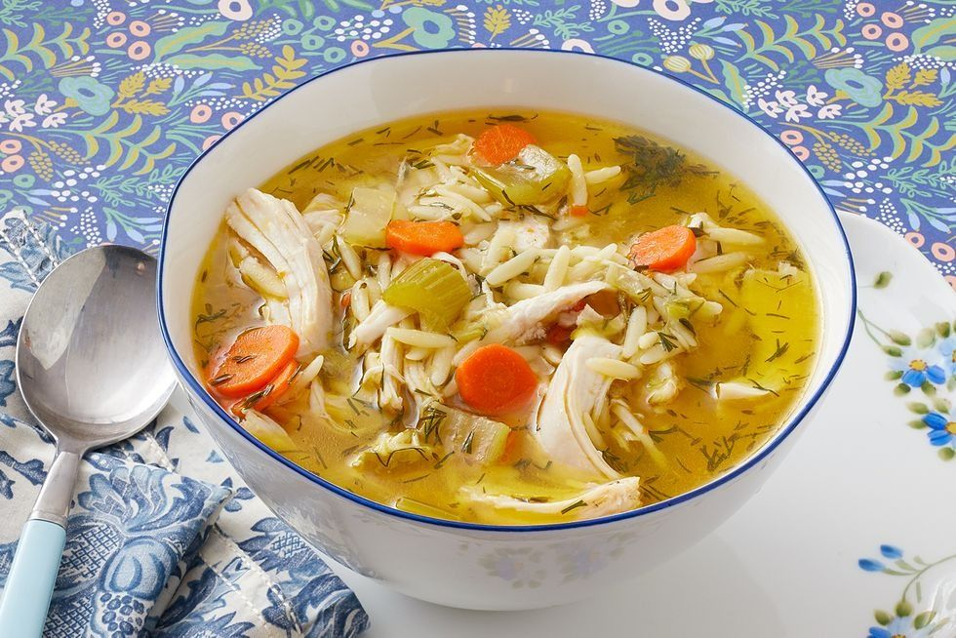
Multi-modal Understanding Examples
Image Input | User Ask | Assistant Answer
 | Should I attend this event? | The event is a garage sale. Garage sales are a great way to save money. So the final answer is yes.
 | Is this soup healthy? | The soup is made with carrots, celery, onions, and carrots. So the answer is yes.
S. Moon, A. Madotto, Z. Lin, T. Nagarajan, et al. AnyMAL: An efficient and scalable any-modality augmented language model. arXiv, 2023.

Slide 45
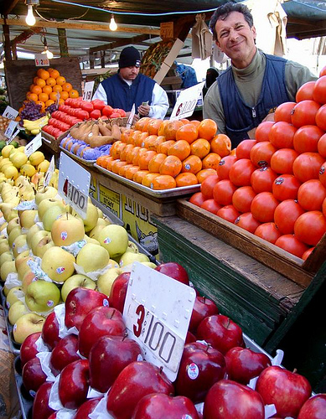
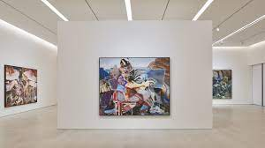
Multi-modal Understanding Examples
Image Input | User Ask | Assistant Answer
 | Describe the scene in front of me. | A man is standing in front of a bunch of fruits and vegetables.
 | If I were a renowned art critic, how would I describe this painting? | It is a large painting with a lot of detail.
S. Moon, A. Madotto, Z. Lin, T. Nagarajan, et al. AnyMAL: An efficient and scalable any-modality augmented language model. arXiv, 2023.

Slide 46
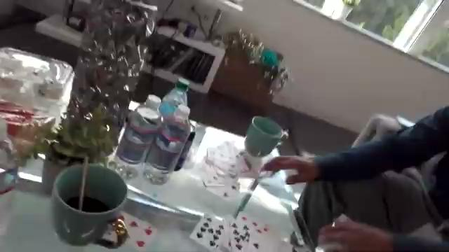
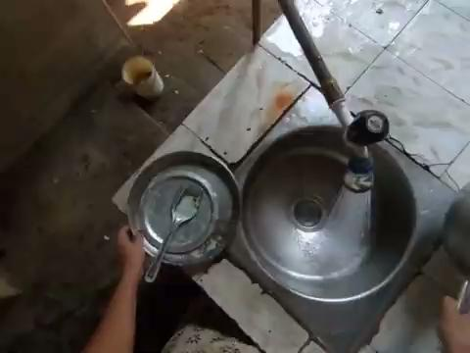
Multi-modal Understanding Examples
Video Input | MM-LLM Capture
 | A man picks cards from the table
 | Rinsing the bowl with water from the tap
S. Moon, A. Madotto, Z. Lin, T. Nagarajan, et al. AnyMAL: An efficient and scalable any-modality augmented language model. arXiv, 2023.

Slide 47
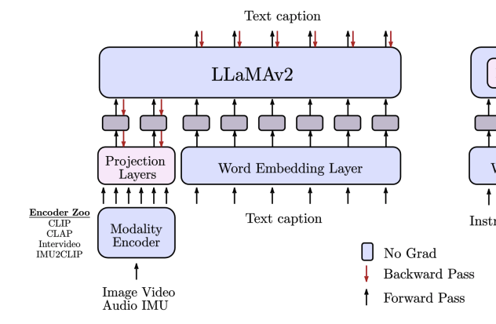
Core Solution: AnyMAL—
Any-Modality Augmented Lang Model
Key advantages
On top of any state-of-the-art LM; e.g., LLaMA, GPT.
Allowing for combinatory modalities as conditioning context
Working for resource-scarce modalities; e.g., audio
Scalability: Quantization to 4 bits & 8 bits
S. Moon, A. Madotto, Z. Lin, T. Nagarajan, et al. AnyMAL: An efficient and scalable any-modality augmented language model. arXiv, 2023.
Notes:
Inertial measurement unit

Slide 48
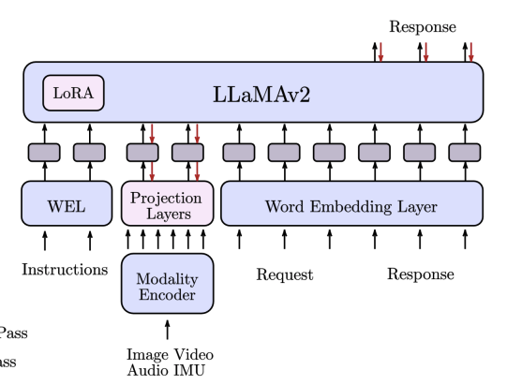
AnyMAL—Any-Modality Augmented Lang Model
Instruction tuning
Manual annotation: 60K examples
Synthetic augmentation: 150K examples
S. Moon, A. Madotto, Z. Lin, T. Nagarajan, et al. AnyMAL: An efficient and scalable any-modality augmented language model. arXiv, 2023.

Slide 49
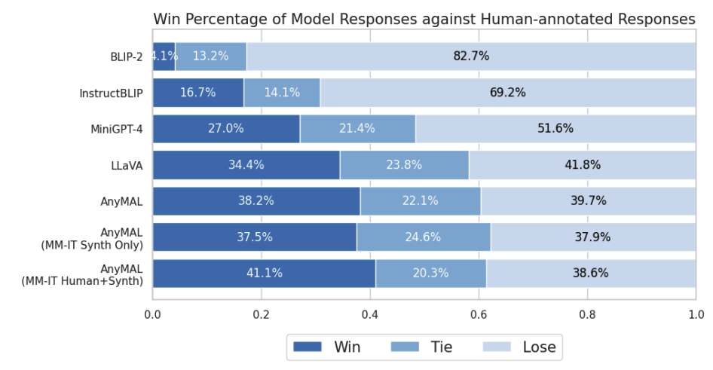
AnyMAL Quality
Better than SOTA MM solutions on our in-house dataset
Human annotations helps significantly
S. Moon, A. Madotto, Z. Lin, T. Nagarajan, et al. AnyMAL: An efficient and scalable any-modality augmented language model. arXiv, 2023.

Slide 50
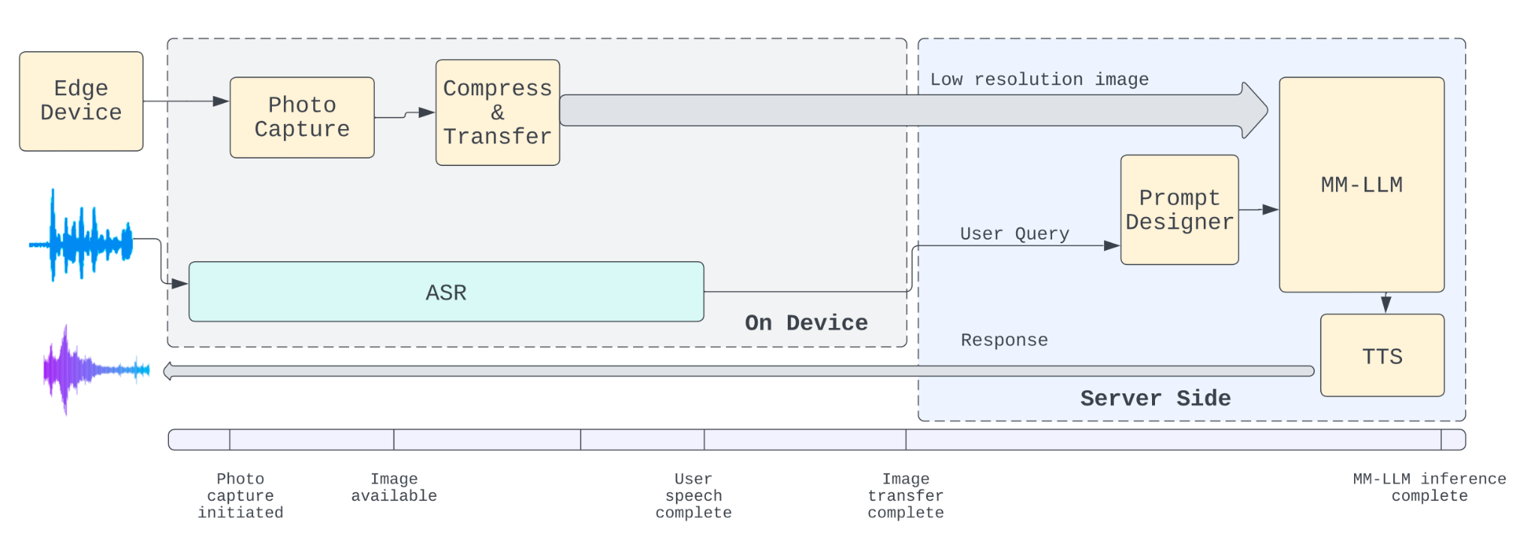
Architecture and Optimizations

Slide 51
Direction 2. Multi-Modal Understanding
Multi-modal Assistant
Knowledge
Augmentation (Web, KG, Real-time APIs, Social network)
Multi-Modal
Personalization
(Memory search, Personalization)
Visual Understanding
Scene Text Recognition
Contextualization
Text LLM
Voice Assistant

Slide 52
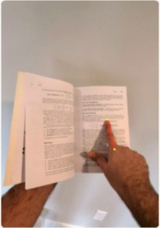
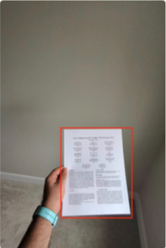
Scene Text Recognition Examples
Image Input | Question | Answer
 | What does this word mean? | In linear algebra, “eigenvector” is a non-zero vector that, when transformed by a linear transformation, results in a scaled version of itself.
 | Can you summarize this? | Sure, this appears to be a research paper that introduces ‘Lumos’, a multimodal question-answering system with text understanding capabilities deployed on wearable devices...
A. Shenoy, Y. Lu, S Jayakumar, D. Chatterjee, M. Moslehpour, P. Chuang, et al. Lumos: Empowering multi-modal LLMs with scene text recognition. arXiv, 2024.

Slide 53
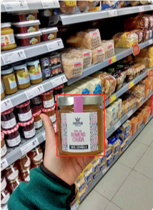
Scene Text Recognition Examples
Image Input | Question | Answer
 | Can you tell me what is this product and where is it used? | This is a raw honey product made from the nectar of rosemary flowers. This product can be used as a sweetener or added to recipes for its unique flavor.
A. Shenoy, Y. Lu, S Jayakumar, D. Chatterjee, M. Moslehpour, P. Chuang, et al. Lumos: Empowering multi-modal LLMs with scene text recognition. arXiv, 2024.

Slide 54
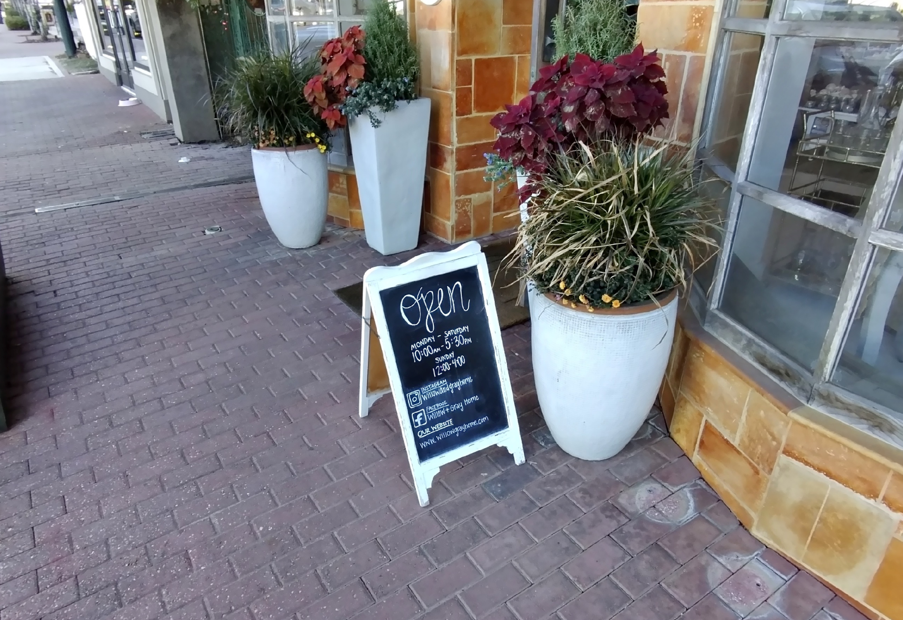
In-the-Wild Scene Text Recognition Challenges
Normal (By cell phone)
Ego-centric (By wearables)
Common challenges
Arbitrary shape
Complex layout
Multiple languages
Unique challenges
Very small text
Blurry images w. movement or sub-optimal lighting cond
Non-horizontal direction
Latency for image transfer
On-device hardware constraints
A. Shenoy, Y. Lu, S Jayakumar, D. Chatterjee, M. Moslehpour, P. Chuang, et al. Lumos: Empowering multi-modal LLMs with scene text recognition. arXiv, 2024.

Slide 55
MM-LLM Only Has Low QA Quality
A. Shenoy, Y. Lu, S Jayakumar, D. Chatterjee, M. Moslehpour, P. Chuang, et al. Lumos: Empowering multi-modal LLMs with scene text recognition. arXiv, 2024.

Slide 56
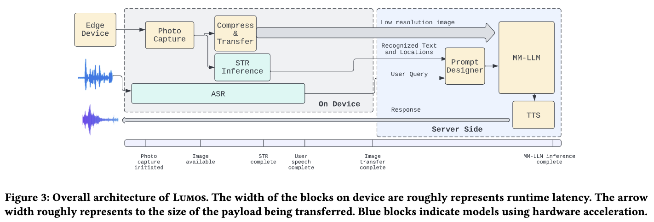
Core Solution: On-Device STR
Key advantages
On-device STR on full-resolution images
Parallelize w. image compression & transfer to reduce latency
A. Shenoy, Y. Lu, S Jayakumar, D. Chatterjee, M. Moslehpour, P. Chuang, et al. Lumos: Empowering multi-modal LLMs with scene text recognition. arXiv, 2024.

Slide 57
Pipeline and Optimizations
Region-of-interest detection w. gesture detection to allow full-resolution STR
Careful model architecture selection to accommodate on-device hardware constraints
Training data curation and augmentation to handle variety of images
On-device export w. quantization and acceleration
A. Shenoy, Y. Lu, S Jayakumar, D. Chatterjee, M. Moslehpour, P. Chuang, et al. Lumos: Empowering multi-modal LLMs with scene text recognition. arXiv, 2024.

Slide 58
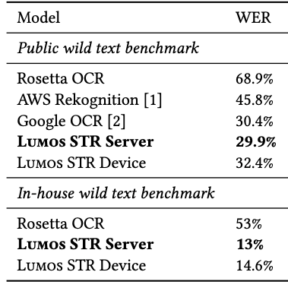
Scene Text Recognition Quality
Big HW resource usage drop w. very little WER increase
Reduce word-error-rate by up to 40% comparing with SOTA solutions on both public benchmark and in-house benchmark
A. Shenoy, Y. Lu, S Jayakumar, D. Chatterjee, M. Moslehpour, P. Chuang, et al. Lumos: Empowering multi-modal LLMs with scene text recognition. arXiv, 2024.

Slide 59
E2E Scene Text QA Quality
Text bounding-box further improves QA accuracy
Improve QA accuracy over MM-LLM-only solution by 28% on summarization, word lookup, and other visual QA tasks
Lumos: Empowering Multimodal LLMs with Scene Text Recognition
Wednesday 11am-1pm
A. Shenoy, Y. Lu, S Jayakumar, D. Chatterjee, M. Moslehpour, P. Chuang, et al. Lumos: Empowering multi-modal LLMs with scene text recognition. arXiv, 2024.

Slide 60
Direction 3. Context-Aware Assistant
Multi-modal Assistant
Knowledge
Augmentation (Web, KG, Real-time APIs, Social network)
Multi-Modal
Personalization
(Memory search, Personalization)
Scene Text Recognition
Visual Understanding
Contextualization
Text LLM
Voice Assistant

Slide 61
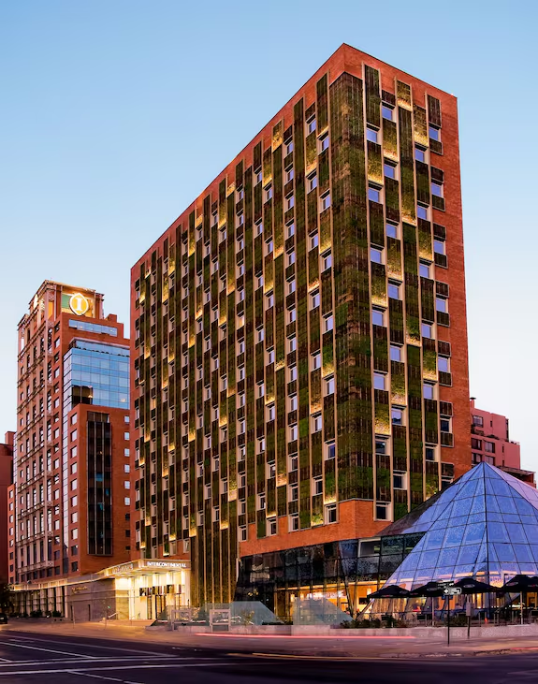
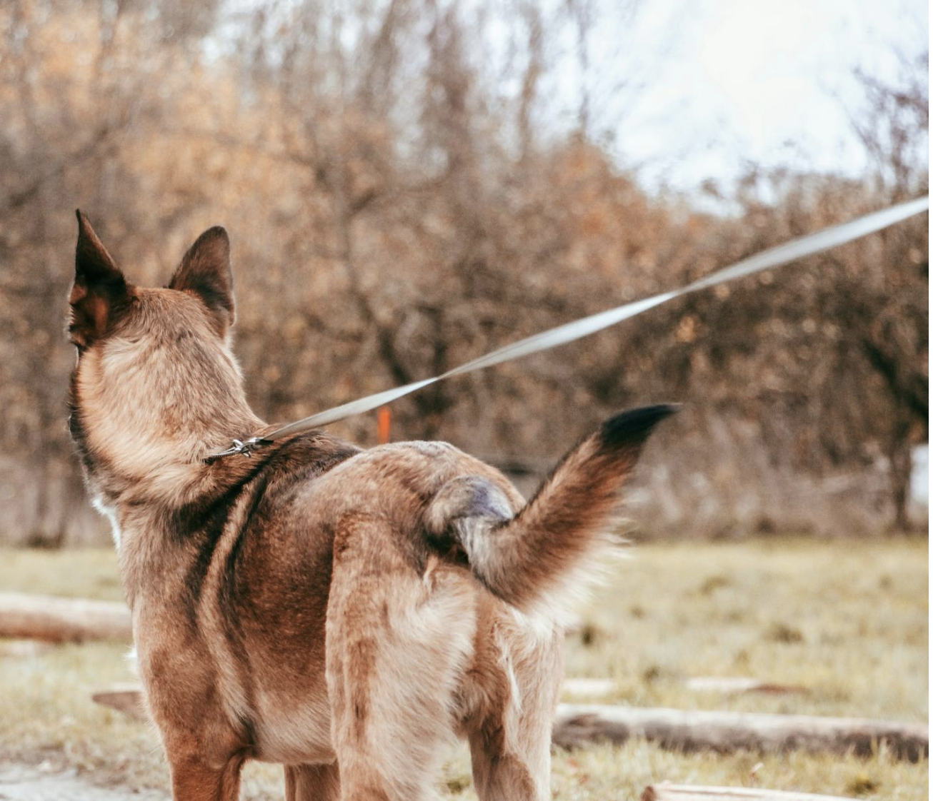
Contextual Service Examples
Question | Context | Answer
What are good restaurants nearby? |  | There are a variety of excellent dining options suitable for a group lunch. Here are some recommended restaurants nearby:...
Play audio book when I walk my dog |  | Would you like to resume the audio book “The Power of Habit”?

Slide 62
Core Solution: Leverage Low-Power Sensors
Challenge: Always-on context detection w. limited battery-life on the device
Example: IMU-based action detection
(Inertial Measurement Unit)
S. Moon, A. Madotto, Z. Lin, A. Dirafzoon, A. Saraf, A. Bearman, B. Damavandi. IMU2CLIP: Multimodal contrastive learning for IMU Motion sensors from egocentric videos and text narrations. arXiv, 2022
Notes:
An Inertial Measurement Unit (IMU) is a device that can measure and report specific gravity and angular rate of an object to which it is attached. An IMU typically consists of:
Gyroscopes: providing a measure angular rate
Accelerometers: providing a measure specific force/acceleration
Magnetometers (optional): measurement of the magnetic field surrounding the system

Slide 63
IMU-Based Action Detection Example 2
IMU (Inertial Measurement Unit)
S. Moon, A. Madotto, Z. Lin, A. Dirafzoon, A. Saraf, A. Bearman, B. Damavandi. IMU2CLIP: Multimodal contrastive learning for IMU Motion sensors from egocentric videos and text narrations. arXiv, 2022
Notes:
An Inertial Measurement Unit (IMU) is a device that can measure and report specific gravity and angular rate of an object to which it is attached. An IMU typically consists of:
Gyroscopes: providing a measure angular rate
Accelerometers: providing a measure specific force/acceleration
Magnetometers (optional): measurement of the magnetic field surrounding the system

Slide 64
Direction 4. Personalization
Multi-modal Assistant
Knowledge
Augmentation (Web, KG, Real-time APIs, Social network)
Multi-Modal
Personalization
(Memory search, Personalization)
Scene Text Recognition
Visual Understanding
Contextualization
Text LLM
Voice Assistant

Slide 65
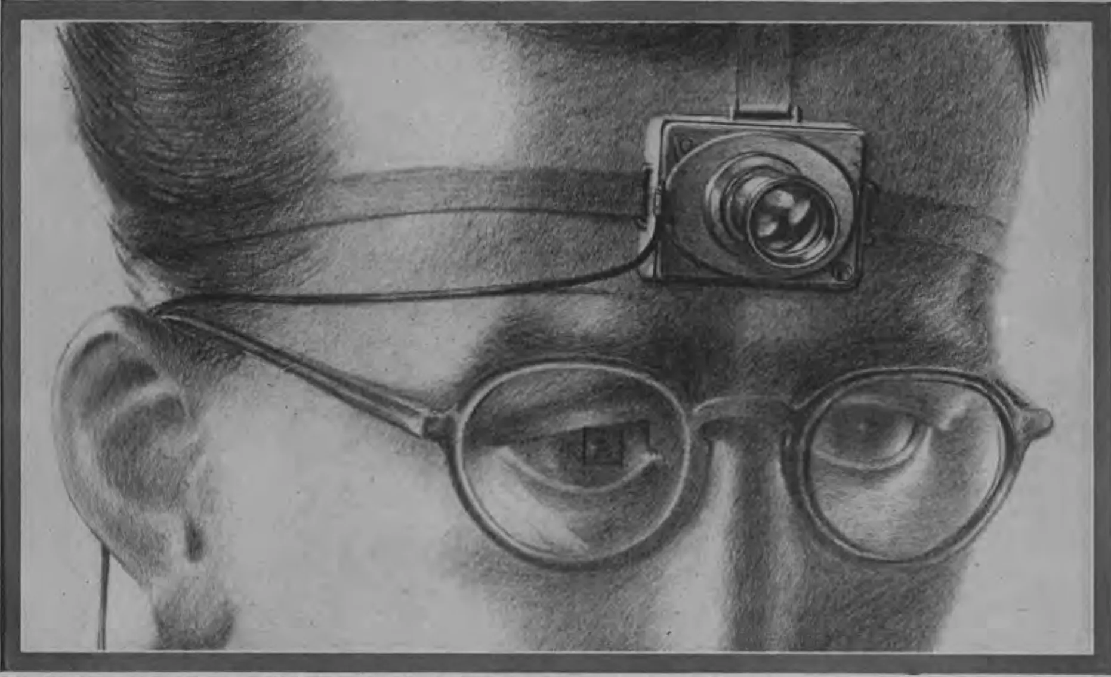
Two Sides of One Coin (1): Great Vehicle for Life Recording
MEMEX (MEMory & EXpansion)
by Vannevar Bush (1945)

Slide 66
Two Sides of One Coin (2):
Great Vehicle for Personalized Assistance
Utility
Memoir
Inspiration
Where did I put my key?
I must have seen this lady before but when and where?
At Lyon you can visit the statue of Saint-Exupéry with the Little Prince by his side. You read that book in 2018 and loved it.

Slide 67
Two Sides of One Coin (2):
Great Vehicle for Personalized Assistance
Utility
Memoir
Inspiration
Where did I put my key?
I must have seen this lady before but when and where?
At Lyon you can visit the statue of Saint-Exupéry with the Little Prince by his side. You read that book in 2018 and loved it.

Slide 68
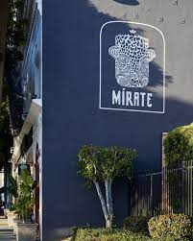
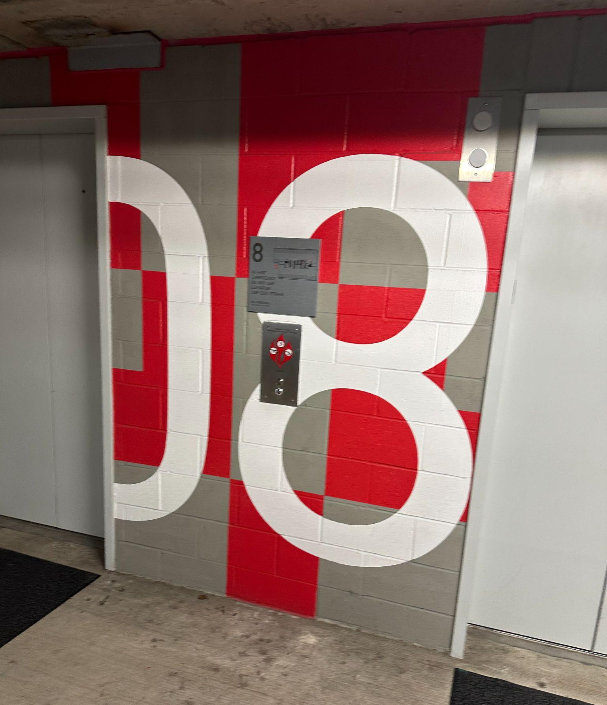
Memory Search Examples (link)
Memory Question | Memory Retrieval Results | Answer
What’s the name of the restaurant I saw last Thursday? |  | It looks like the name of the restaurant is Mirate
Which floor did I park? |  | You parked on Floor 8.

Slide 69
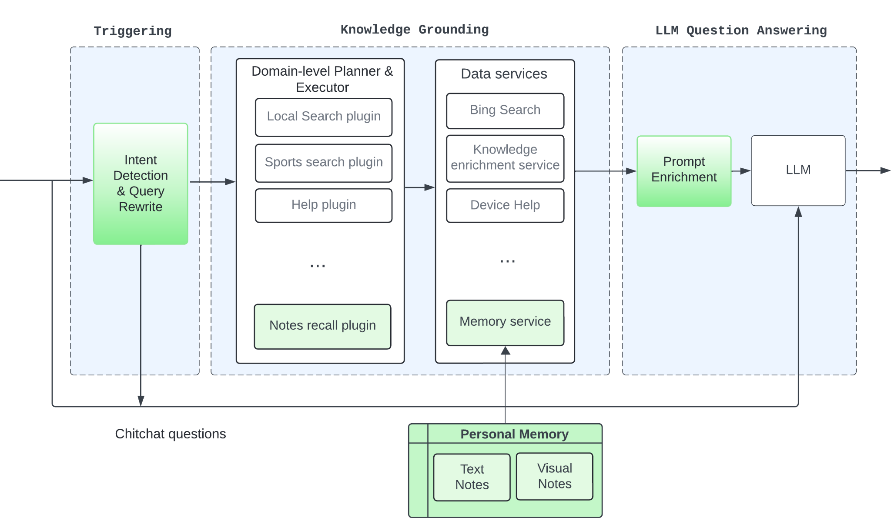
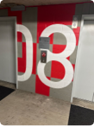
Core Solution: RAG on User Memory + MM-based QA
Example: Recall where I parked | Intent: Note_recall Rewritten query: where I parked | Retrieved note: Index (mem2, “my parking level”, “08”, “The image depicts a parking elevator with number 08”) Consider time/loc for retrieval | LLM Answer: You parked at Level 8. Use latest image when appropriate for Q&A; in future will summarize Over multiple photos for list question

Slide 70
Where Are the Memory From?
Always-on streaming—Extremely resource consuming!
Detected events—Always-on context detection
Explicit request— e.g., “Remember where I parked”; reuse same pipeline

Slide 71
What Would Future Assistants Look Like?

Slide 73
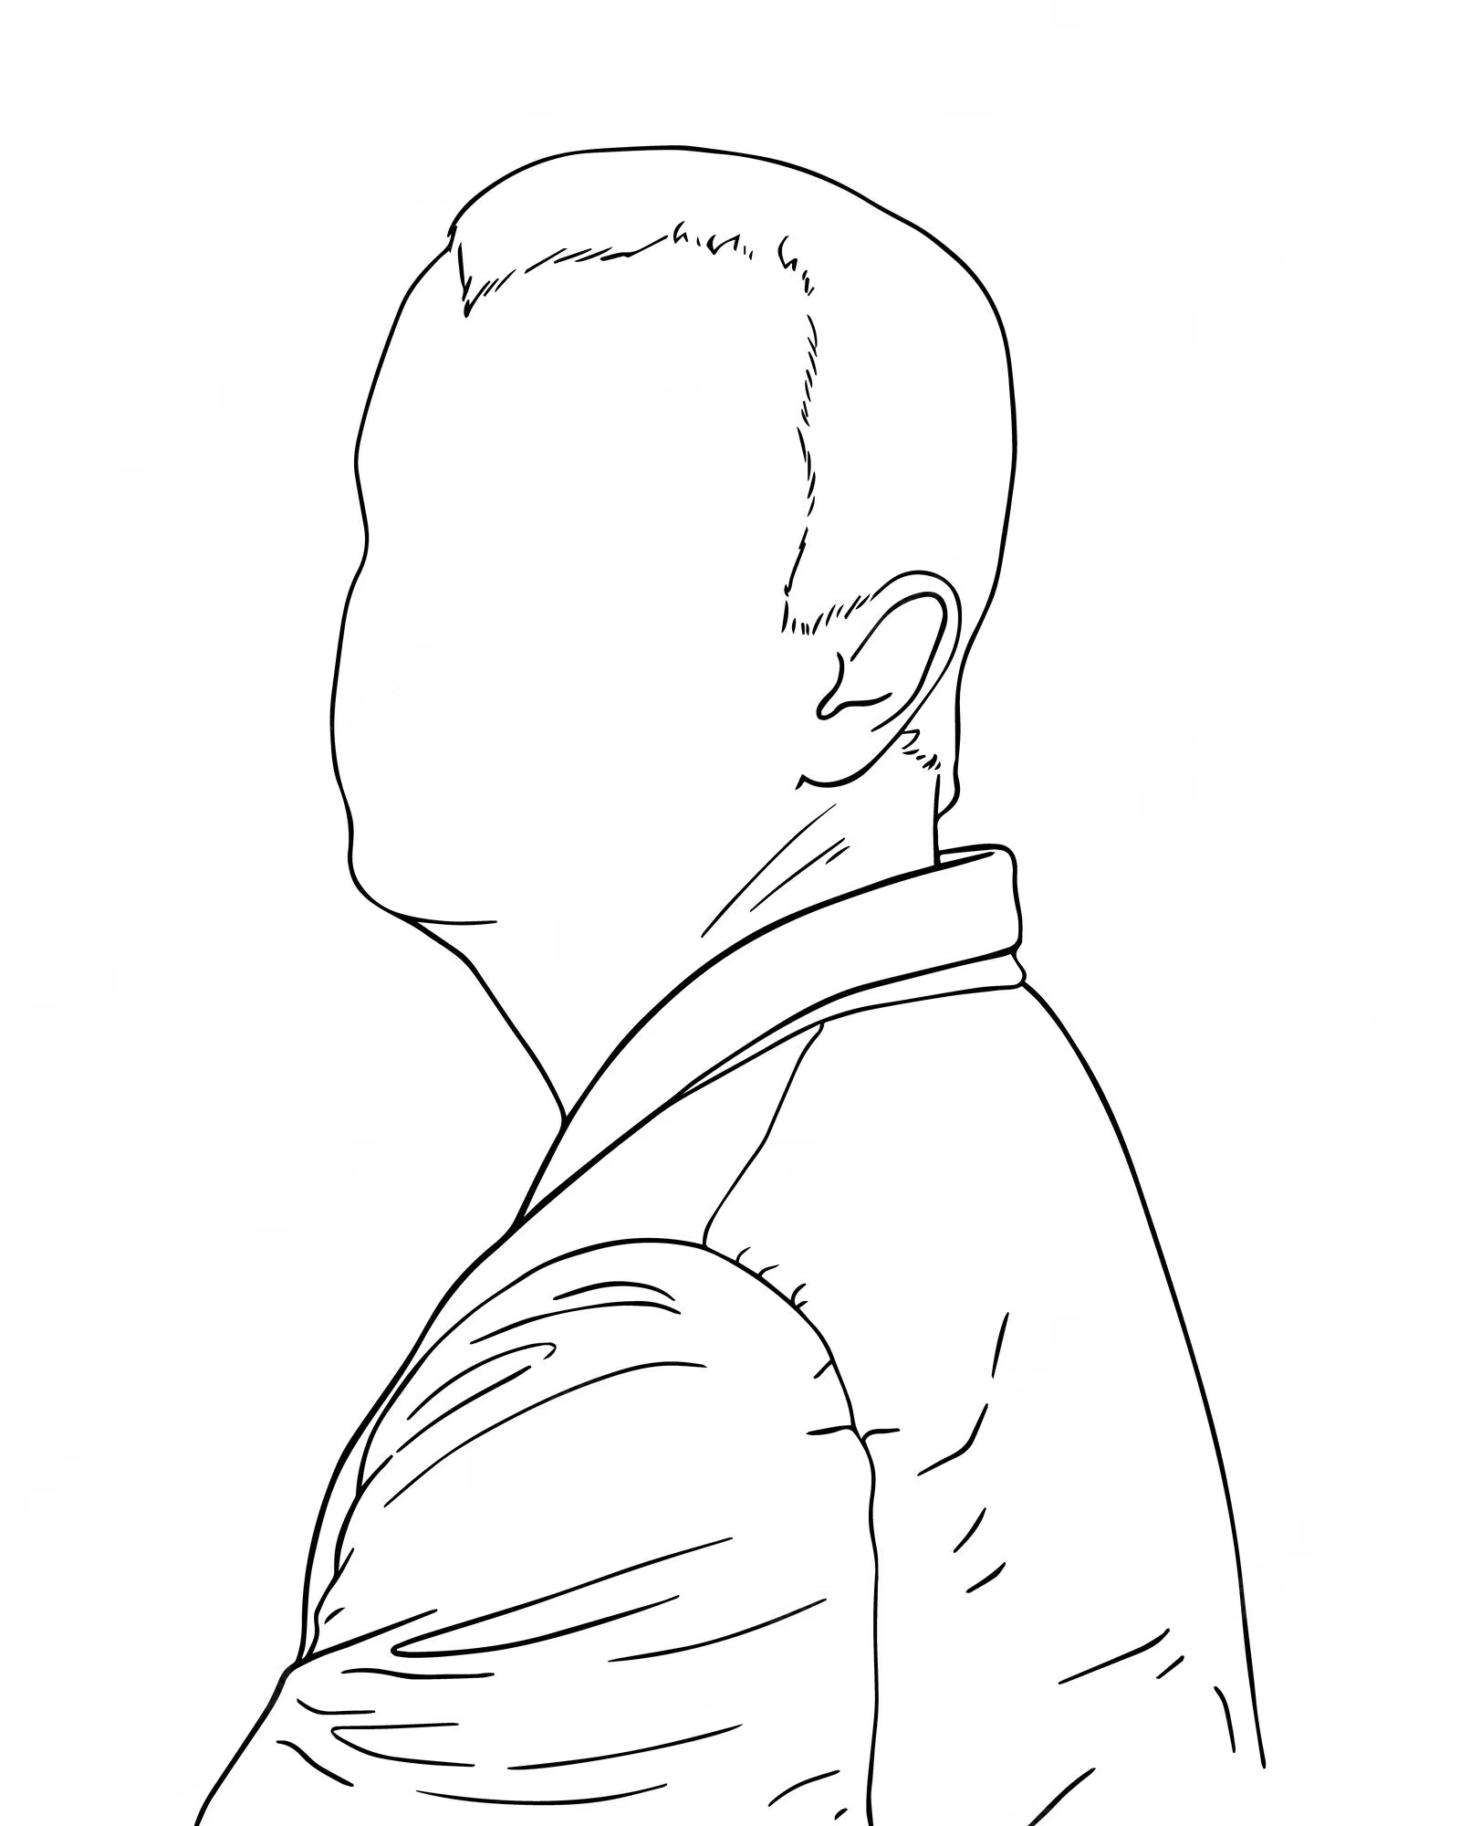
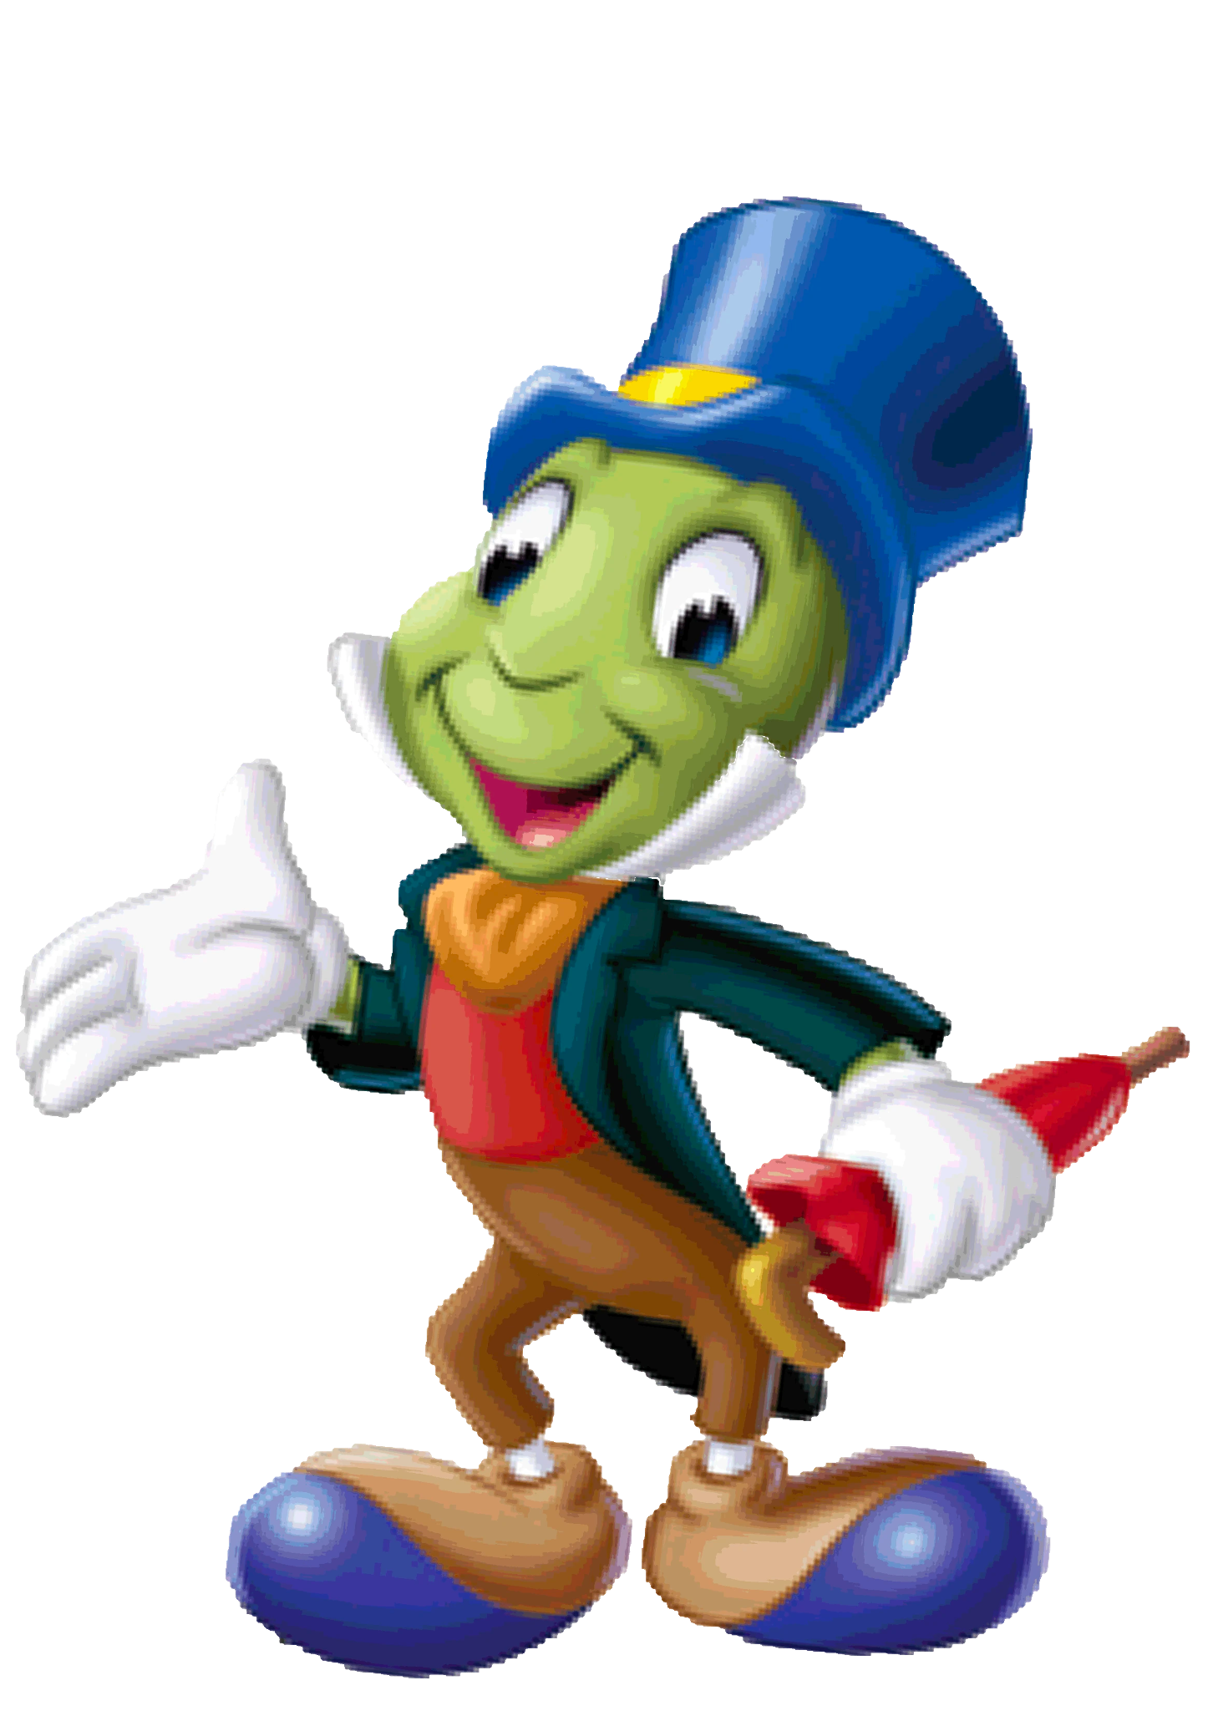
Future Virtual Assistants
In future, everyone will be served by a SET of specialized and personalized intelligent assistants (personas).
Travel Asst.
Health Asst.
Family Asst.
Conference Asst.
1. Introduction | 2. Conversational AI Basics | 3. Multimodal Conversational AI | 4. Personalized Conversations | 5. Privacy Preserving Assistant | 6. Conclusions

Slide 74
Research Directions—I. More Proactive & Personal
Trustworthy experts in each domain
Personalized information and recommendations
Super memory to connect one’s past and present
Proactive services to further alleviate load
Travel Asst.
Health Asst.
Family Asst.
Conference Asst.
1. Introduction | 2. Conversational AI Basics | 3. Multimodal Conversational AI | 4. Personalized Conversations | 5. Privacy Preserving Assistant | 6. Conclusions

Slide 75
Research Directions—II. Eco-systems
Each persona is invoked at an appropriate time
Collaborations between personas
The platform to enable scaling up personas
Access to personal information in the right representation
Users in control
Travel Asst.
Health Asst.
Family Asst.
Conference Asst.
1. Introduction | 2. Conversational AI Basics | 3. Multimodal Conversational AI | 4. Personalized Conversations | 5. Privacy Preserving Assistant | 6. Conclusions

Slide 76
Research Directions—III. Function Under Constraints
Latency for responses
HW Constraints: memory, battery, thermal
Connections and data transfer
Human attention is the biggest constraint: simplifying rather than burdening
Travel Asst.
Health Asst.
Family Asst.
Conference Asst.
1. Introduction | 2. Conversational AI Basics | 3. Multimodal Conversational AI | 4. Personalized Conversations | 5. Privacy Preserving Assistant | 6. Conclusions

Slide 77
What Do I Enjoy about
Being a Scientist at Industry?
REALITY
Real problems to motivate the research
Real challenges from high launch bar on quality, latency, etc.
Real challenges from tight constraints on resources etc.
Real metrics to understand e2e quality, user satisfaction, and business impact
Real data in the wild for evaluations
Real craving for simple solution to avoid unnecessary complications
No worry for good baselines or SOTA solutions

Slide 78
Why Do I Appreciate Scientific Approaches in Product Launches
THOROUGHNESS
Thorough literature understanding to build upon the best solutions
Thorough experimental study to ensure the best launches
Thorough thoughts to get intuitions on WHY in addition to HOW
Confidence in production launching
Curiosity leading to next wave of innovations

Slide 79
Take-Aways
Thank You!
An intelligent assistant should be an agent that knows you and the world, can receive your requests or predict your needs, and provide you the right services at the right time with your permission
Next-generation wearable assistants require new research on federated RAG, multi-modal understanding, contextual AI, and personalization
Harmony between device-side and cloud-side computing is a key to enable wearable assistants
Industry nurtures and appreciates science

